Slide 1
Participation in strategy work
UWL Doctoral Conference
Ashley Garlick | London Geller College of Hospitality and Tourism
29 May 2019
Notes:
Abstract opening: No single CEO or strategy team can know it all. Organizations are beginning to understand the value in involving others in the creation of strategy. There is mounting evidence that opening the strategy processes to a wider audience through greater inclusion and transparency can have significant positive benefits for firms (Mack and Szulanski, 2017). Sitting alongside emergent strategies and autonomous strategy work, participation is used to increase commitment to strategies (Laine and Vaara, 2015: 616), while an absence of participation has a negative impact on the quality of the resulting strategy (Floyd and Wooldridge, 2000). Despite this, within the academic literature there is currently a very limited understanding of how participation informs and shapes strategy work in organizations (Hutter, Nketia, and Füller, 2017).

Slide 2
The study
This thesis aims to produce a framework of participation strategy making that explains how practices, objects and episodes are used as part of a strategizing process.
It will achieve this through the following objectives:
To identify the practices used by specific actors during a strategizing process
To examine how objects and episodes are used in generating a collective understanding of strategy
To apply sensemaking theory to explain how practices, objects and episodes interact during a strategizing process
To explore different strategic practices used in strategizing and how these relate to participation in strategy making.
Research Questions:
How do different roles use participation practices as part of a strategizing process?
What practices are employed during a strategizing process, and how can participation in strategy making influence this process?
How objects and episodes are used to facilitate participation in strategy?
How does participation in strategy impact sensemaking among participants?

Slide 3
Why Strategy As Practice?
Strategic Management emerged out of the 1960s as a way of looking at what firms should do in order to succeed (Jarzabkowski and Whittington, 2008)
Aligned to the strategy process movement, SAP emerged initially as “micro-strategizing” (Johnson et al., 2003)
SAP is grounded in sociological theory, in the same way that the traditional approach to strategy is grounded in economics
SAP moved the focus from ‘the firm’ to instead what people actually do – strategy is something you do, not something you have
Framed around Practitioners, Practice and Praxis as “sensitising devices” (Jarzabkowski, 2019).
Allows for the consideration of discursive and sociomaterial aspects of strategizing
Notes:
This can be achieved by exploring the three “masses” of strategy identified by Richard Whittington (2015):
Increased involvement in strategy of actors beyond the Senior Management Team through mass participation activities;
Renewed focus of the use of mass bearing material artefacts in strategy work; and
The proliferation of these material artefacts being common objects of mass production (such as flipcharts, sticky notes or PowerPoint decks).

Slide 4
What is currently known about participation?
Greater openness leads to greater accountability (Whittington, 2019). The opening of strategy can be defined in terms of transparency and inclusion (Hautz et al, 2017). Openness in strategy making is an increasing trend e.g. Wikimedia (Dobusch et al., 2019), Red Hat and IBM (Tavakoli et al., 2017).
Participation is the elicitation of input, contributions, feedback, or buy-in to strategic decisions during the formulation of strategy (Mack and Szulanski, 2017). There is currently a very limited understanding of how participation informs and shapes strategy work in organizations (Hutter, Nketia, and Füller, 2017).
Organizational structure (Carney, 2004), practitioner role (Mantere, 2008), level (Rouleau, Balogun and Floyd, 2015) and distance from the centre (Regner, 2003); communication technologies (Neeley and Leonardi, 2018)
Sensemaking provides a mid-level theory made up of meaning making and legitimation (Jalonen et al., 2018). Individual meaning needs to lead to collective understanding through discursive and sociomaterial practices (Seidl and Werle, 2018).

Slide 5
The gap
Most participation studies only consider particular practice or episode types (Introna, 2019). A recent call has been for more research that bridges process and practice in strategy (Burgelman et al., 2018). There is a lack of knowledge over how sensemaking develops across multiple episodes over time as an on-going process (Sandberg and Tsoukas, 2015).
This study adopts a context that allows us to understand the phenomenon of participation in an extreme way (Jarzabkowski, 2019). This context sheds theoretical light that would not otherwise have been seen.
It considers how participation occurs as part of an entire strategizing exercise, over a three-year period. This will contribute a new theoretical framework of participation strategy making useful to both academics and practitioners – something described as a rare combination (Golsorkhi, Rouleau, Seidl and Vaara, 2015).
The existing literature is incomplete because SAP research has to date focused too much on describing practices, and ignored how practice is created (Rasche and Chia, 2009). The strategy formulation literature’s preoccupation with content means that there is a gap in the literature that considers how the content fits within an overall strategizing process.
The literature is inadequate because there has historically been a focus on how tools and artefacts are used in strategizing, but a lack of understanding about the internal logic applied by actors. There needs to be an understanding of how material objects interact with human activity in a way that informs understanding, but also aids collective sensemaking.
Notes:
Despite the most common application of sensemaking being within strategy and organizational change studies, very few studies try to compare sensemaking efforts “within and between different types of sensemaking episodes” (Sandberg and Tsoukas, 2015: S21). Therefore, there is still a limited understanding of how sensemaking actually takes place, or the relationship between participation and sensemaking.
Studies have found that participation is impacted by organizational predisposition (Ashmos et al., 1998) and structure (Carney, 2004). It is less likely to occur in highly rule orientated organizations but is more likely to occur in organizations with lower past performance than those with higher past performance. Flatter hierarchies enhanced downward communication flows, which permit more involvement in strategy development. Whereas more complex (or taller) structures tended to be perceived as excluding from strategy and had poorer communication and a lack of access to information

Slide 6
The method
Single case study
Eight semi-structured, in-depth interviews conducted May/June 2018 (5 hours 36 minutes of transcripts)
Chief Executive Officer / Director of Strategy / Chief Volunteer / Chair of the Board / 4 x Regional Directors
26 hours of overt participant observation, across ten strategy workshops in eight geographical locations between 5 April 2018 and 5 May 2018
Field notes transcribed, as well as material outputs captured in NVivo.
32 documents, 4 videos and 245 emails captured and analysed
Included organizational memos, communications, FAQ sheets, published speech transcripts
Underpinned by Social Constructivism
Analysed using “inductive composition” (Berends and Deken, 2019) and “thick description” (Balogun, Bartunek, and Do, 2015)
Notes:
Following Berends and Deken (2019), results are initially presented using an inductive composition. Findings are presented chronologically as a recounted narrative that is not yet theorized. Doing so maintains the temporal coherence that it important in qualitative process studies (Langley, 1999; Pettigrew, 1990). This was then composed into a visual timeline of events, to aid interpretation in presenting the sequence of events.

Slide 7
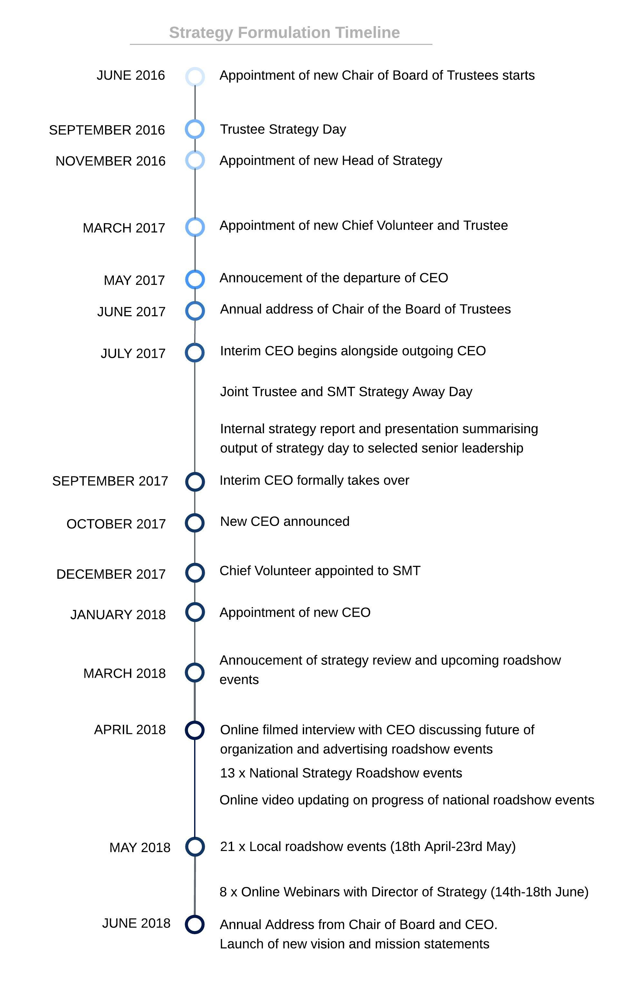
Initial findings
Trigger of (re)structure
Introduction of new personnel, or personnel changing roles would trigger listening exercise
The role itself was not an automatic trigger for involvement, but instead perceived legitimacy and trust seen as significant (invisible network)
Impact of iteration
Iterative process of sensemaking aligns with an increasingly wider participation – begins at an individual level, ends with a public statement of strategy, with widening levels in between
Episodes provide protected space for participants to explore understanding together, and through sensemaking, leads to collective understanding.
Discursive and sociomatieral practices are used to confirm and re-affirm strategic decisions through affirmation/disaffirmation
Notes:
The case study organization is a registered charity and company limited by guarantee that has a history spanning over 150 years. In 2015, it collected income of over £104m, The company has a Board of Directors, who are legally responsible for the governance and management of the organization. The Chair of the Council of Trustees also acts as the Chair of the Board of Directors. Three trustees are ex officio directors of the company. A Senior Management Team of 14 are led by a Chief Executive Officer. Operationally, the company has four Regional Directors (not Board level), who are responsible for their geographical territories. In addition to a team of employees, each region has circa 5,000-8,000 volunteers in frontline, lower- and middle-management roles. The organization includes a total of approximately 32,000 personnel across both paid and volunteer functions.
Re-structure
“we needed to realign ourselves and bring back a commitment to charitable output, led by volunteers, and to therefore have a strategic discussion to decide what chartable output that should be” (Chair of the Board – Interview – June 2018).
“You get lots of ideas together, you start to look to coherence. It rather depends whether or not the Chairman knew what outcome he wanted before he went into the room… That’s exactly what I had. I knew what the mood of the organization wanted. I had a pretty clear instinct what the outcomes should and would be.” (Chair of the Board – interview – June 2018).
“A lot of the themes that came up in that session are the types of things we are talking about now. They’ve been crystallised and shaped but we’re not disembarking from what was discussed in July by the Trustees” (Director of Strategy – Interview – June 2018).
“From day one, I made it clear that it was important that the precepts that I’d set out in my interview, were clear to everybody in the organisation. So coming new into the organisation, I had set out that volunteers are paramount. That I value the role and contribution of young people. And that I believe that the organisation could do more to raise income to deliver improved services on the front line…And so I used that conversation piece, talking about my experience of being interviewed, entering the organisation, and why I thought I was hired, to set up conversations. And that created a very dynamic narrative about historic perceived failures, opportunities and where the shared beliefs were.” (CEO – Interview – May 2018).
Iteration
This, again, provided an opportunity to confirm or refute the Trustee/SMT discussions as being ‘correct’: “Reaffirming things about directional travel. Things like community connectedness, the importance of volunteers. They’re obvious things but actually the warmth of the reception to just voicing it demonstrated that we’re hitting a connection” (Director of Strategy – Interview – June 2018).
While they all adopted the same format, the content from earlier workshops would be re-introduced at later workshops, shaping the nature of the discourse through phrases such as “we’ve heard that consistently in other workshops”, or “there are some really clear consensus themes coming out from across the country” (Observation notes – workshops 5 & 7 – April 2018).

Slide 8
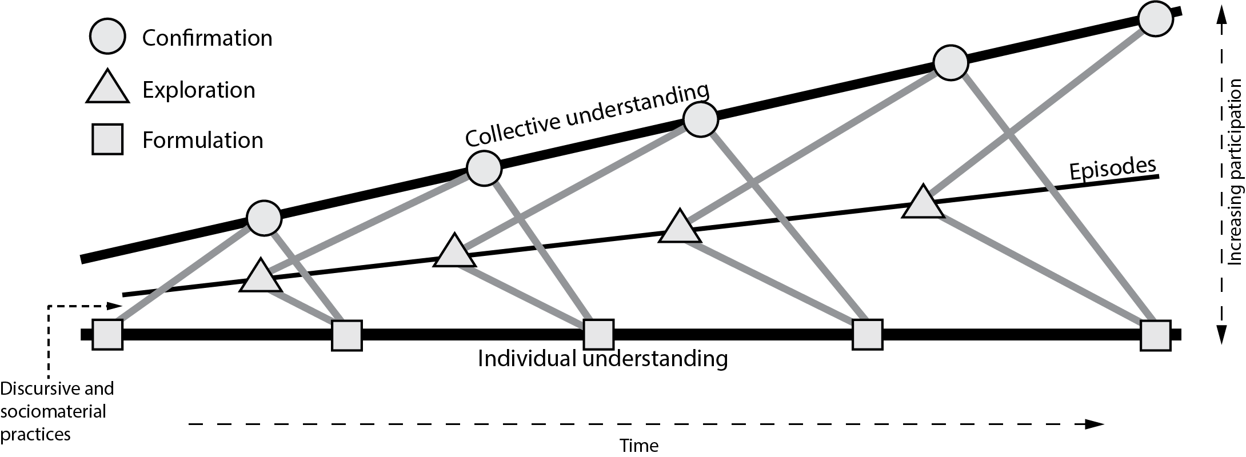
A framework of participation strategy
An iterative, three-stage model
Individual understanding formulates meaning
Explore in strategizing episodes
Confirmed against collective understanding

Slide 9
What now?
Further round of 12 semi-structured interviews scheduled for June 2019 combined with further document analysis
These will delve deeper into how specific practices were used by different actors
Consider how objects and episodes interact with practices to inform the participation process
Notes:
Research questions:
How do different roles use participation practices as part of a strategizing process?
What practices are employed during a strategizing process, and how can participation in strategy making influence this process?
How objects and episodes are used to facilitate participation in strategy?
How does participation in strategy impact sensemaking among participants?
In order to answer these research questions, this thesis sets out with the following aim and objectives:
Aim and objectives
This thesis aims to produce a framework of participation strategy making that explains how practices, objects and episodes are used as part of a strategizing process.
It will achieve this through the following objectives:
To identify the practices used by specific actors during a strategizing process
To examine how objects and episodes are used in generating a collective understanding of strategy
To apply sensemaking theory to explain how practices, objects and episodes interact during a strategizing process
To explore different strategic practices used in strategizing and how these relate to participation in strategy making.

Slide 10
Thank you for your time
What questions do you have?

Slide 11
References
Balogun, J., Bartunek, J. M., and Do, B. (2015). Senior Managers’ Sensemaking and Responses to Strategic Change. Organization Science, 26(4), pp960–979.
Berends, H., and Deken, F. (2019). Composing qualitative process research. Strategic Organization, pp1–13.
Burgelman, R. A., Floyd, S. W., Laamanen, T., Mantere, S., Vaara, E., et al. (2018). Strategy processes and practices: Dialogues and intersections. Strategic Management Journal, 39(3), pp531–558.
Carney, M. (2004). Middle manager involvement in strategy development in not-for profit organizations: the director of nursing perspective - how organizational structure impacts on the role. Journal of Nursing Management, 12(1), pp13–21.
Dobusch, L., Dobusch, L. and Müller-Seitz, G., 2019. Closing for the benefit of openness? The case of Wikimedia’s open strategy process. Organization studies, 40(3), pp.343-370.
Floyd, S. W., and Wooldridge, B. (2000). Building Strategy from the Middle. London: Sage Publications.
Golsorkhi, D., Rouleau, L., Seidl, D. and Vaara, E. eds., (2015). Cambridge handbook of strategy as practice. 2nd edition. Cambridge University Press.
Hautz, J., Seidl, D., and Whittington, R. (2017). Open Strategy: Dimensions, Dilemmas, Dynamics. Long Range Planning, 50(3), pp298–309.
Hutter, K., Nketia, B. A., and Füller, J. (2017). Falling Short with Participation — Different Effects of Ideation, Commenting, and Evaluating Behavior on Open Strategizing. Long Range Planning, 50(3), pp355–370.
Introna, L.D., (2019). On the making of sense in sensemaking: Decentred sensemaking in the meshwork of life. Organization Studies, 40(5), pp.745-764.
Jalonen, K., Schildt, H., and Vaara, E. (2018). Strategic concepts as Micro-Level tools in strategic sensemaking. Strategic Management Journal. https://doi.org/10.1002/smj.2924.
Jarzabkowski, P. (2019). What is strategy-as-practice as an approach to strategy research? Available at: https://youtu.be/WuBvpEeo4qY (Accessed: 25 May 2019).
Jarzabkowski, P. and Whittington, R., 2008. A strategy-as-practice approach to strategy research and education. Journal of Management Inquiry, 17(4), pp.282-286.

Slide 12
References
Johnson, G., Melin, L., and Whittington, R. (2003). Micro Strategy and Strategizing: Towards an Activity-Based View. Journal of Management Studies, 40(1), pp3–22.
Laine, P. M., and Vaara, E. (2015). Participation in strategy work. In D. Golsorkhi, L. Rouleau, D. Seidl, & E. Vaara (Eds.), Cambridge Handbook of Strategy as Practice (2nd editio): 616–631. Cambridge, UK: Cambridge University Press.
Mack, D. Z., and Szulanski, G. (2017). Opening Up: How Centralization Affects Participation and Inclusion in Strategy Making. Long Range Planning, 50(3), pp385–396.
Mantere, S. (2008). Role expectations and middle manager strategic agency. Journal of Management Studies, 45(2), pp294–316.
Neeley, T. B., and Leonardi, P. M. (2018). Enacting knowledge strategy through social media: Passable trust and the paradox of nonwork interactions. Strategic Management Journal, 39(3), pp922–946.
Regnér, P. (2003). Strategy creation in the periphery: Inductive versus deductive strategy making. Journal of Management Studies, 40(1), pp57–82.
Rouleau, L., Balogun, J., and Floyd, S. W. (2015). Strategy-as-practice research on middle managers’ strategy work. In D. Golsorkhi, L. Rouleau, D. Seidl, & E. Vaara (Eds.), Cambridge Handbook of Strategy as Practice (2nd editio): 589–615. Cambridge, UK: Cambridge University Press.
Sandberg, J., and Tsoukas, H. (2015). Making sense of the sensemaking perspective: Its constituents, limitations, and opportunities for further development. Journal of Organizational Behavior, 36(S1), ppS6–S32.
Seidl, D., and Werle, F. (2018). Inter-organizational sensemaking in the face of strategic meta-problems: Requisite variety and dynamics of participation. Strategic Management Journal, 39(3), pp830–858.
Tavakoli, A., Schlagwein, D. and Schoder, D., 2017. Open strategy: Literature review, re-analysis of cases and conceptualisation as a practice. The Journal of Strategic Information Systems, 26(3), pp.163-184.
Whittington, R., 2019. Opening Strategy: Professional Strategists and Practice Change, 1960 to Today. Oxford University Press.

