Slide 1
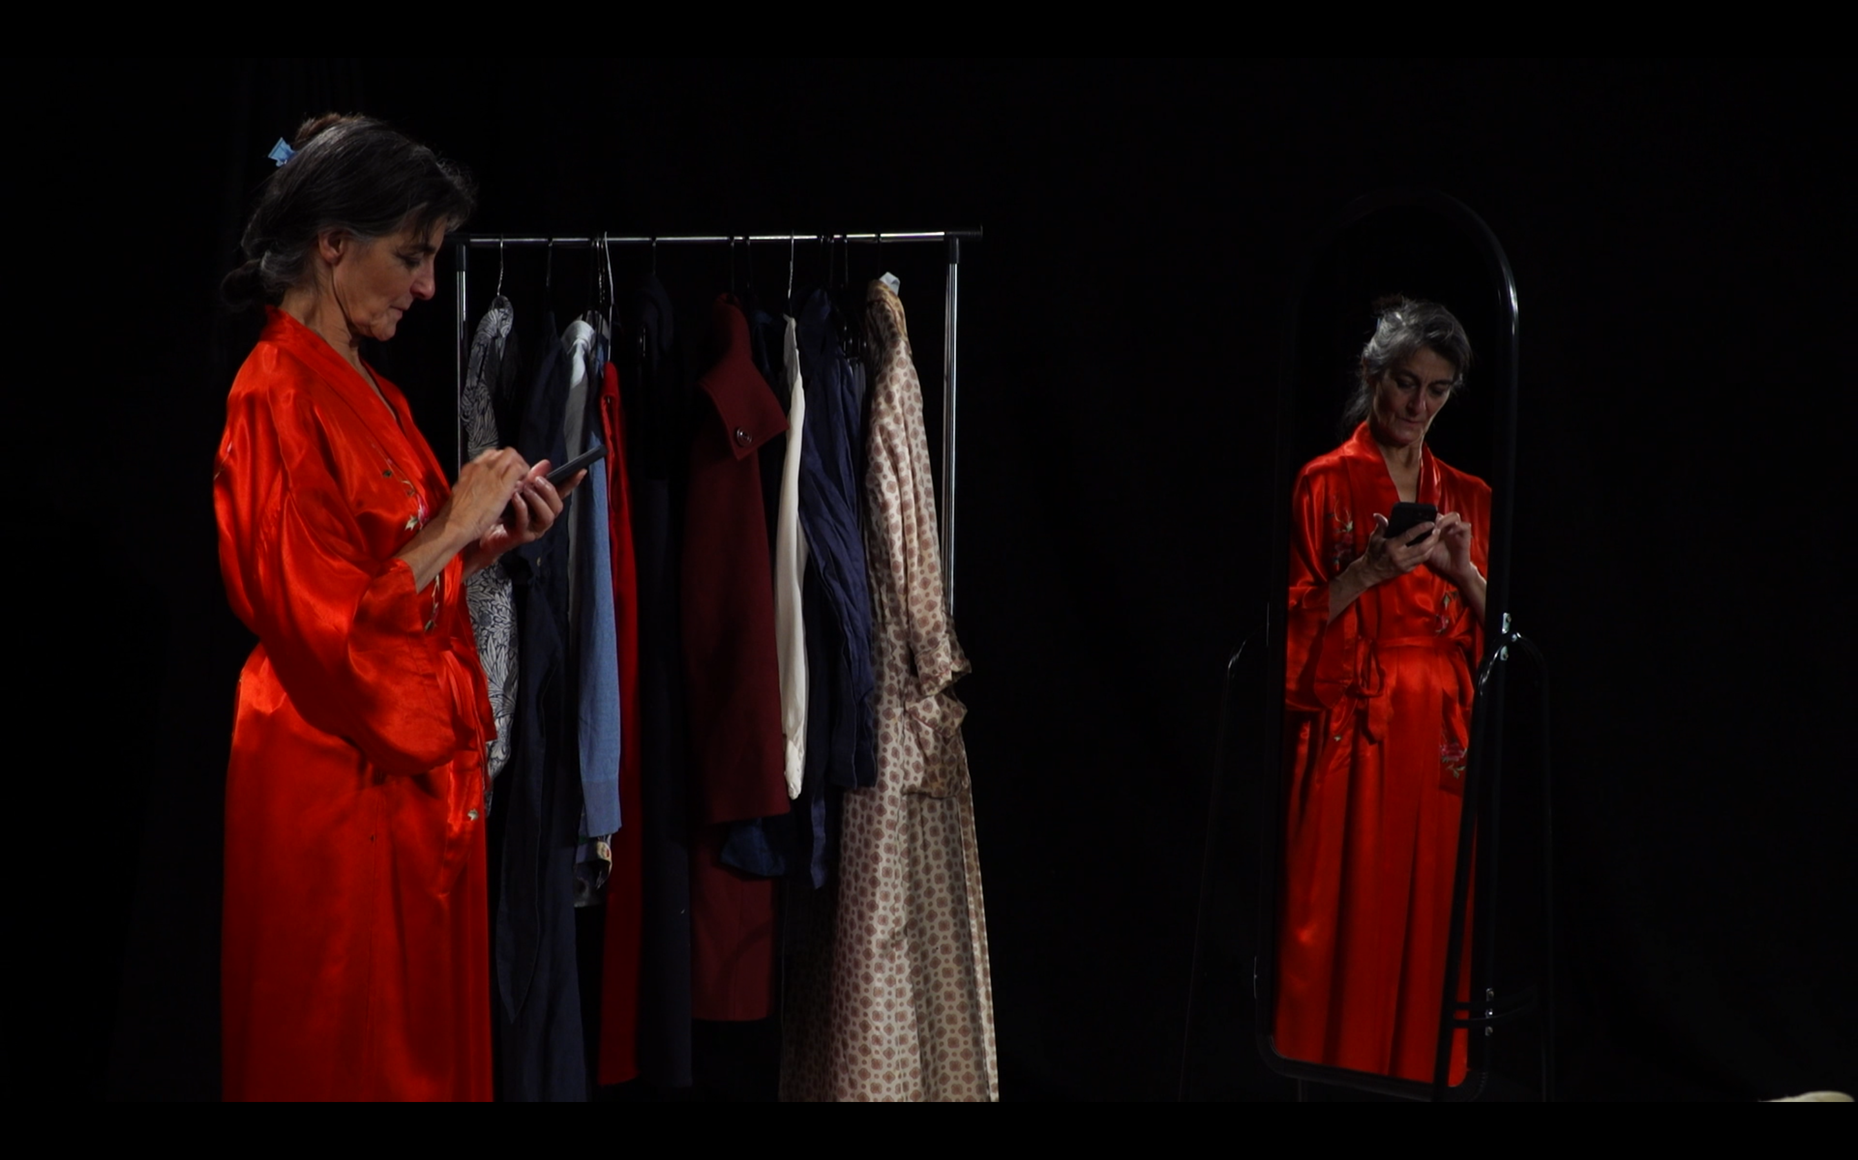
Acting against ageism
Ageism, Representation, and the Cultural Construction of Ageing

Slide 2
Confronting ageism
How the three sections connect — and recombine for different formats
Identify
Respond
Examine
Naming the stereotypes
Countering stereotypes
The play
1 hour
Part 1
Part 2
Part 3
The 1-hour version adds an extra scene (Scene 1: Adverts) to introduce the themes Part 1 would otherwise cover.
2 hours
Part 1
Part 2
Part 3
3 hours
Part 1
Part 2
Part 3
Used in this format
Not included

Slide 3



Adaptability
The core structure stays fixed — optional materials let the facilitator tailor it to the group in front of them
Discussion worksheets
Additional scene clips
Script-comparison worksheet
Extra prompt sheets for Part 1's themes, for a facilitator to draw on depending on the group's interests and pace.
Extra recorded scenes (e.g. Scene 1: Adverts), for groups who want more case-study material or a shorter format.
An activity comparing the script text to the performed clip, for groups keen on closer textual reading.
Extends Part 1
Extends Part 2
Adds to Part 2
All optional — the facilitator chooses what to bring in based on the size, background, and pace of the group.

Slide 4
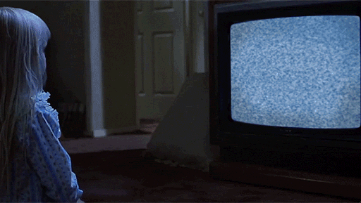
Pre-session activity
Watch the studio-filmed play Go Gently
While watching, note down the following:
  A moment that surprised you.
  A moment that felt familiar.
  A representation of ageing that seemed problematic, ambiguous, or challenging.
  A question the play raised for you.
  The scene that made you think the most about ageing and ageism.

Slide 5
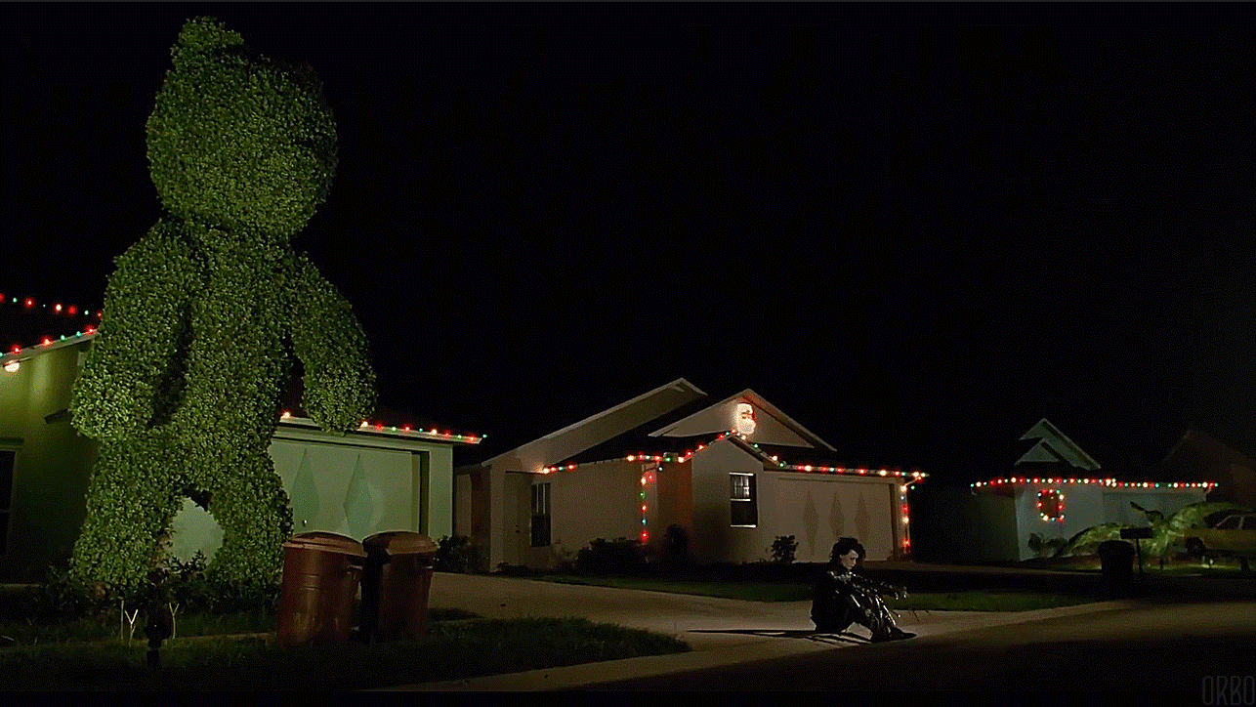
Plan & aims
Part One: Mapping Cultural Narratives of Ageing
Part Two: Case Study Analysis – Go Gently
Part Three: Deconstructing and Reimagining Narratives
Identify common stereotypes about older age.
Explore how representations of ageing shape knowledge, attitudes, and policy.
Analyse a cultural text (Go Gently) through a critical lens.
Develop strategies for recognising and challenging ageist assumptions in research, teaching, and professional practice.

Slide 6
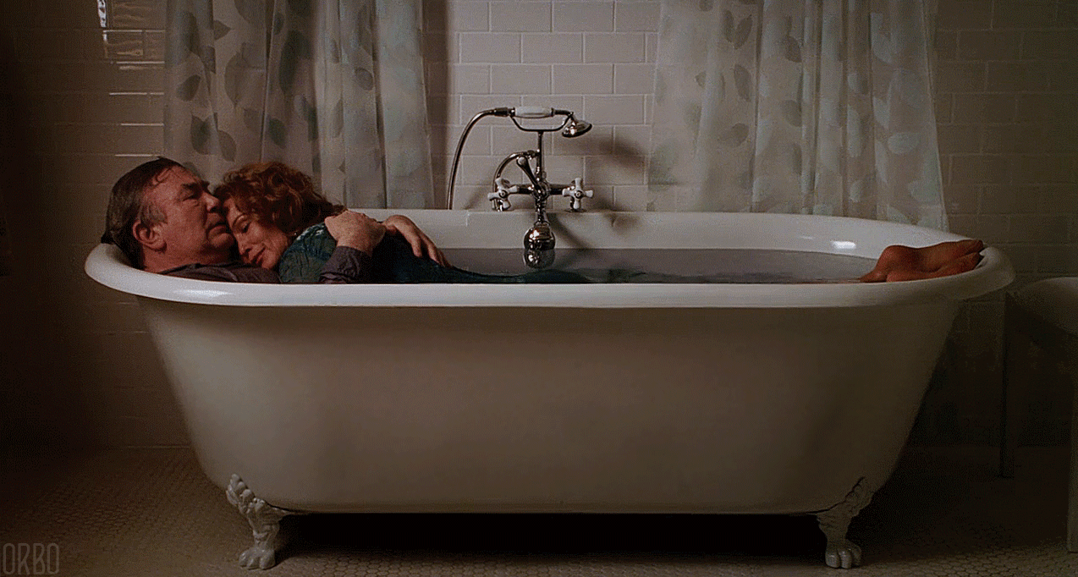
Part one:
Mapping Cultural stereotypes around Ageing

Slide 7
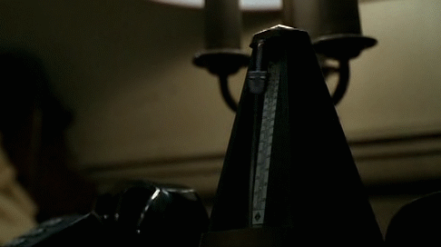
"What comes to mind when we say old age?"
Work individually for two minutes
Write down the first five words, images, or ideas that come to mind when you hear:
  old age
  older person
  ageing
Consider our shared list:
Which themes dominate?
Which are positive?
Which are negative?
What assumptions appear repeatedly?
What is absent?
10 minutes

Slide 8
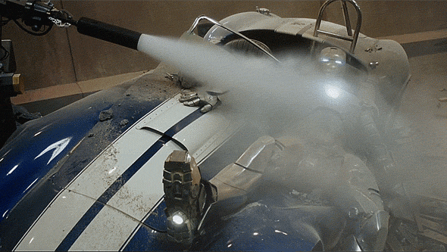
1. Beyond biology
When we talk about ageing, how much of what we mean is biological, and how much is shaped by social and cultural expectations?
  What makes someone seem "old"?
  Is age something we are, or something we perform?
  How might different contexts alter our perceptions of two people who are the same age?
20 minutes – selected questions

Slide 9
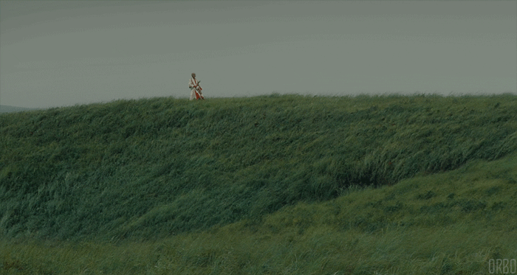
2. Age as a system of power
In what ways does age operate like other social categories, shaping who is listened to, valued, trusted, or ignored?
  When does age confer authority?
  When does it diminish authority?
  Who gets to define what counts as "appropriate" behaviour at different ages?

Slide 10
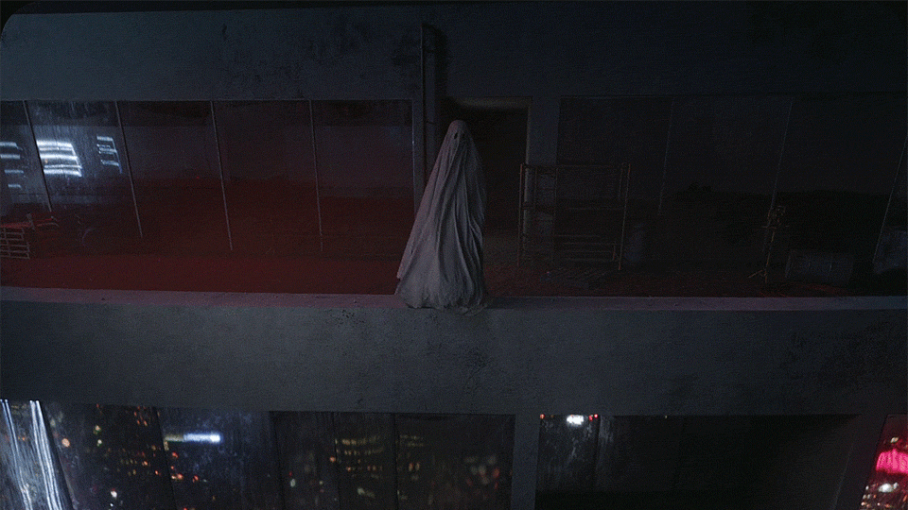
3. Visibility and Invisibility
Are older adults highly visible in contemporary culture, or largely invisible?
  Where do we see older people represented?
  What kinds of older people tend to be represented?
  Whose ageing remains unseen?

Slide 11
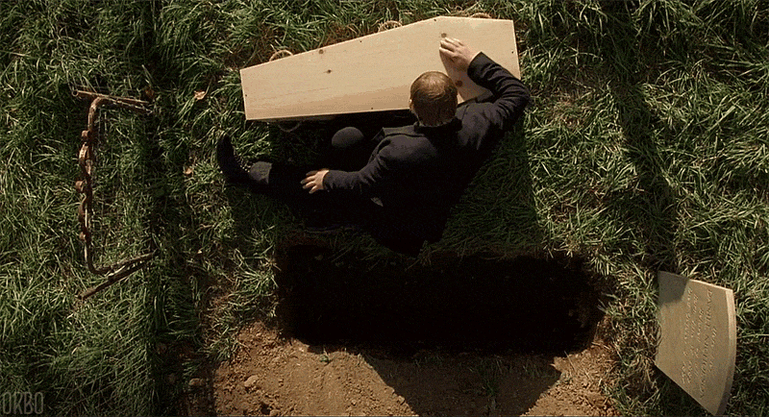
4. Narratives of decline
How often do cultural stories about ageing assume decline, loss, or deterioration?
  What kinds of losses are most commonly associated with ageing?
  What emotions are attached to those losses?
  What experiences of ageing are left out when decline becomes the dominant narrative?
  Can you think of some examples from film, TV, or advertising?

Slide 12
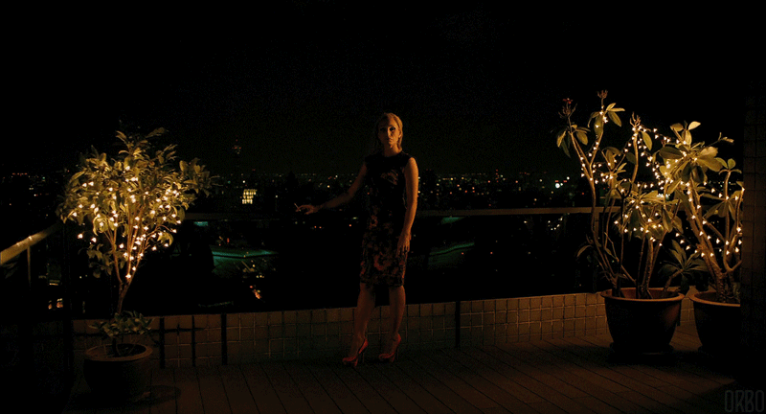
5. "Successful" or "Positive" Ageing
What does our culture suggest a person should do in order to age "well"?
  What assumptions sit behind ideas such as active ageing, healthy ageing, or successful ageing?
  Who can realistically meet these expectations?
  What happens to people who cannot?
  Can you think of some examples from film, TV, or advertising?

Slide 13
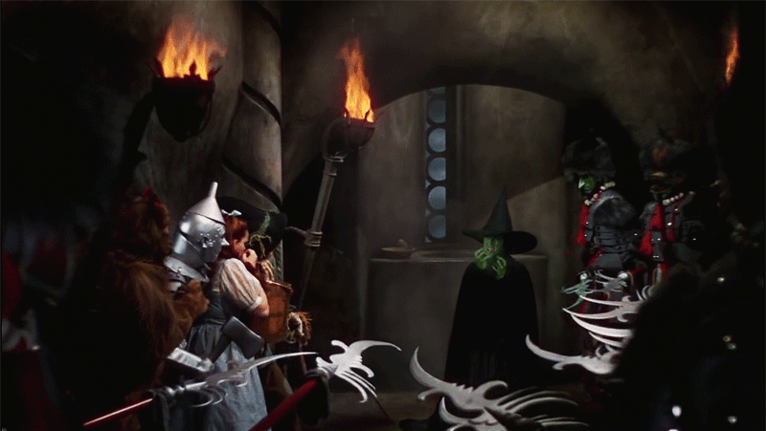
6. The ageing body
Why do bodily changes associated with ageing provoke such strong cultural reactions?
  Which bodily signs of ageing attract the most attention?
  Why do some signs become stigmatised?
  How are people encouraged to respond to visible ageing?

Slide 14
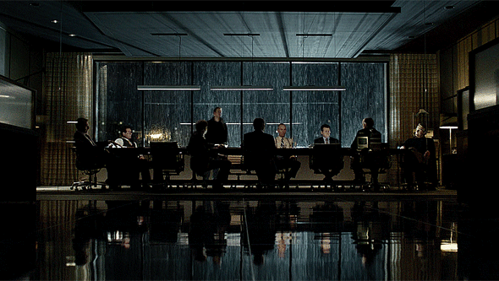
7. intersectional ageing
Is there such a thing as a typical experience of ageing?
  How do class, gender, ethnicity, disability, sexuality, and geography shape experiences of ageing?
  Which older lives tend to become the "default" examples?
  What diversity gets overlooked?

Slide 15

Activity: Narrative Mapping
In groups, write down your responses to the following question:
What are the dominant stories our culture tells about ageing?
  Consider themes such as dependency, wisdom, burden, active ageing, anti-ageing, intergenerational conflict
For each narrative, consider the following questions:
  Where do we encounter it?
  Who benefits from it?
  Who is marginalised by it?
  What is ignored?
20 minutes

Slide 16
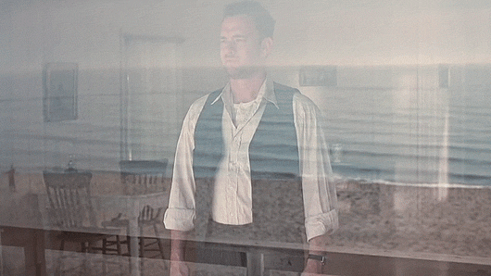
reflection
Which narratives feel most powerful today?
Which have changed over time?
How do these narratives appear within academia?
How do they shape research priorities, teaching, and institutional culture?
10 minutes

Slide 17
Part two: case study analysis – go gently

Slide 18
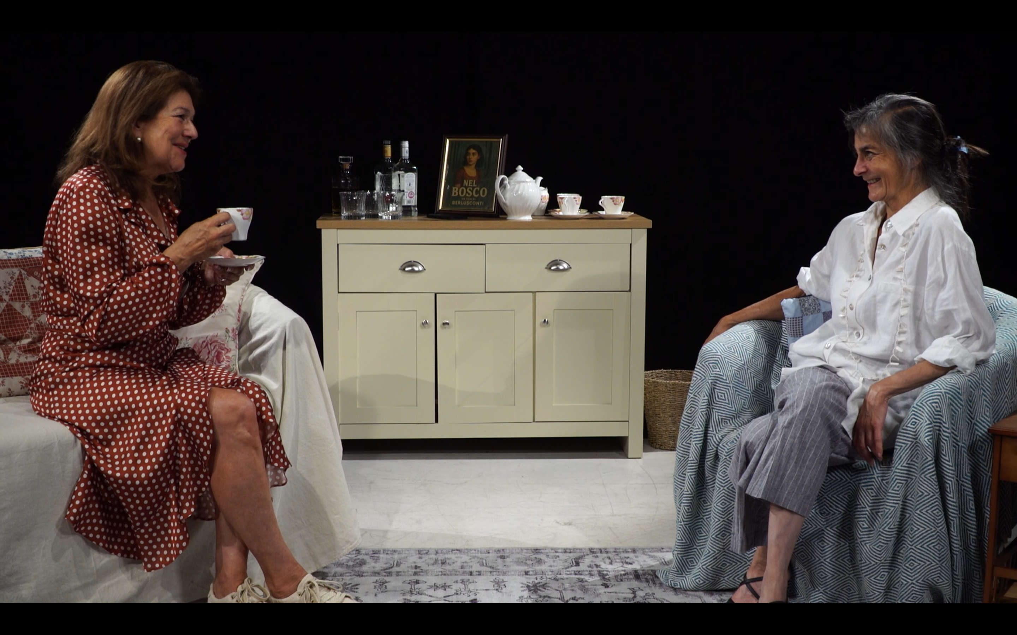
Initial discussion
In pairs, share one scene, image, line, or interaction from the play that stayed with you
  Why did it stay with you?
  What assumptions about ageing does it reveal or challenge?
10 minutes

Slide 19
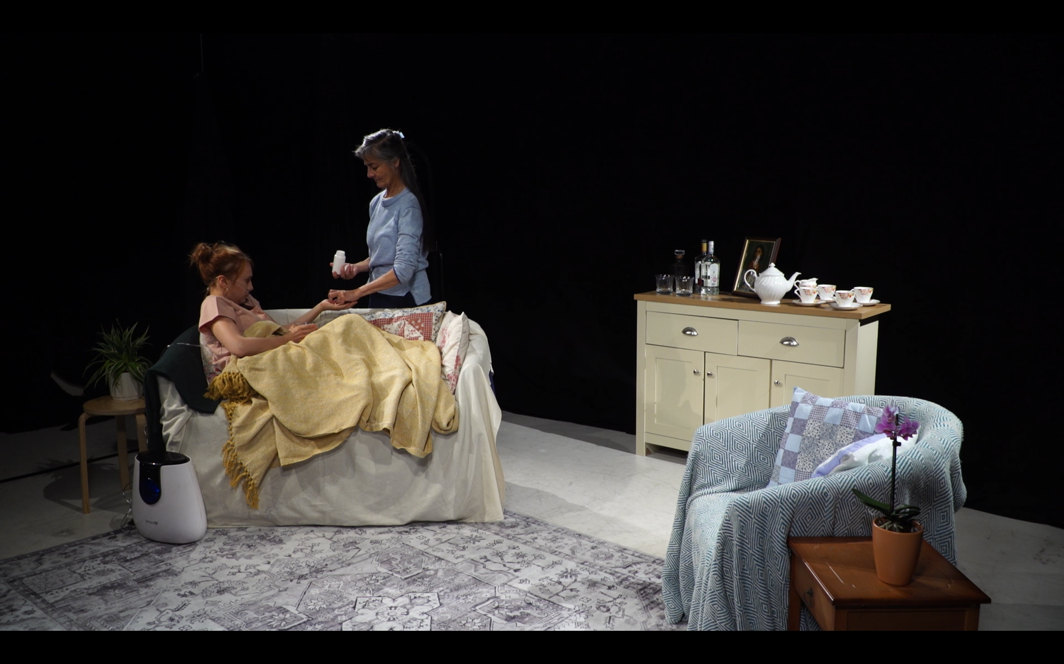
Scene analysis: climactic conflict
Representation
How is age being represented?
What visual or narrative cues are being used?
Assumptions
What assumptions about ageing appear?
Who is assumed to have authority?
Who is assumed to be vulnerable?
Voice
Whose perspective dominates?
Whose voice is absent?
Complexity
Does the scene reinforce stereotypes?
Does it complicate them?
Does it do both simultaneously?
25 minutes

Slide 20
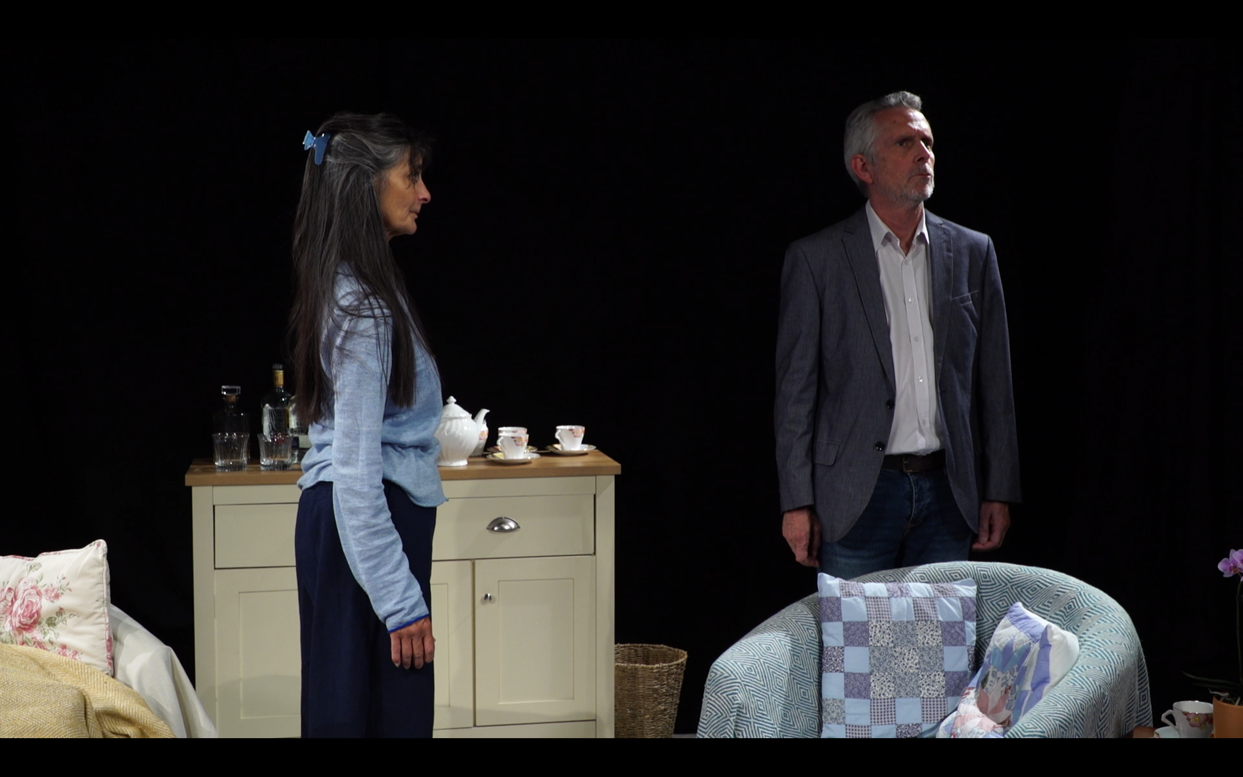
Re-watch
Watch the scene again, focusing on a specific lens
Group A
Ageism and stereotypes
Group B
Embodiment and the ageing body
Group C
Care, dependency, and autonomy
Group D
Gender and ageing
Group E
Memory, identity, and temporality
What became visible on the second viewing that you did not notice the first time?
25 minutes

Slide 21
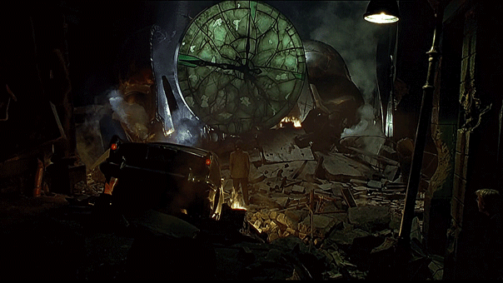
Part 3:
Deconstructing and
Reimagining Narratives

Slide 22
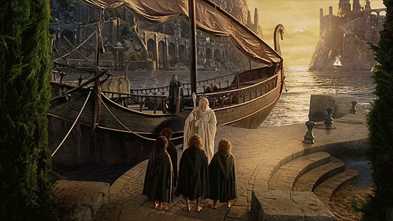
Stereotype audit
In groups, identify stereotypes found
  in the play
  in broader media
  in academia
  in policy discourse
For each stereotype, note down what it assumes and what it obscures
Examples might include: older people are frail, older people are wise, ageing equals decline, ageing well means remaining youthful
15 minutes

Slide 23
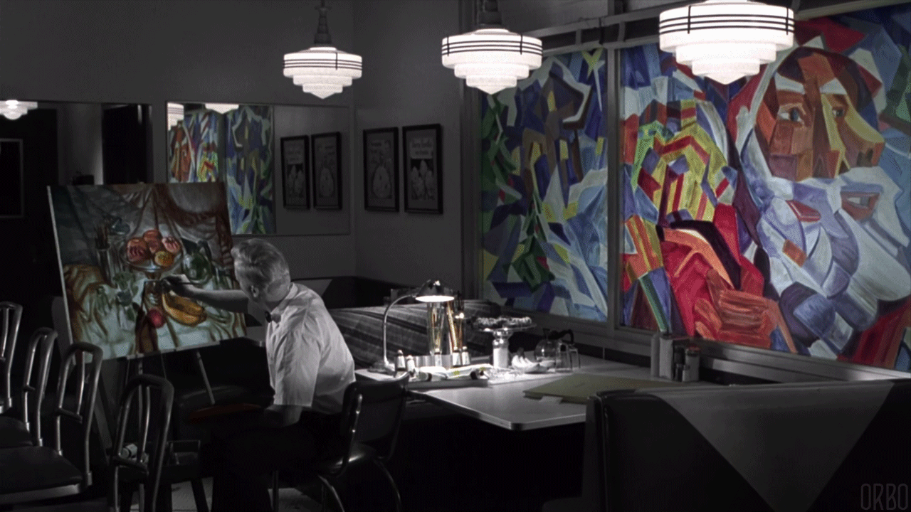
Counter-narrative workshop
Choose a stereotype
Describe where you have seen this in a specific media example from film, TV, or advertising
Consider:
  What alternative story could be told?
  What perspectives are missing?
  What complexity has been flattened?
  What would a less ageist representation look like?
Plan and/or create:
  a revised scene
  a short synopsis
  a research question
  a teaching activity
20 minutes

Slide 24
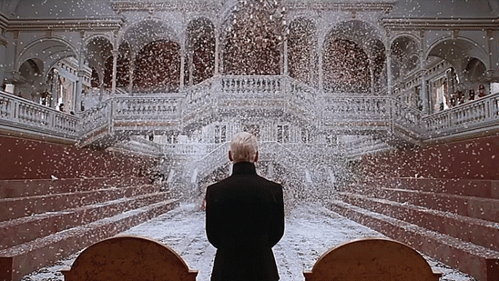
Application exercise
How might this discussion affect your own work?
Consider:
  research design
  participant recruitment
  curriculum design
  public engagement
  media commentary
  institutional practice
Can you identify a change you could make based on today’s ideas?

Slide 25
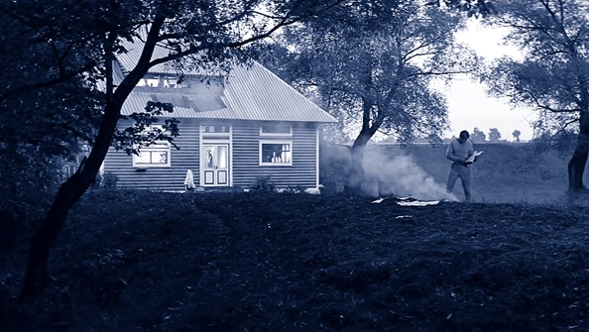
Closing reflection
Before this session, I thought ageing was...
Now I am questioning...
One narrative I will pay more attention to is...

