Slide 1

Writing for publication
Professor Jennie Wilson
Richard Wells Research Centre

Slide 2

What does writing for publication involve?
Adding new knowledge to the field
‘Telling your story’ - clearly and succinctly explaining
  what you did?
  how you did it?
  what happened?

Slide 3

How do I decide where to publish?
Who are my target audience?
What do I have to say?
Who needs to hear it?
What journals publish on this topic?

Slide 4

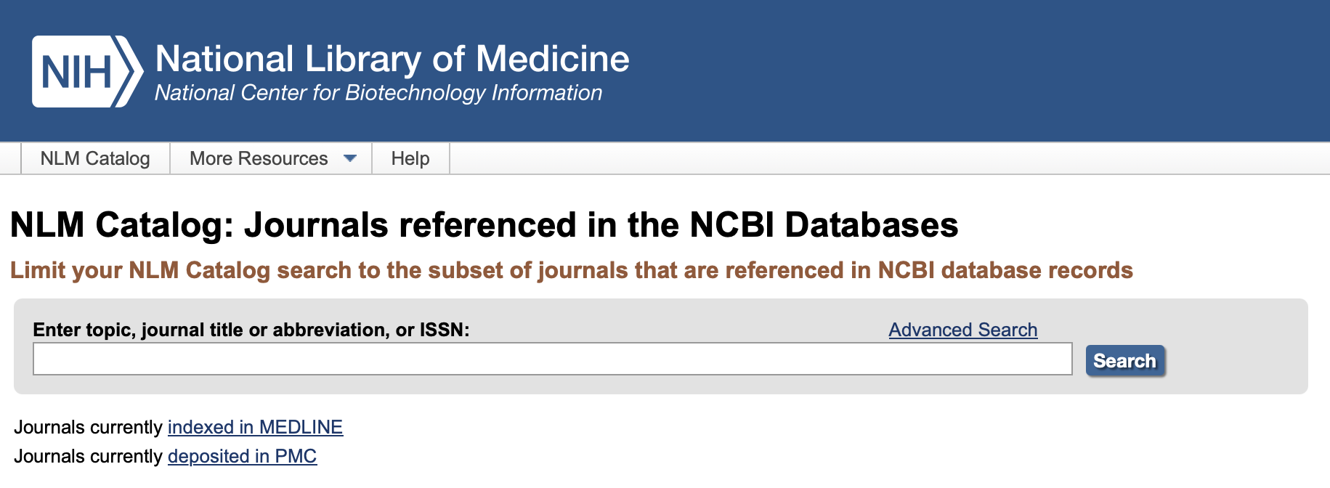
What kind of journal?
Peer reviewed
  Beware of predatory journals who charge fees to publish but no quality checks, peer review, or editorial service
Indexed in PubMed or other search engines?
Open access? (requires a fee)
Impact factor?

Slide 5
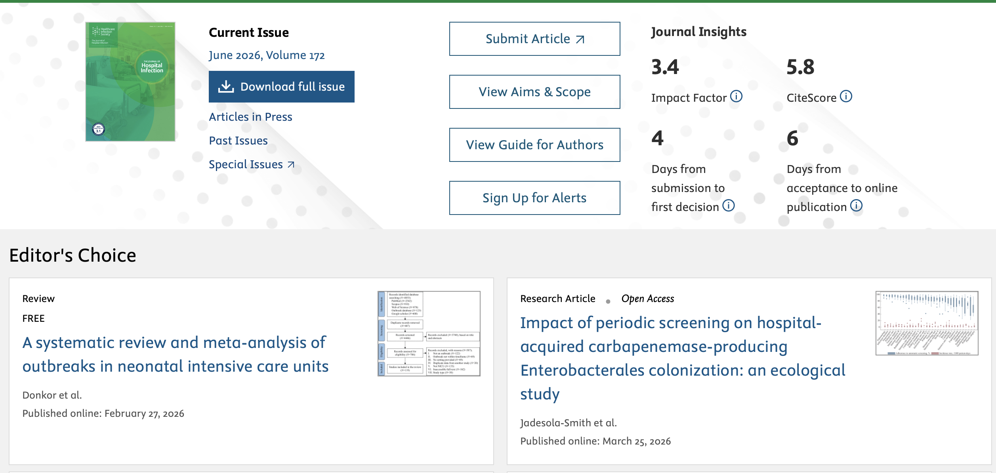

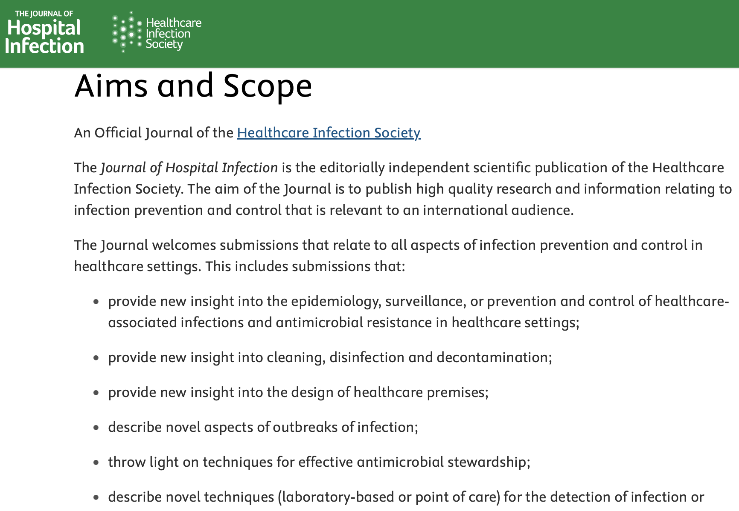
Type of article?
Original research
Quantitative or qualitative
Systematic evidence review
Research-based commentary

Slide 6

Open access publishing
Subscription journals
  no Open Access component
Hybrid journals
  subscription journals which enable open access for a fee
“Gold’ open access journals
  all papers are open access with fees applied
  ‘Read and Publish’ agreements

Slide 7
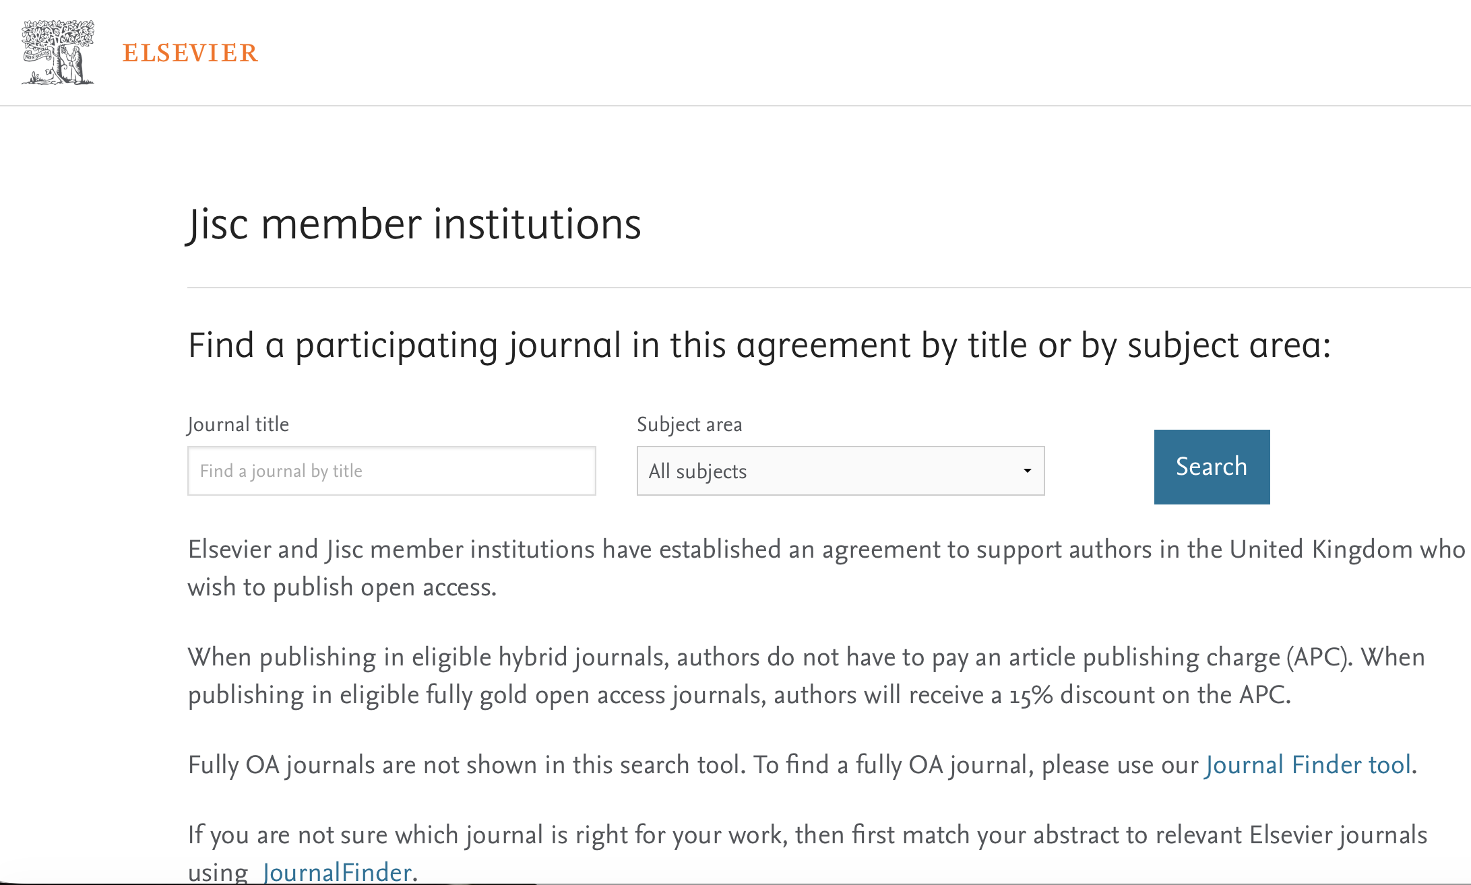
UWL ‘Read & Publish’ agreements
Association of Computing Machinery
Wiley (open access journals)
Sage (hybrid journals)
Elsevier

Slide 8
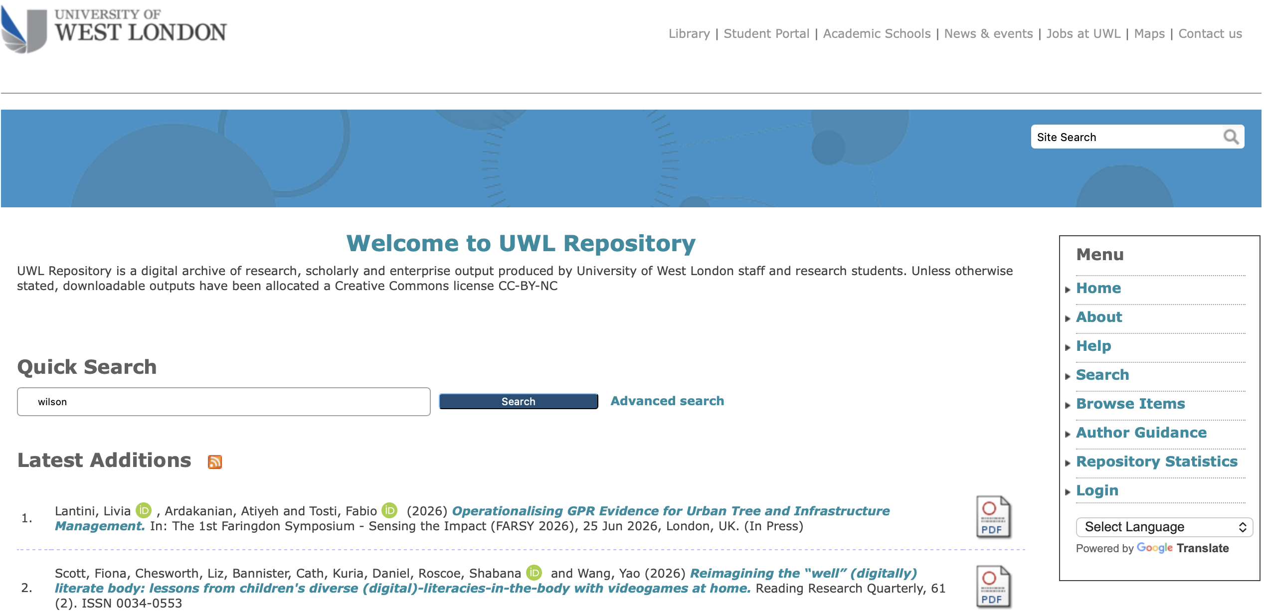
UWL Repository
  If not publishing in open access journal then you will need to upload your ‘accepted’ manuscript to the UWL repository
  This means that your work can be found by others via the repository rather than the journal

Slide 9
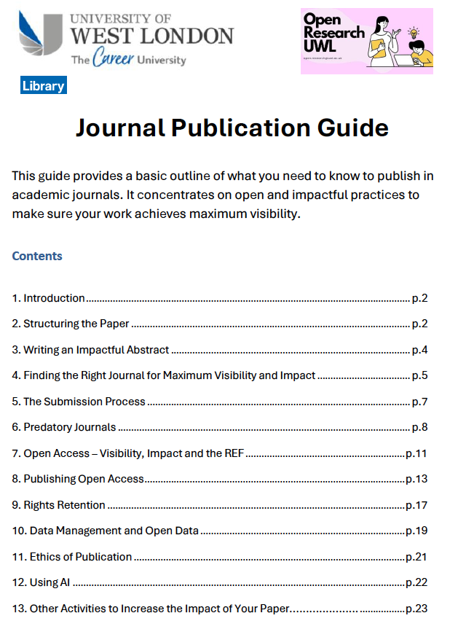
Contact Marc Forster Open research Manager at UWL library
https://www.uwl.ac.uk/current-students/library/support-research

Slide 10

The Five “C’s” of writing for publication
Coherence
Clarity
Consistency
Conciseness
Conviction
Clarity
Coherence
Consistency
Conviction
Conciseness

Slide 11

Structure of a research paper
Background
Methods
Results
Discussion
Conclusion (not always necessary)
Other elements
Strengths & limitations
‘What work adds’
Key words

Slide 12
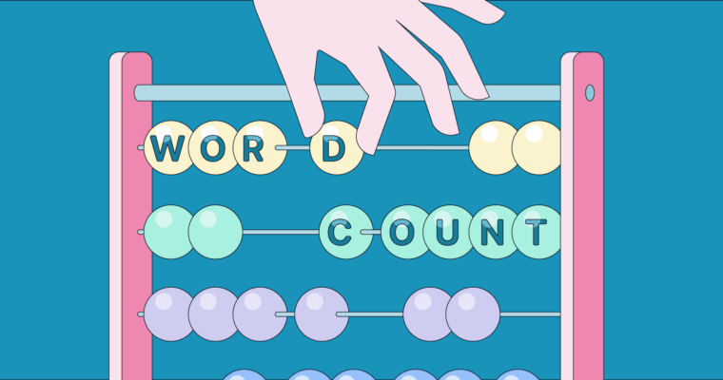
Word count!
Varies between journals
Original research usually 3 – 4000 words (tables usually count as around 500 words)
Quantitative research maybe more (6000)
Additional material can usually be added as ‘web appendices’
You will need to be concise!

Slide 13

Structuring your paper
Introduction
  Set the scene, context for work, why it is an important issue
  It does not need to be very long
  It does not need to review every publication on the topic!
  End the introduction with the aims & objectives of your study/work
    What question were you trying to answer?

Slide 14

Methods
Study design
  Use recognised Study Reporting Guidelines
Setting
  where, what unit, time frame
Participants
  eligibility or exclusion criteria
Recruitment or selection of participants
Sampling method (if relevant)
Must refer to ethical approval

Slide 15
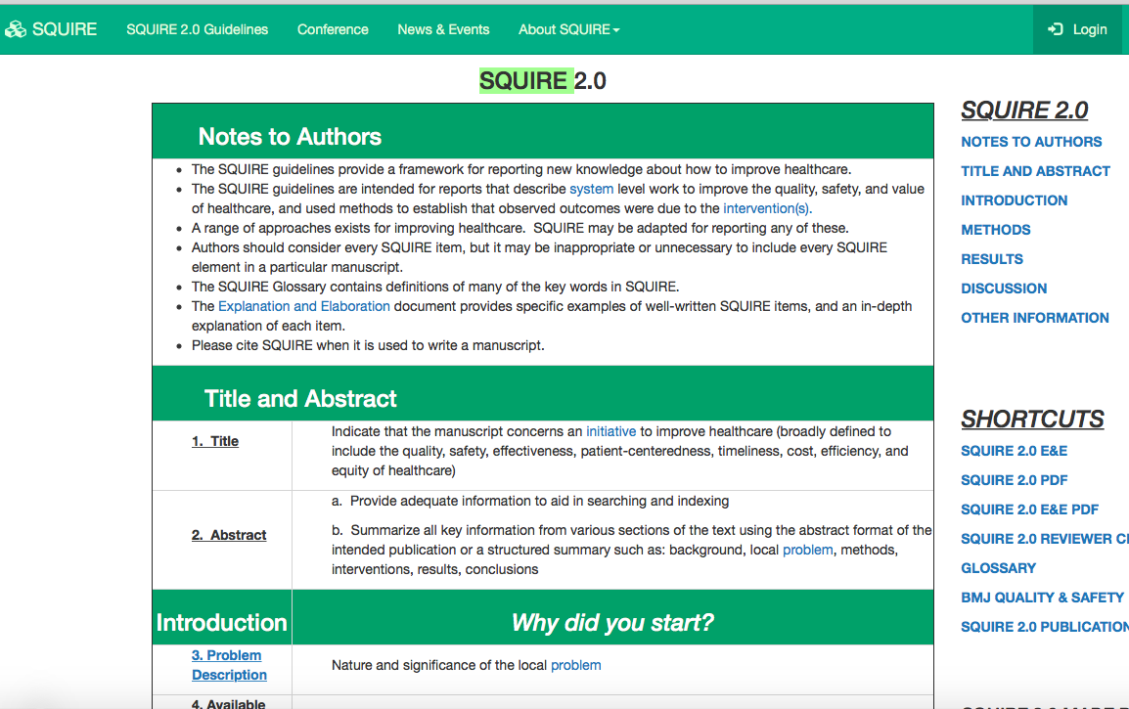
SQUIRE: Reporting Quality Improvement studies
System level work to improve the quality, safety, and value of healthcare, using methods to establish that observed outcomes were due to the intervention(s).
  Problem description
  Available knowledge
  Specific aims
  Context
  Interventions
  Study methods
  Measures
  Analysis
  Results
  Discussion

Slide 16
Methods continued
Describe what was done
  Clear definitions (think about ‘non-expert’ audience)
  Be concise but clear
  Enough detail to be replicated by others
  Clearly describe interventions/treatments
Include any statistical methods used

Slide 17

Results
Start with summary e.g. size of sample, no. cases, no. questionnaires/respondents
Use tables to display detail
  refer to, but do not repeat, numbers in text
  Ensure content is easy to understand (define terms in footnotes)
Label figure axes and data
Clearly define calculations (e.g. numerator/denominator)
Do not include methods
Do not interpret results – simply state them

Slide 18
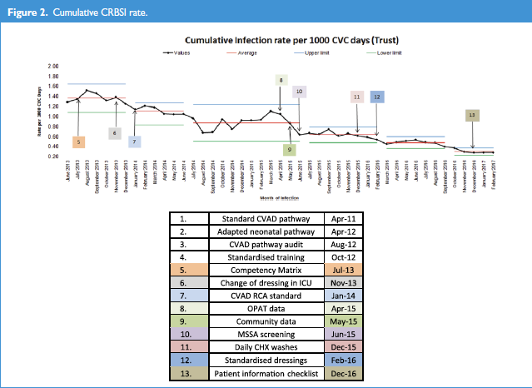

Slide 19
Purpose of the Discussion
Interprets the significance of your findings in light of what was already known about the research problem being investigated
Identifies and explains any new understanding or insights
Discusses relevance of findings to wider literature
Connects to the introduction
  Research questions or hypotheses you posed
  Does not simply repeat or rearrange the introduction

Slide 20

Discussion
Summarise your main findings (results)
  Do not repeat your results
  Do not present new results in the Discussion
Interpret your findings
  Answer your own research/improvement question!
  Why are your results important
  How do your results compare with other similar studies?
  Why might your results differ from those of other authors?
  Alternative explanation - why might your results not have been as expected?
Strengths and limitations of your research?
  What are the implications of your findings

Slide 21
A few editor red flags
Don’t over interpret your results, be conservative in your claims
  Remember that the data are the data: nothing more, nothing less.
Don’t write two results sections
  focus on the interpretation of those results, not the data itself.
Don’t introduce new results in the discussion
Don’t ignore non-significant results
  discuss everything, but be concise, brief, and specific.

Slide 22
Tips on organisation
Describe the relationships shown by each major result and place them in proper perspective.
The sequence of this information is important;
  first state the answer,
  then the relevant results,
  then cite the work of others.
Present issues in the same order as they were described in your results section.
Highlight unexpected findings

Slide 23
Top Tip!
Each paragraph should be focused on a specific point
Start each paragraph with a sentence introducing what it is about
If you took the 1st sentence of all your paragraphs the reader should be able to know what the paper is about

Slide 24
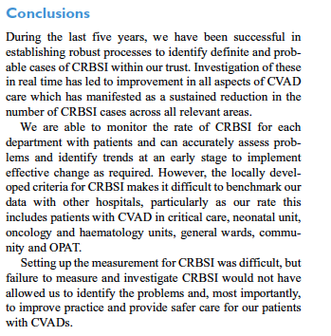

Conclusion
You can provide a succinct summary of what your work has shown as a concluding statement (2 or 3 sentences!)

Slide 25
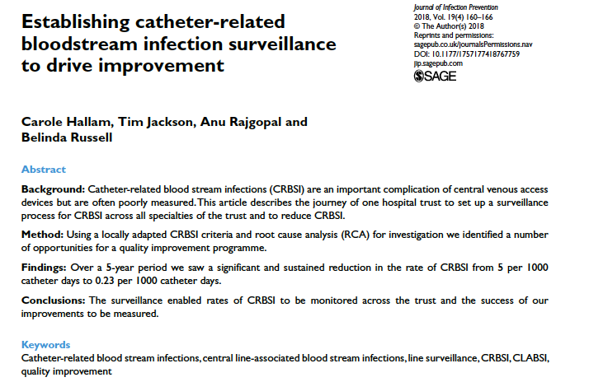
Abstract
Structured abstract
  Usually 250-300 words
  Structured with headings e.g. Introduction, aims, methods, results, conclusions
Unstructured abstract
  Summary of paper
  Similar content without headings

Slide 26
Using AI
Check journal policy on AI
Do not use AI to create manipulate or alter results
Can use to help you edit e.g. improving clarity
You are responsible for the accuracy of any material generated by AI – check sources, avoid plagiarism, ensure you apply critical analysis
Disclose how AI has been used in the manuscript

Slide 27
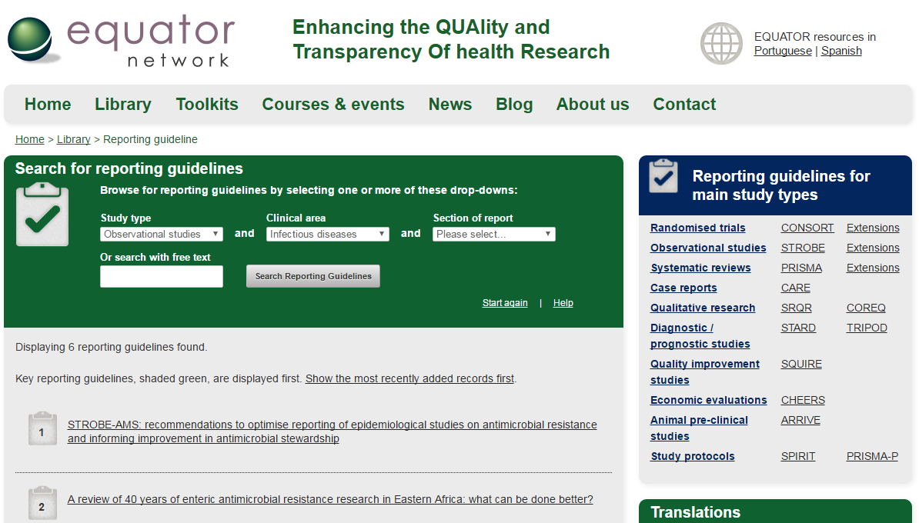
Use study reporting guidelines
http://www.equator-network.org/

Slide 28
Submitting a paper to a journal

Slide 29
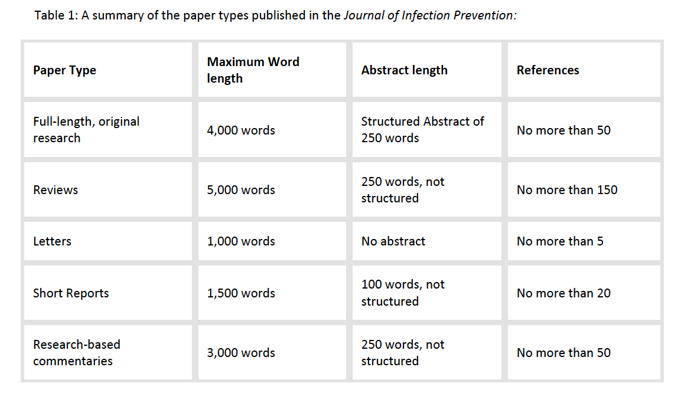
Author guidelines
Check the author guidelines for the journal you intend to submit to
Make sure you follow the guidelines
Types of article
Structure
Word length
Author contribution
Referencing style
Figure – submission format e.g. jpeg

Slide 30
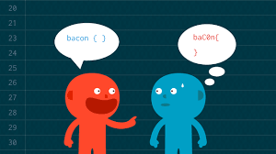
Format
Format your submission as outlined in Instructions for Authors
Use correct grammar and consistent tenses
Use academic language
  Generally, ‘third person’; avoid emotive words like ‘enormous’,
Use every sentence wisely
  don’t repeat yourself and make sure what you are saying is clear, important to say and in a coherent, logical order!

Slide 31

Checking your work
Get someone else in your team to read it (who is good at writing!)
  Does it make sense
  Is it well structured
  Is it written in an academic style
  Can the English & grammar be improved?

Slide 32
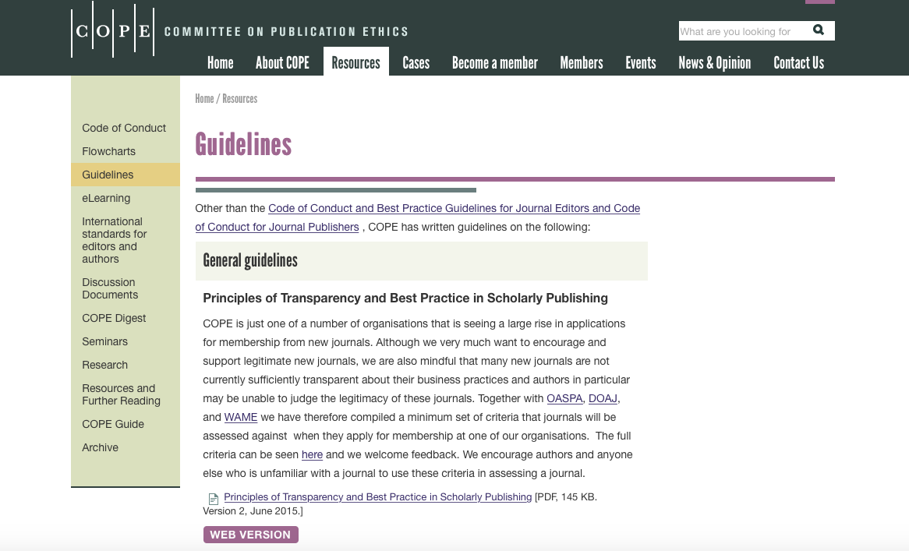
Authorship (COPE guidelines)
Authors should meet all 4 criteria:
Substantial contribution to:
  conception/design
  Acquisition of data
  Analysis/interpretation of data
Drafting or revising the work
Final approval
Accountable for accuracy/integrity
International Committee of Medical Journal Editors (ICMJE)
You can find information on the COPE website

Slide 33

Publishers’ Peer review Processes
Single blind vs. double blind review
Typically 2-3 reviewers selected and invited to review
Recommendations include:
  Accept
  Minor revision
  Major revision
  Reject

Slide 34
Why is peer-review important?
View on importance of the work
Check on quality of work
  methods & analysis appropriate
  conclusions valid
Check on ‘readability’
  Does it make sense?
  Could the work be replicated - is anything missing
Improve structure & content
Endorsement by ‘peers’
  indication of robustness

Slide 35

Review, revise, respond
Thank reviewers
Avoid defensive tone
Respond to all points raised
Can justify alternative – but pick your battles!
Structure your response (create a table with Q and As; track change or highlight manuscript text)

Slide 36

Think about what you need to do now to convert your work into a publication!
Draft an outline plan for the content of the paper

Slide 37
In your plan….....
What needs to be done to complete your first draft?
When will you schedule your writing time?
Who is going to be your critical friend?
Use SMART objectives
  Specific, Measurable, Achievable, Realistic, Timely

