Slide 1

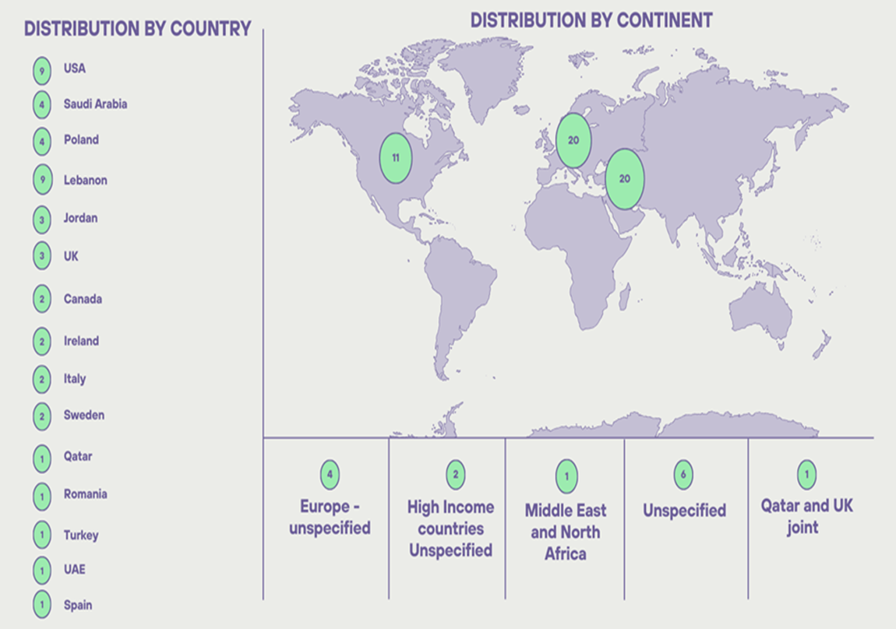
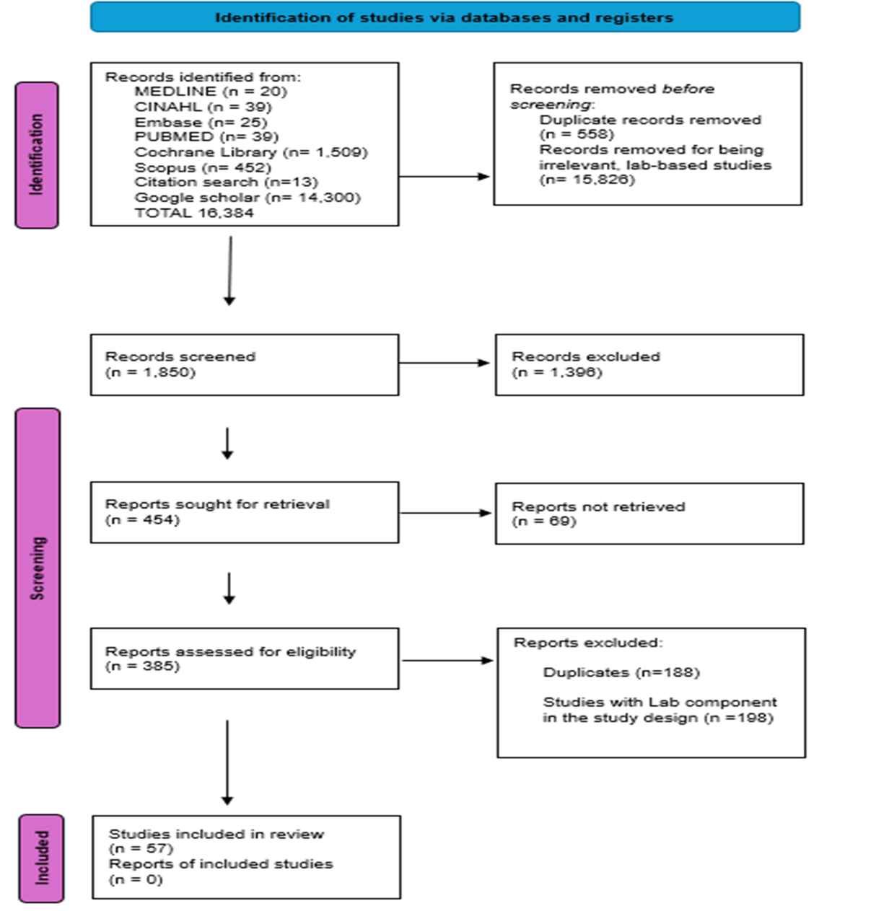
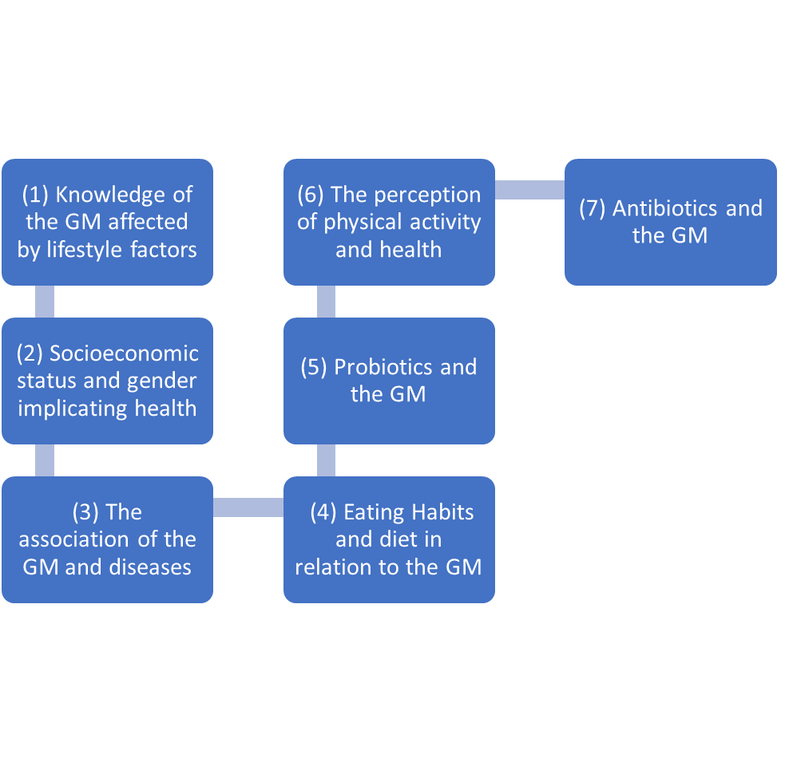

The knowledge, health beliefs and lifestyle choices among adults to maintain a healthy gut microbiome
Rita Kmeid ꞌ, Professor Heather Loveday ², Professor Jennie Wilson ³
Richard Wells Research Centre, College of Nursing, Midwifery and Healthcare, University of West London, United Kingdom
Introduction
Materials & Methods
Results
Conclusion
Background
Methods
This scoping review has represented 57 total studies that follow the inclusion criteria, of which much fewer publications from earlier years. The data shows that there has been a noticeable increase in the number of publications starting the year 2020, which suggests the growing interest in this subject area, reflected in more funding or possible improvements in data collection or research methodologies which in turn is reflected by an increased number of studies that are prevalent to the field suggesting that it is becoming not only novel research, but a more active field with new research published frequently.
A gap remains in the research specific to this topic, particularly in Lower-income countries. Hence, this scoping review locates the existing evidence and identifies the gap in the literature that is essential to provide a wider knowledge and future expectations such as tailored interventions. These interventions may include specific dietary adjustments, targeted probiotics, and stress management techniques aimed at optimizing GM for diverse populations. Additionally, the integration of technology in monitoring GM such as Zoe or Omnicare, such as wearable devices and mobile applications, is becoming increasingly relevant, allowing for real-time data collection and analysis to inform personalized health plans.
Recent international studies delved deeper into the role of the gut microbiome (GM) in metabolism, immunity and its association with long term conditions such as diabetes, cancer and neurodegenerative diseases. Various factors have shown its association with these chronic conditions such as diet, exercise, lifestyle factors and antibiotic use. Therefore, understanding the extent of public knowledge and lifestyle choices is crucial to design interventions that will improve knowledge and influence health and the association of the GM.
A systematic search strategy was conducted to retrieve published research about the knowledge, awareness and perspectives of various lifestyle choices affecting the GM. An initial limited search was conducted in the databases MEDLINE and CINAHL, followed by a full search strategy in PubMed, Embase, PsycINFO, Cochrane Library and Scopus.
Initial Keywords used included:
‘awareness OR understanding OR knowledge’ AND
‘Lifestyle choices OR health behaviour OR health beliefs’ AND ‘gut microbiome OR gut bacteria OR gut microbiota OR microbiota’
An additional Google Scholar search was conducted using the phrase: ‘Lebanese culture affecting the gut microbiome and health’
Aims
The objective of the scoping review is to explore people’s knowledge, awareness and perspectives on lifestyle factors and their impact on a healthy gut microbiome. The results of this scoping review will help inform the second phase of this study, that is qualitative research phase in the form of semi-structured interviews.
Limitations
The limitation of this review is the heterogeneity of the included studies. The study design, assessment, outcome measures and sampling techniques may have hindered the ability to draw a single conclusion across the studies. Among the study limitations, the current scoping review limited the search to qualitative studies that identify obstacles and issues that must be addressed in this study and its weakness is in its diversity and interdisciplinary search.
Research Questions
Search Strategy
What knowledge skills and behaviours are needed by individuals and communities to enable healthy lifestyle choices to maintain a healthy gut microbiome?
Sub-questions:
• What lifestyle factors do people perceive to be important in maintaining a healthy gut?
• How does the cultural background and geographic locations of individuals influence the choices they make to maintain a health gut microbiome?
• What information and resources do people access to help them make lifestyle and health choices to maintain a healthy gut?
Acknowledgments
The authors are grateful to the Richard Wells Research Centre at the University of West London.

