Slide 1

Annual PhD Student Conference – 12 July 2024: London
Maintaining a healthy gut microbiome: a mixed methods exploration of the knowledge, health beliefs and lifestyle choices of Lebanese diaspora in the UK, USA and Lebanon
Rita Kmeid, UWL, UK
Supervisors: Professor Heather Loveday and Professor Jennie Wilson, UWL, UK

Slide 2
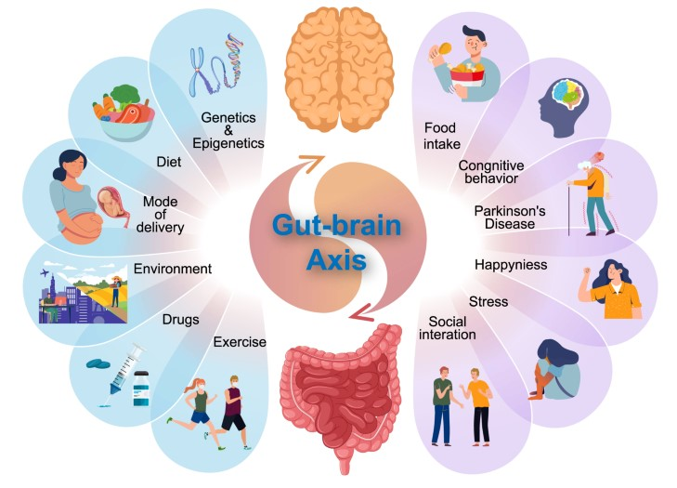
What is the Gut Microbiome?
Human gut is home to microorganisms
Live in communities in the intestines
known as the gut microbiome (GM)
Factors affecting GM
Has a vital role in health and wellbeing
Can prevent long-term conditions (LTC’s)
The aim of this study is to explore the health beliefs, lifestyle choices and knowledge of Lebanese communities to maintain a healthy gut and to co-design health information resources to improve people’s knowledge and health choices.
Figure 1: The gut-brain axis and the factors affecting it (Hou et al., 2022)

Slide 3
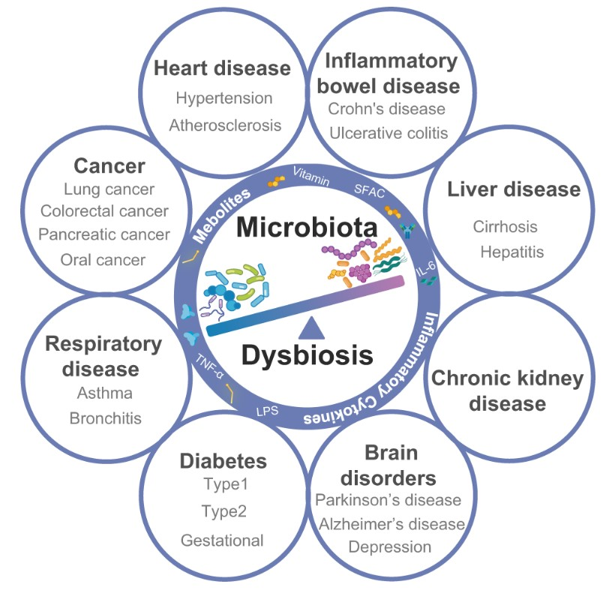
Rationale of the Study
1
Understanding the role of Gut Microbiome
Bodily functions
Disturbed GM
LTC’s are a public health concern
2
Factors affecting the GM
Associated risk factors
3
The knowledge gap among the Lebanese community
Related studies in the Middle East Area
Gap in the knowledge and perception of the Lebanese communities
Figure 2: GM dysbiosis contributing to various diseases (Hou et al., 2022)

Slide 4
Methodology
Research Questions
Study Design
What do Lebanese communities know about maintaining a healthy gut and its relationship to lifestyle factors and long-term conditions, and what information would help them to make healthy
lifestyle choices?
Sub-questions:
(1) Knowledge and health beliefs
(2) Factors
(3) Lifestyle choices and impact of migration
(4) Information and resources
Figure 3: Sequential Exploratory Mixed Method Design (adapted from Creswell and Plano-Clarke, 2013)
Phase 1
Qualitative: Interviews
Phase II
Quantitative: Questionnaire
Phase III
Question 4
Qualitative: Focus groups
Questions 1,2,3
Questions 1,2,3
Notes:
Say something here about the philosophical stance - Pragmatism
Mixed methods were used to examine experiences, attitudes, and perspectives. – Say something here about the sequesntial Exploratory design and the qual quant qual sequence
The Theoretical Domains Framework (TDF) and Capability, Opportunity, Motivation Behaviour Model (COM-B). This model has been used as a final level of synthesis in phase 1 create a framework for the next phase of this study.

Slide 5

Phase I: Interviews
Participants
Data Collection
Face-to-face interviews
Virtual interviews using Windows Teams
Semi-structured interview guide
Duration: one to one hour and a half
Qualitative Data Analysis
Stage 1 | Stage 2 | Stage 3 | Stage 4 | Stage 5 | Stage 6
Familiarisation with the data | Generating initial codes | Searching for themes | Reviewing themes | Defining and naming themes | Writing the report
Image: https://www.aljazeera.com/economy/
Table 1: The six-step method of manual coding and TA (Braun and Clarke, 2013)
Notes:
Phase I: Participants: In phase one of the study an individual semi-structured interview is initiated, informing the online survey in phase two. There are three study settings: Lebanon, the UK, and the USA.
Exclusion criteria
Participants who have professional knowledge of the gut microbiome would be excluded such as medical doctors and professionals in the healthcare
Inclusion criteria
Participants were adults ranging from 18- 75 years old (2) residents of the country either UK, USA or Lebanon for a minimum of 5 years (3) and were able to give consent.

Slide 6
Findings
Theme1: Being Lebanese
Subthemes: Eating and diet, Activity and Being home and abroad
Theme 3: Relationship between food and gut health
Subthemes: Knowledge about GM, Experiences of GM and food choices
Theme 2: Gender Roles
Subthemes: Female lifestyles, male lifestyle and Expectations and Attitudes

Slide 7
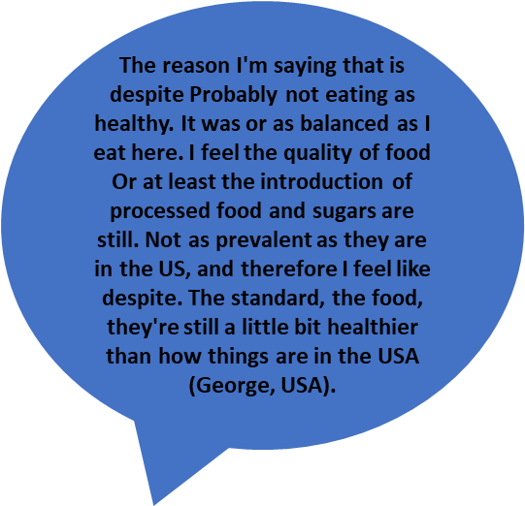
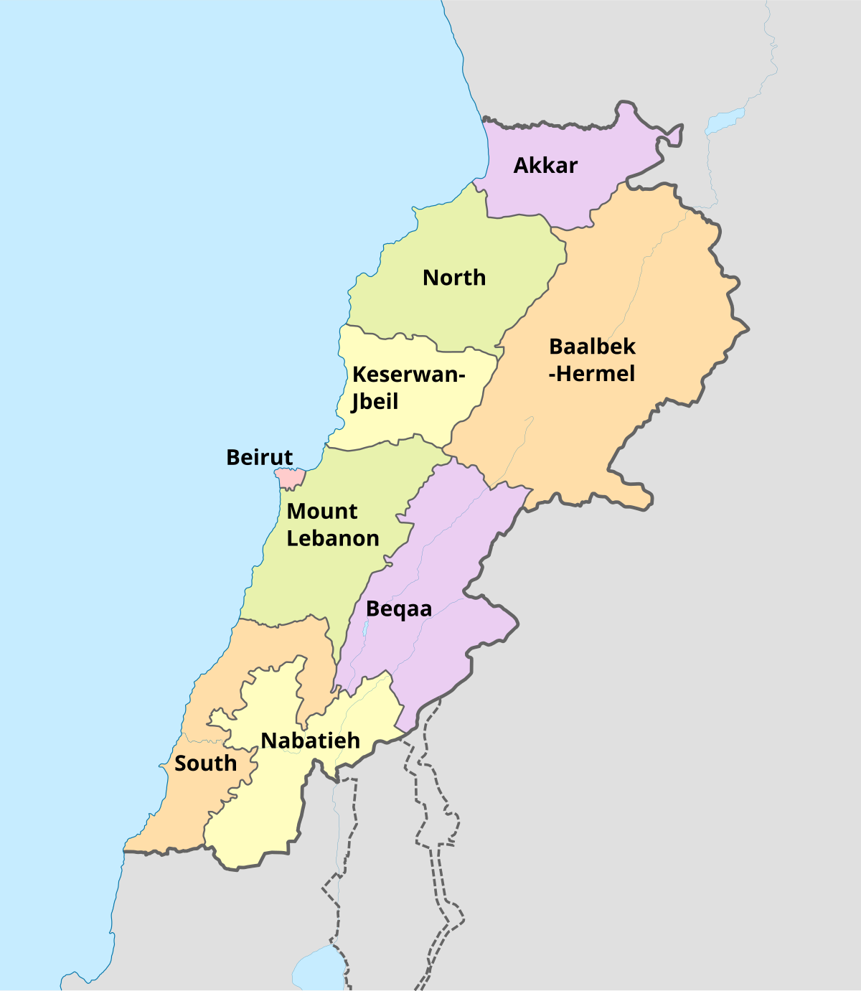
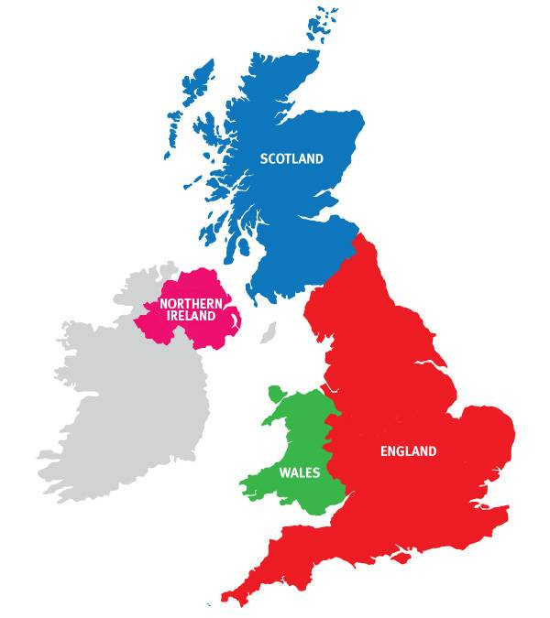
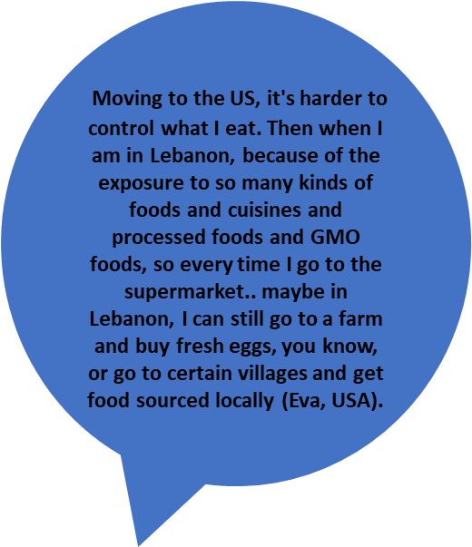
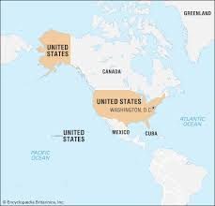
Being Lebanese - Being home and away
Image: Why should you visit the UK? | VisitEngland
Image: https://upload.wikimedia.org/wikipedia/commons/thumb/6/66/Lebanon_governorates_english.svg/1200px-Lebanon_governorates_english.svg.png
Image: https://cdn.britannica.com/85/183785-050-77A0FDB5/The-United-States.jpg

Slide 8

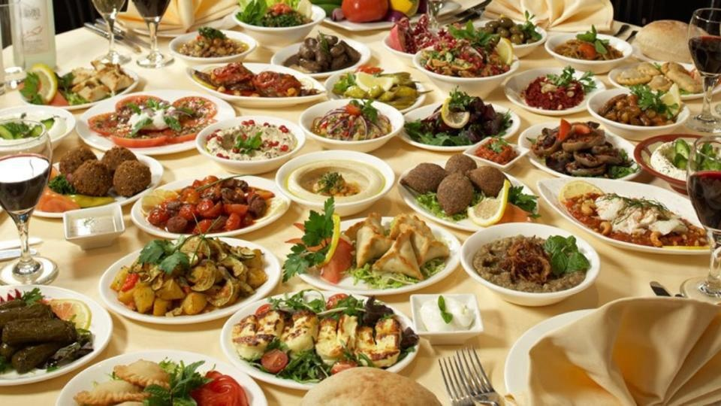
Being Lebanese – Eating and Diet
It's part of the culture that you need to either drink or eat or take sweets or so it's like they get offended if you don’t … it's a big conflict. Because I noticed this when I'm back in Lebanon for few weeks for vacation. I must fight to say no. I don't want to eat (Ely, UK)
‘ It's always a joy to gather with family and friends. Around the meal and that, of course, impacts my lifestyle. About the Lebanese culture, like all their gatherings, are around food… even if you're not hungry, you would sit down and eat'. (Chelsea, USA)
Image: Lebanese Food: 20 Must-Try Dishes in Lebanon | Will Fly for Food

Slide 9
Being Lebanese - Activity
Maybe if I was there then I could carve out some time. OK, like Mom, can you watch the kid...While I exercise or go for a run. I should probably just carve out some time that is untouchable to do some physical activity for myself, I took some karate classes last year, which were great’… (Chelsea, USA).
You become less active because when we first moved here as kids we were not allowed to go out. Whereas in Lebanon we are used to do lots of activities, we used to go to the countryside. When we moved to the UK, we had no friends or relatives. We stayed indoors most of the time because we were very young and my mom was not well acquainted with the country, so it wasn't easy. Everything changed when we came here...So when we go to Lebanon I never put on weight. I always lose weight. (Valentina, UK)

Slide 10



Looking ahead: Exploring Knowledge and Beliefs – COM-B
Capability (C)
‘ I am a workaholic and I think sitting down, preparing food and eating is a waste of time. This is why I don't like to waste time by preparing food, especially when you don't have anyone to do it for you’ (Tony, UK).
Opportunity (O)
‘ I have no one to watch my kids, you know, where in Lebanon I might say, OK, mom, take my kids, my sister, or even my dad. I have this kind of activity that I must attend, even my husband works long hours. I'm stuck. It is so hard for me to really find the time to do anything. I'm doing everything by myself since I moved to the USA. In Lebanon I would find the support I need’ (Chloe, USA).
Motivation (M)
‘ In Lebanon, people are barely managing their expenses. Their daily struggles are increasing, the Lebanese people’s only concern now is how to get along and provide food on their tables and for their children... We have had an unstable series of events especially after the Beirut Port explosion 3 years ago. This has affected every Lebanese person whether they lived close to the Port or not. We are all emotionally and physically drained because of this situation... We just want to live, we don’t really think of our health at some point, it is not a priority anymore…’ (Soumayya, Lebanon).
Notes:
Findings from phase I will help inform the questionnaire in phase II and will use the COM-B model to explore knowledge and beliefs.
The interview findings will be framed around the COM_B model, for example

Slide 11

References
Thank you!

