Slide 1
Library Apprenticeships at the University of West London; challenges and rewards
Julian Roland, Head of Library Service Delivery, University of West London Library Services
Marcin Tumidajski, Assistant Librarian and former Library Services Apprentice, University of West London
Sanmeet Kaur; Current Library Services Apprentice

Slide 2

Format of Presentation
University of West London and its Library Services
Library Apprenticeships at the University of West London – The Library Service perspective
Library Apprenticeships at the University of West London; - the apprentice perspective

Slide 3
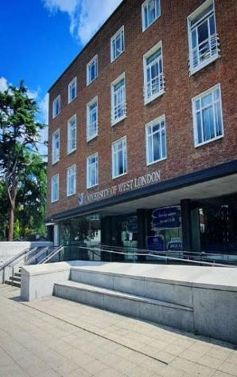
University of West London and its Library Services
Campuses and sites in Ealing, Brentford, Reading and Oxford
A diverse student community and a commitment to equality of opportunity and social inclusion
47.9% of our students are from black and ethnic minority groups.
53.5% of our students are female.
59.5% of our students were aged 21 or over on entry.
54% of students are from areas of multiple deprivation.
Excellent teaching and student experience
Ranked 30th university in the UK - The Guardian University Guide 2025
Number 1 London university for overall student satisfaction in the National Student Survey 2025**.
Best university for Student Experience and Teaching Quality in the UK in The Times and Sunday Times Good University Guide 2024.
Best modern* London university (non-specialist) in the Complete University Guide 2025.
80% of our research is rated as world-leading (4*) or internationally excellent (3*) in the latest Government Research Excellence Framework (REF) assessment.
CSE Accredited Library Services
Three libraries – The Paul Hamlyn Library and BIH Library at Reading plus at Ruskin College.
44 staff across three teams ; Customer Experience, Academic Support and Content and Scholarly Communications.

Slide 4
Library Apprenticeships at the University of West London – The Library Service Perspective.
Apprenticeship Levy
Encouraging fresh faces in to our service
A Grade 3 position and a vacancy
Four Apprentices 2022, 2023, 2024 and 2025 – different experiences and challenges for library and apprentices
Change of Job Title and introduction of rotations
Changes to contract lengths and secure progression
Future challenges

Slide 5
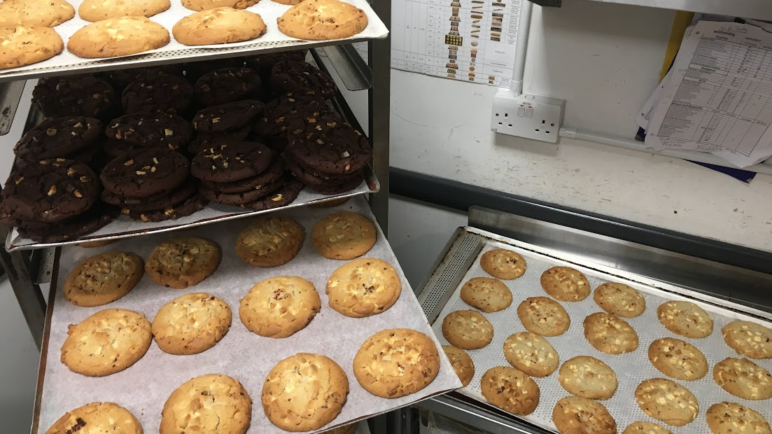
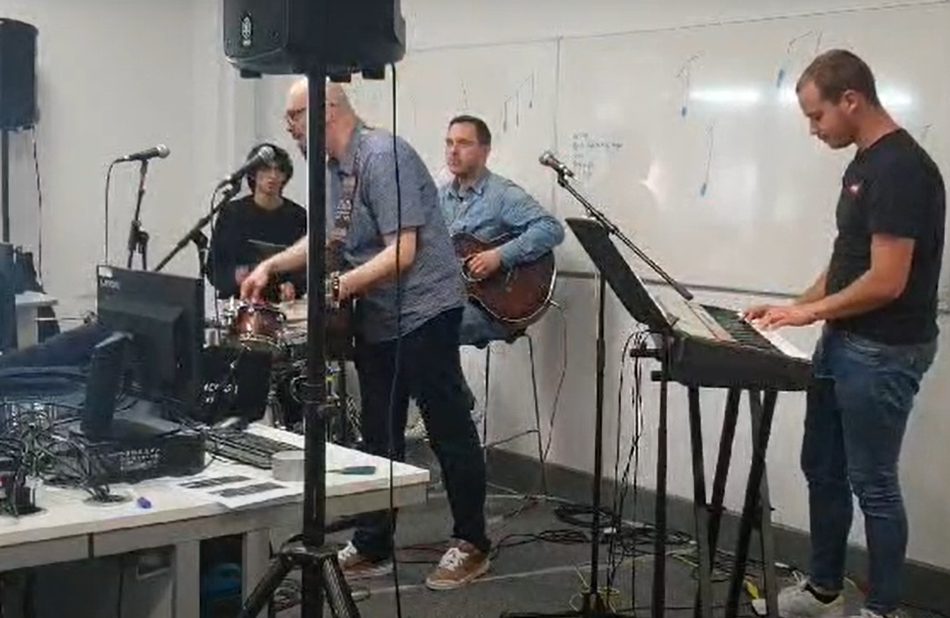
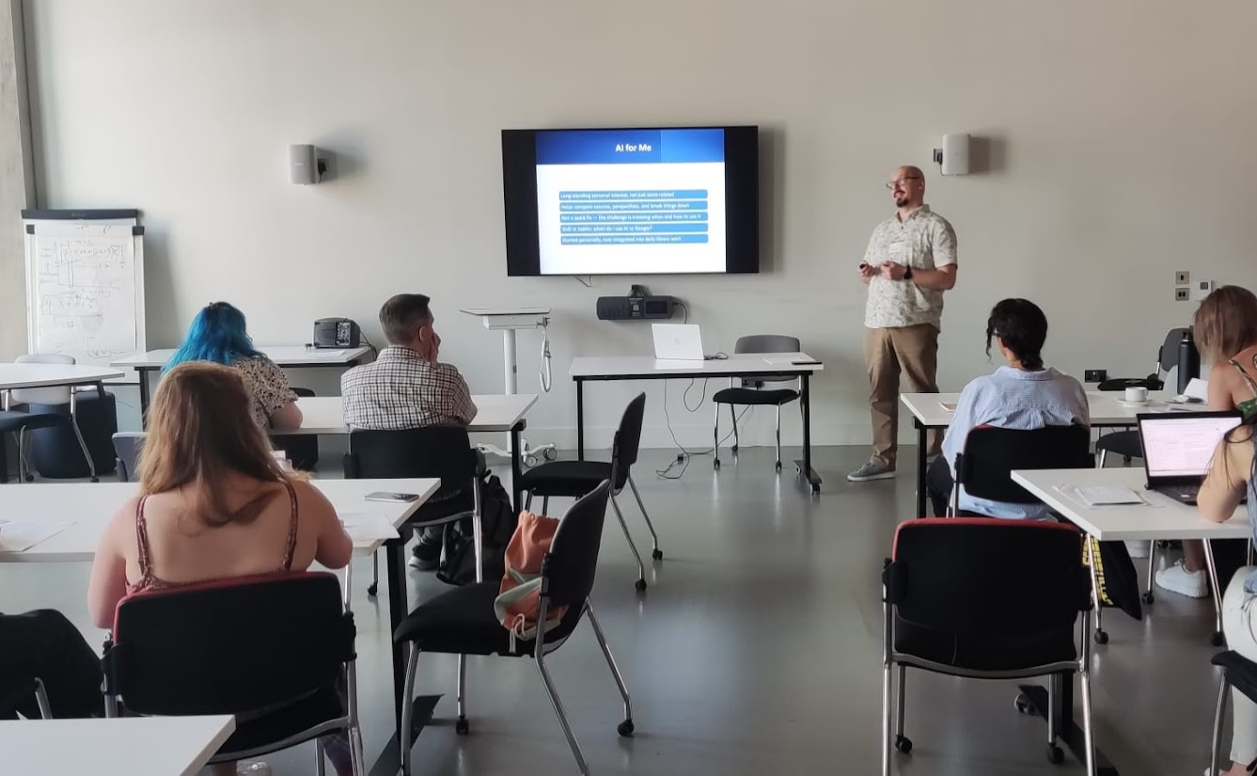
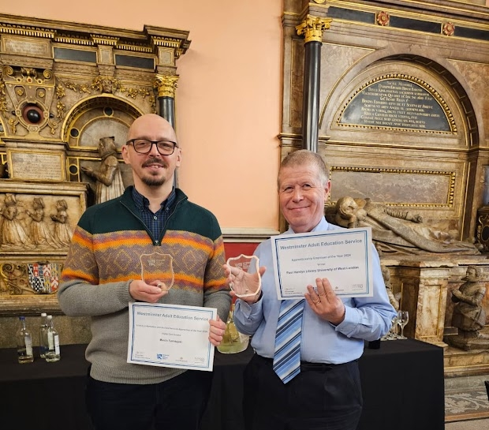
The Graduate Perspective – Marcin
Never Too Late: How I Found My Place in Libraries

Slide 6
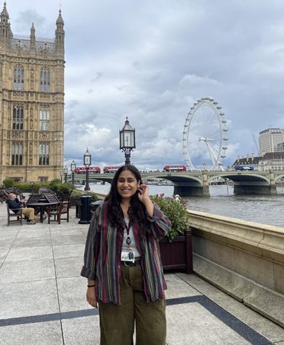
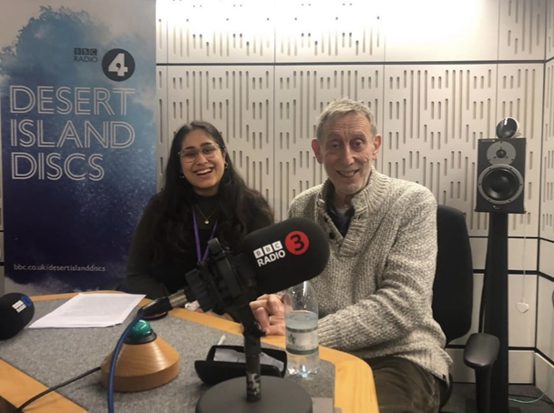
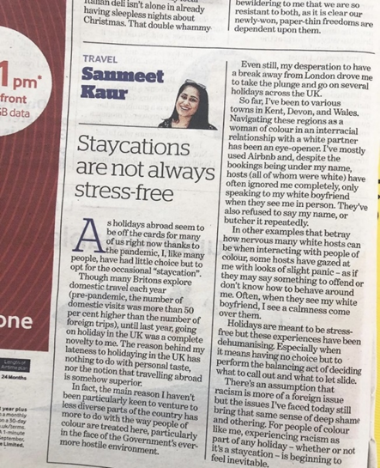
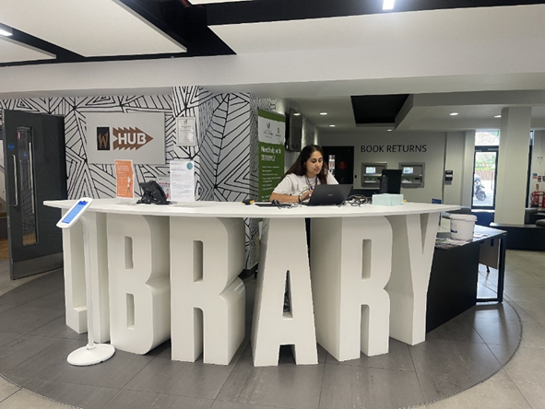

The Apprentice Perspective – Sanmeet
A New Chapter: My Journey from Politics to Libraries and Archives

