Slide 1

ARTIFICIAL INTELLIGENCE AND PERCEPTIONS
The student, the teacher and the librarian
Image taken from https://www.simplilearn.com/tutorials/artificial-intelligence-tutorial
May 2025
Dr. Janice Fernandes
Academic Support Manager
University of West London
janice.fernandes@uwl.ac.uk

Slide 2
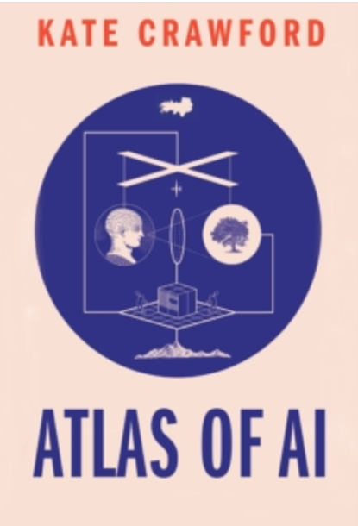
What is Artificial Intelligence
ARTIFICIAL
Made by human beings, not occurring naturally
INTELLIGENCE
Ability to acquire and use knowledge and skills
Current AI is
neither
Artificial nor Intelligent
Application of statistical analysis tools
Growing set of machine learning techniques
Notes:
Reference to the source of information used in your research. When you directly quote, paraphrase or summarize the essential elements of someone else's idea in your work, it is followed by an in-text citation.

Slide 3
Some AI tools available today
TEXT | IMAGES | VIDEOS | RESEARCH | TRANSLATION
ChatGPT | Leonardo | Synthesia ai | Consensus | Deep L
Quillbot | Getimg.ai | Canva | Scispace | Reverso
Perplexity | Gooeyimages.ai | Invideo ai | Semantic scholar | Wordvice.AI
Grammarly | Dalle-E | Flexclip | Iris AI | Google translate
Rytr | Midjourney | Animaker | Scite | Babylon
Jasper | Picsart | Steve AI | Jenni ai | Microsoft translate
Copilot | Craiyon | Videoleap | Evernote | Linguee
Notes:
Gemini is an AI chatbot from Google AI that can be used for a variety of research tasks, including finding information, summarizing texts, and generating creative text formats. It can be used for both primary and secondary research and it is great for creating content.

Slide 4


Students Perception of AI Tools
Perception 1: Why do I need to waste time sitting through a boring lecture when AI can do my assignment for me?
Perception 2: You have no idea how good I am at using AI tools; No professor or software could ever pick up on it !
Perception 3: Why do I need to learn citations and referencing when AI will do it for me?

Slide 5
Why these perceptions among students
Might have predominantly used Google for searching and finding information
Might not have been introduced to information literacy
Might not be aware of academic ethics and referencing
Might be time-bound, mature learners, digital literacy
Might be an international student, a non-English speaker
Might have low confidence in themselves as academic writers
Might be neuro-divergent, have anxiety, might not understand the assignment, might look for an easy way out
Curiosity, dependence, peer pressure

Slide 6
Do students really use AI for academic research?
66% | 54% | 36% | 53%
Use AI to explain concepts | Use AI to suggest ideas | Use AI mainly as a private tutor | Use Generative AI for assessments
35% | 22% | 63% | 65%
Unaware that AI produces false information | Are satisfied with AI support | Consider their institution has a clear AI policy | Think their institution can detect AI-generated work
Freeman, J. (2024). ‘Provide or punish? Students’ views on generative AI in higher education’, HEPI Policy Note 51. Available at: https://www.hepi.ac.uk/wp-content/uploads/2024/01/HEPI-Policy-Note-51.pdf

Slide 7
What students think about AI Tools
A uni student considered AI as “a top student” in their class, because “When I have doubt and couldn’t find other people to help me out, ChatGPT seems like a good option.”
AI can “help polish articles” and provide personalized feedback for written texts
I believe that the use of ChatGPT will reduce teachers’ workload for answering questions.
“It follows a general revolution of technology, similar to the public use of computers 40 years ago.
Chan, C.K.Y., Hu, W. Students’ voices on generative AI: perceptions, benefits, and challenges in higher education. Int J Educ Technol High Educ 20, 43 (2023). https://doi.org/10.1186/s41239-023-00411-8

Slide 8
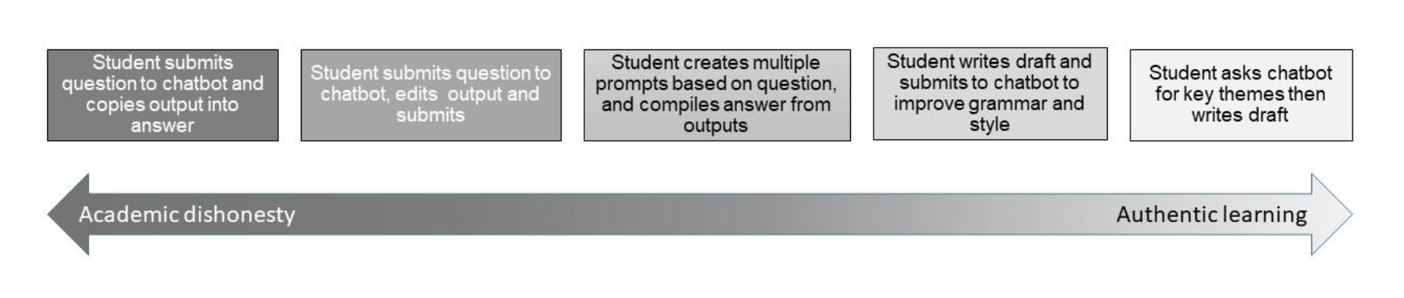

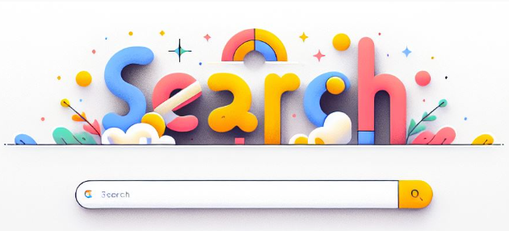
Student perceptions and academic integrity
Student perspectives on learning and working in the era of AI | Advance HE
AI and academic integrity
Image created by ChatGPT 27/4/2025
Image created by Co-pilot 27/4/2025

Slide 9
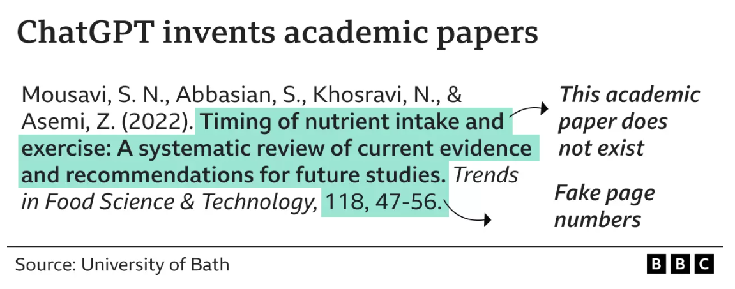
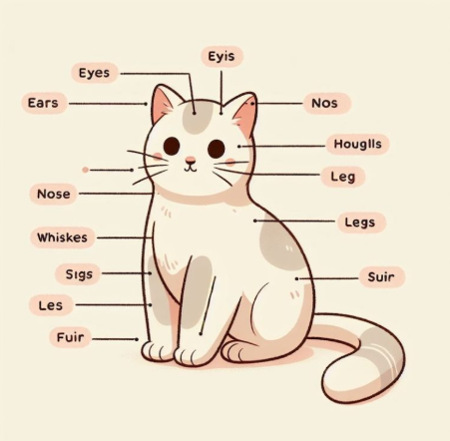
What can be done about it ?
Introduce AI tools in a gentle but correct way
Explain the advantages and disadvantages through examples and case studies
Explain about hallucinations, bias, and data privacy
Explain about critical thinking and evaluation of both the source and content of information
Talk about the university guidance on AI
mislabelled-cats

Slide 10
BA40103E - Employability Skills
The graduate employment market and emerging trends
Written assignment report - 1000 words , 30% weightage, 40% pass mark
RESULTS FROM CHATGPT
Remote work and flexibility
Technology and digital skills
Continued learning and adaptability
Green jobs and sustainability
Healthcare and biotechnology
Entrepreneurship and startups
Globalization and cross-cultural competence
Good set of points but very vague and repetitive, Old thoughts and probably everyone in the class has the same flow!
ARTIFICIAL INTELLIGENCE
LIBRARIAN

Slide 11

BA40103E - Employability Skills
The graduate employment market and emerging trends
Written assignment report - 1000 words
BEFORE YOU GET RESULTS FROM CHATGPT -
Look at the learning outcomes in the module study guide
Look at the assessment criteria
Look at the marking scheme
Think of the required flow of the document
Consider the statistical information required
Remember you will be submitting through Turnitin
Teach students that you don’t need AI for this - to think critically, to distinguish fake news and understand what is expected of you !

Slide 12

Have you heard of the following AI lingua
Tortured phrase - AI generated text modified to avoid plagiarism detection software.
Bot-tastic - When an AI performs exceptionally well
Robo-babble - When an AI generates nonsensical or overly technical responses.
Artificial Ignorance - When an AI fails to understand something simple.

Slide 13


Teacher’s Perception of AI Tools
Perception 1: You should attend lectures and engage with the teacher and classmates to build your knowledge base.
Perception 2: Academic Integrity underpins university education; No matter how you use AI to write an assignment, your teacher will always know !
Perception 3: Dissemination of research results relies on impact factors and visibility; strengthened by literature review, publishing, and speaking at conferences, which AI cannot do!

Slide 14
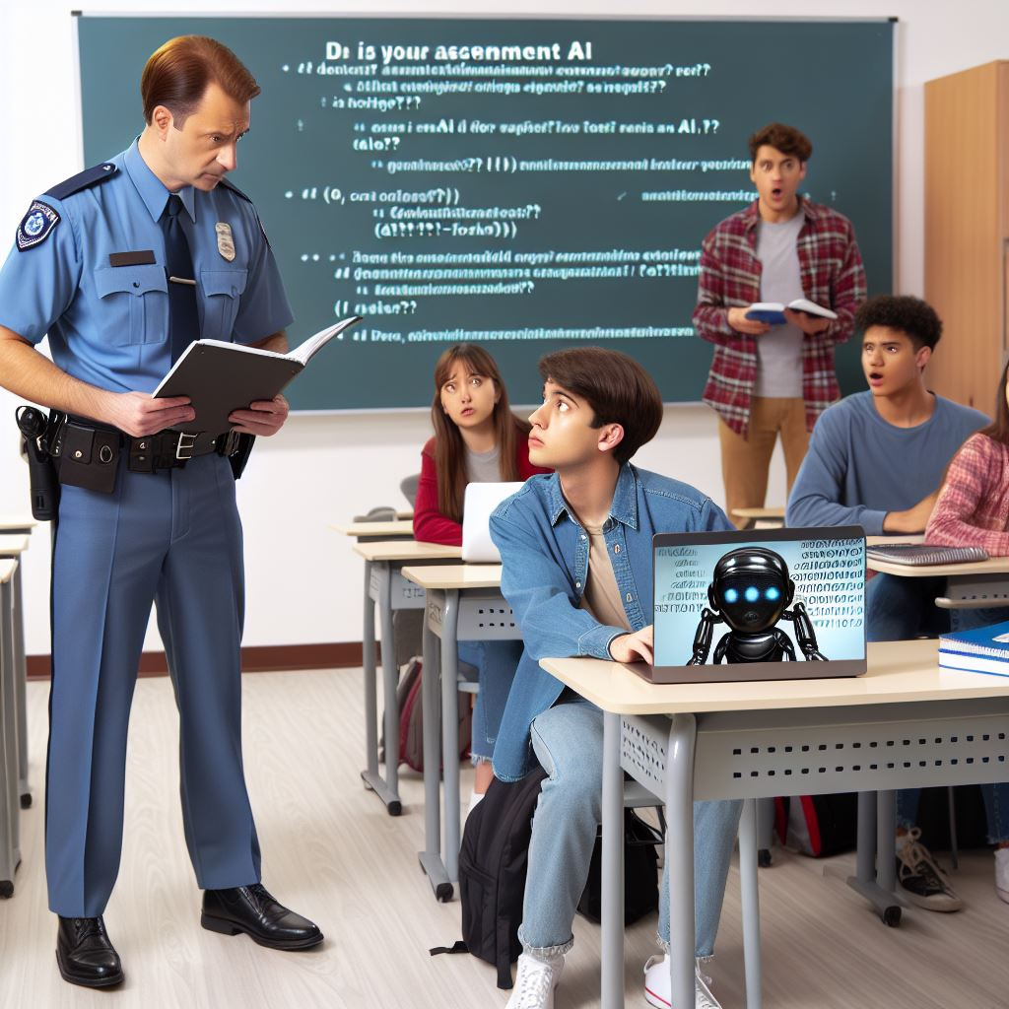
What are teachers worried about ?
Concern about Integrity | Threat to academic honesty and authentic learning; unfair advantage to some students
Frustration over detection | Students using a series of AI tools to paraphrase and re-paraphrase
Loss of skills | Overusing AI might lead to a generational decline in critical thinking and academic writing abilities.
Divided opinions | Some teachers strictly oppose AI Some teachers think students must learn to use AI tools Some teachers are still confused about right or wrong
Need for clear policies | No standardization across universities for AI policies or guidance

Slide 15
How can academics prevent plagiarism by AI?
Education - plagiarism , clear guidelines for use of AI tools
Assignments - interesting, encouraging originality and creativity; journaling, practice research, and autoethnography
Drafts – hand in for review before the final submission
Assessment - open-ended demonstrating critical thinking, problem-solving, and communication skills
Rubric - evaluate the quality of the student work checking for learning and the student’s grasp of the knowledge base
Quantity v/s Quality

Slide 16
Some challenges that academics face
How can I differentiate between student-written assignments, AI-modified assignments and AI-generated assignments?
Does the use of AI in assignments have the potential to influence the marking process?
Will this lead to assessment bias in the long run?
Will it be easier to detect AI in assignments as time goes by?
Will the novelty of using AI in assignments fade away or will it be replaced by something newer?
Is the Assignment and the Assessment
a test
for the student or the teacher ?
The impact of AI on academic integrity - British Journal of Educational Technology

Slide 17

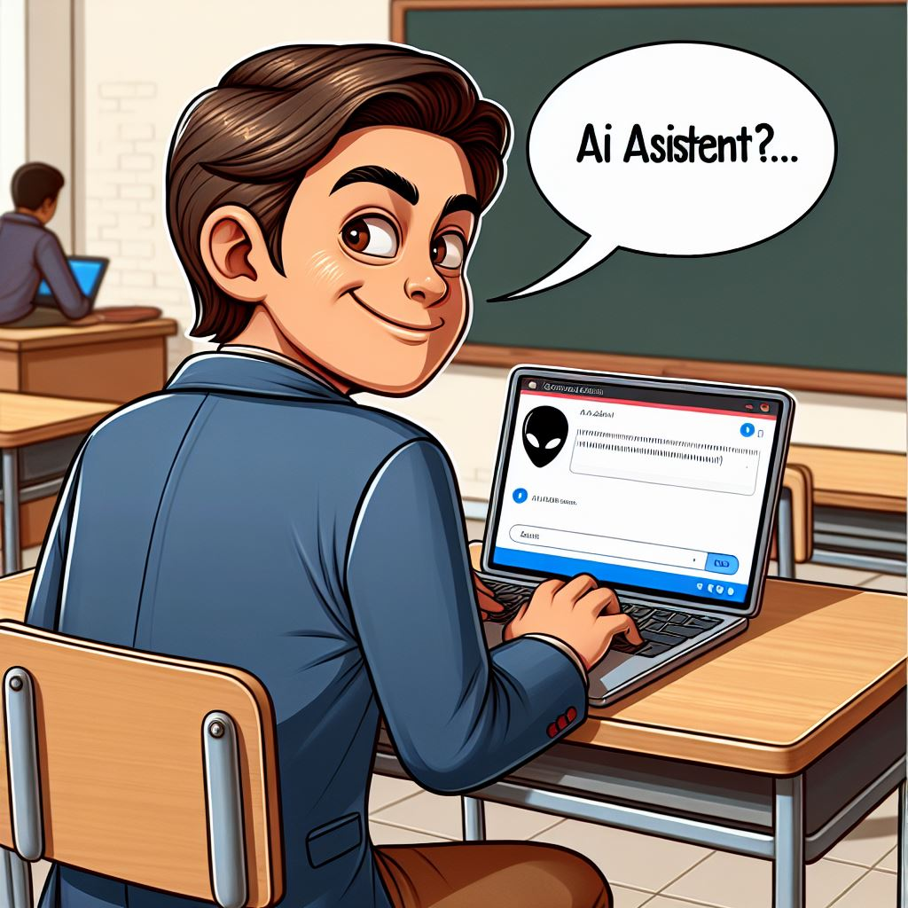
Librarian’s Perception of AI Tools
Perception 1: AI tools will come and go, librarianship has a solid foundation of knowledge support and exchange.
Perception 2: As a librarian, I don’t need to learn about AI; it’s not in my job description.
Perception 3: AI is unethical and incorrect ; we should not encourage its use.

Slide 18
What the academic librarian can do
LEARN
Why students use them and how they use them
Talk to students
Talk to colleagues
Attend webinars and workshops - LILAC
CILIP AI Coffee morning
Myspace library
TEACH
Students to use them effectively and ethically
AI Literacy
Hands-on workshops
Referencing it correctly
Demonstrate AI tools
Grammarly/Goblin Tools
DEVELOP
Guidelines, raise awareness and collaborate with others
AI libguides
Workshops / Role play
Sharing best practices
CPD
Similarity detector

Slide 19
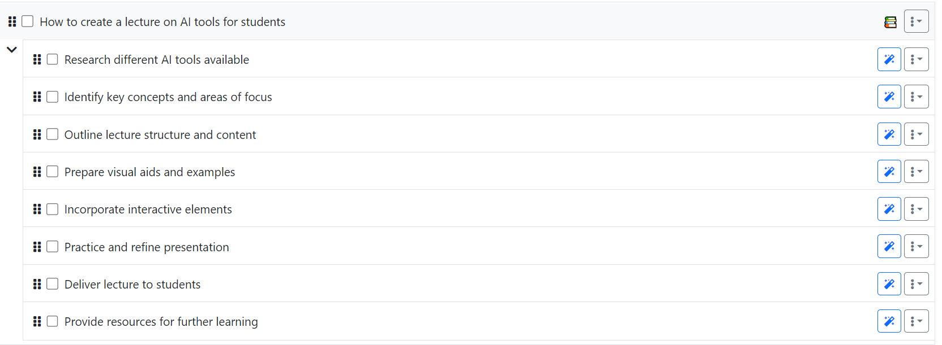
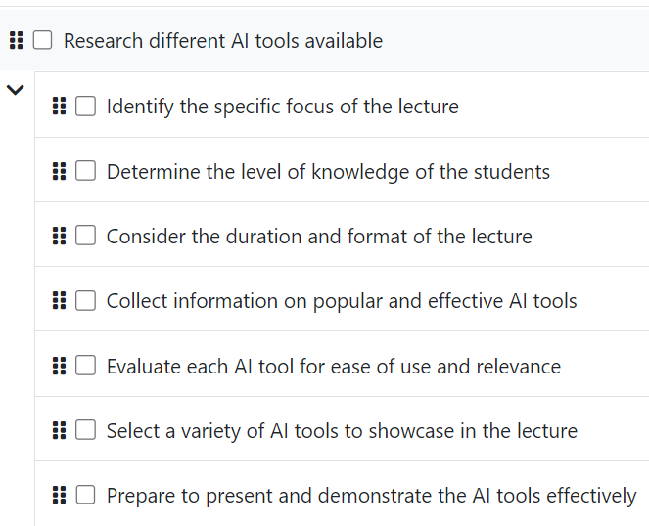
Goblin Tools – MagicToDo

Slide 20
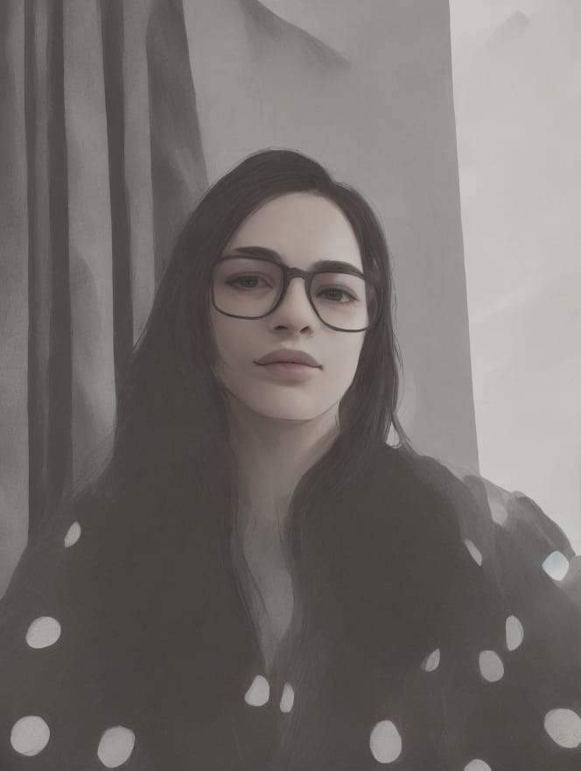

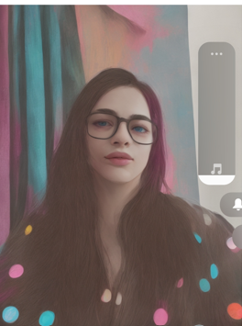


WHICH ONE OF THESE IS THE REAL “YOU”?
This is the question that your supervisor/examiner is constantly asking
THANK YOU
Images created by getimg.ai and gooey.ai
20

Slide 21
AI tools – some resources
https://www.economist.com/united-states/2024/02/28/is-googles-gemini-chatbot-woke-by-accident-or-design
https://academia.stackexchange.com
https://www.cilip.org.uk/news/661388/Can-AI-do-your-reading-for-you--should-it.htm
ChatGPT: Can students pass using AI tools at university? - BBC News
Schools ban ChatGPT AI tool, afraid students will cheat, plagiarize (usatoday.com)
ChatGPT's creators launch second tool to help teachers detect plagiarism (usatoday.com)
https://www.elsevier.com/products/scopus/scopus-ai
https://www.sciencedirect.com/AI and AI
https://www.sheffield.ac.uk/saas/elevate/ai-principles Acknowledge , Describe ,Evidence Template https://docs.google.com/document/d/1UXBBKWMJ4oIcsXtigETU0L82I2DHFBZy3bFxGajVrbQ/copy
https://www.nottingham.ac.uk/currentstudents/news/using-artificial-intelligence-in-your-studies
https://www.leedsbeckett.ac.uk/student-information/academic-skills-and-advice/academic-integrity/
What does it mean if students think that AI is more intelligent than they are? | Wonkhe
College Students Want Their Money Back After Professor Caught Using ChatGPT - Newsweek

