Slide 1
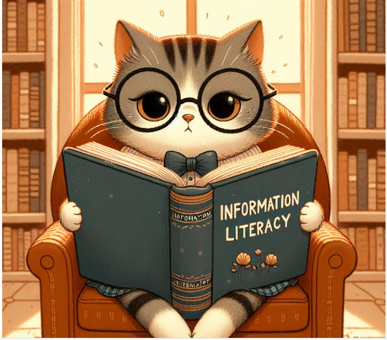
THE BEST TEACHING SESSION Information Literacy through Engagement, Empowerment, Value and Impact
Dr. Janice Fernandes
Academic Support Manager
University of West London
June 2025
Image from Copilot through a detailed prompt

Slide 2
What do we mean by Information
AN ANSWER
What is Deepseek?
A FACT
Blended learning has become more significant after the pandemic
AN OPINION
Changing immigration rules causes instability to the country’s economy
A VIEWPOINT
I think countries in the Asian sub-continent have deep-rooted cultural traditions
Notes:
The value of information literacy in five key contexts:
• Everyday – when people find information online
• Citizenship – helping people to understand the world around us
• Education – developing critical thinking skills at all stages of education, from school to higher education
• The workplace - Contributing to employability
• Health – finding reliable sources of health information

Slide 3
What is Information Literacy?
Recognise the need for information
Identify what information is needed
Find that information
Evaluate information critically for credibility
Use that information ethically
A critical skill set in the digital age and the era of fake news.
Image from https://wjccschools.org/jhs/library/information-literacy/

Slide 4
What is Information Literacy
“Information literacy is the ability to think critically and make balanced judgements about any information we find and use. It empowers us as citizens to develop informed views and to engage fully with society.”
Chartered Institution of Library and Information Professionals.
Information Literacy is essential in these 5 contexts of life
DAILY NEEDS
EDUCATION
WORKPLACE
HEALTH
CITIZENS
Notes:
The value of information literacy in five key contexts:
• Everyday – when people find information online
• Citizenship – helping people to understand the world around us
• Education – developing critical thinking skills at all stages of education, from school to higher education
• The workplace - Contributing to employability
• Health – finding reliable sources of health information

Slide 5
The 5 components of information literacy
IDENTIFY
Need for information; changing information
FIND
Search strategies, tools, techniques, engines
EVALUATE
Currency, Relevance, Authority, Accuracy, Purpose
APPLY
Use effectively, analyse and present appropriately
ACKNOWLEDGE
Ethical use, copyright , referencing, plagiarism
Notes:
The value of information literacy in five key contexts:
• Everyday – when people find information online
• Citizenship – helping people to understand the world around us
• Education – developing critical thinking skills at all stages of education, from school to higher education
• The workplace - Contributing to employability
• Health – finding reliable sources of health information

Slide 6
What is Critical Information Literacy
Information Literacy is essential in these 5 contexts of life
DAILY NEEDS
EDUCATION
WORKPLACE
HEALTH
CITIZENS
Notes:
The value of information literacy in five key contexts:
• Everyday – when people find information online
• Citizenship – helping people to understand the world around us
• Education – developing critical thinking skills at all stages of education, from school to higher education
• The workplace - Contributing to employability
• Health – finding reliable sources of health information

Slide 7
Information Literacy through Engagement
Active learning techniques, quiz and polls (inclusive)
Large classroom teaching – interactive case studies, worksheets, handouts (diverse learners)
Small group teaching – individual reflection and Q&A
Digital training – Exercises in the use of Libsearch, databases, referencing etc.
Watching instructional videos followed by Q&A
Online sessions – ask for feedback, queries in the chatbox, unmute and talk
1-2-1 sessions – observation, direct engagement

Slide 8
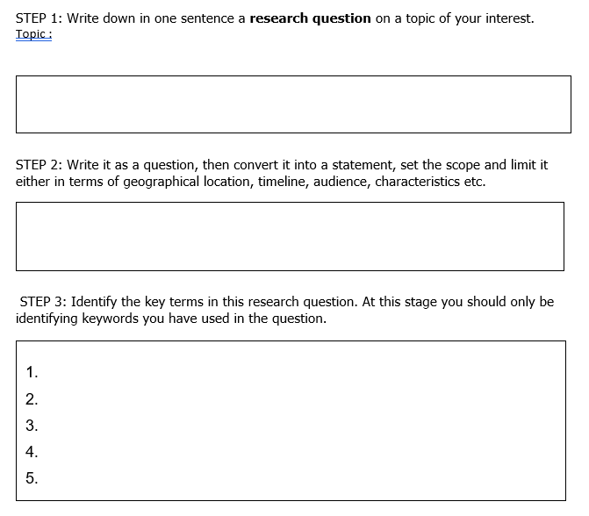
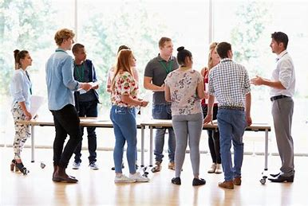
Some activities to engage learners
Debate on Referencing

Slide 9
Information Literacy through Empowerment
Helping students become confident independent researchers
Examples – best option to travel from home to university
Examples – forwarding messages on WhatsApp (fake news?)
Examples – First 5 search results from Google (sponsored?)
Examples - question the power structures behind information production - Who creates knowledge? Whose voices are included or excluded?
Examples – using diverse and inclusive sources (black music, deaf actors, )
AI tools – hallucination, bias and data privacy

Slide 10
Teaching students about skills for life
Create an image of a watch showing 3:25 pm
Create an image of an Academic Support Manager
Create an image of a Manager
Microsoft collects data from you, through our interactions with you and through our products.

Slide 11
Teaching students to ask the right questions
Chen, Y., & Alvarez, M. (2019). Mitochondrial RNA editing and its role in cellular aging. Journal of Molecular Biosciences, 28(4), 455–468. https://doi.org/10.1016/j.jmbs.2019.04.007
How to spot a hallucination
Journal Name - Journal of Molecular Biosciences sounds credible but does not exist on ScienceDirect.
DOI - The DOI format looks realistic but does not go anywhere when pasted into a web browser
Topic - Mitochondrial RNA editing and aging is a credible research topic but paste the title in Google Scholar/Libsearch and check
Authors - Common names don’t seem suspicious but check if the authors have written more about the topic (famed authors generally do)

Slide 12
Information Literacy through Value
Understanding the need for acknowledgement and referencing
Understanding research ethics, citations and impact factors
Understanding Intellectual Property Rights / Copyright
Understanding the evaluation of the source and content of information
Understanding misinformation (no intention to deceive) and disinformation (intention to deceive)
Shifting the focus from assignments to real life
Framework for Information Literacy for Higher Education | Association of College and Research Libraries

Slide 13
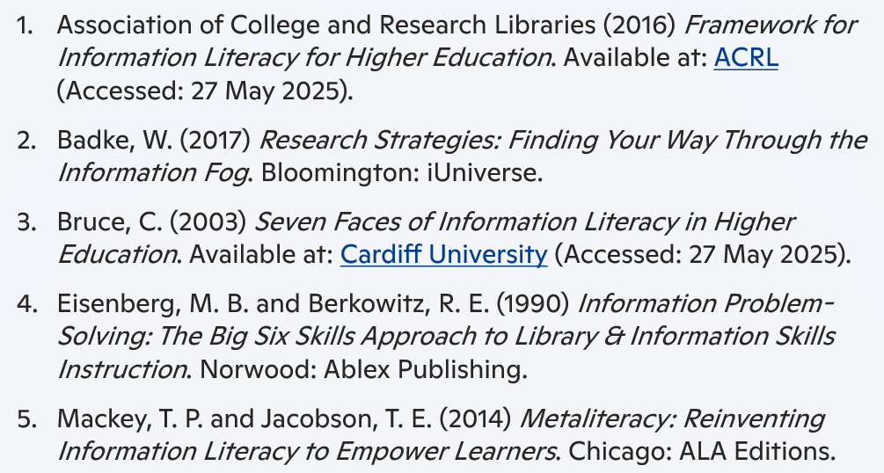
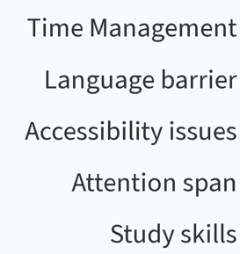
Why attend an Information Literacy session ?
Notes:
Magazines
Magazines publish articles on topics of popular interest and current events. The articles are written by journalists and are for the general public.
Magazines, like journals and newspapers, are called "periodicals" because they are published at regular intervals throughout the year. You can find print magazines at newsstands and in libraries. Some are now available on the Web as electronic magazines.

Slide 14
Information Literacy through Impact
PDCA – Plan – Develop – Check – Action
Information literacy learning objectives
Information Literacy KPIs and achievement rates
Qualitative and quantitative research projects
Student accolades / messages from academics
CPD / best practices/ conferences
Be informed - AI, ChatGPT, Sustainable libraries, Chatbots
Impact demonstrates the value of librarianship

Slide 15
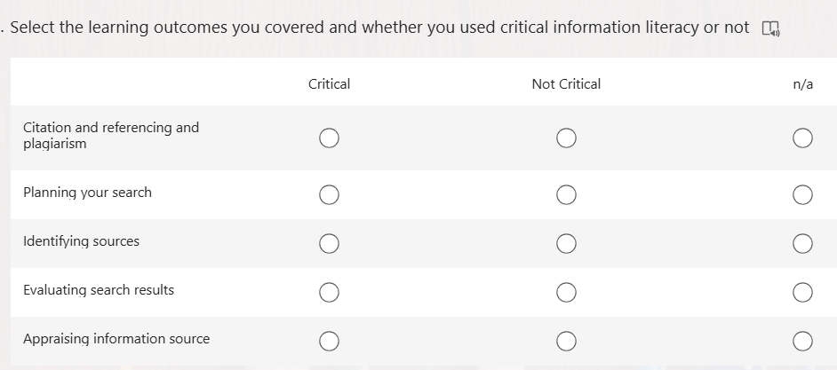
At the end of every IL teaching session
Subject librarians complete an IL KPI form

Slide 16
Demonstrate the impact of your teaching
https://repository.uwl.ac.uk/id/eprint/12339

Slide 17
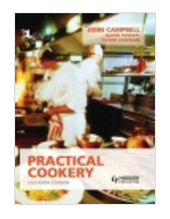
Cookery books and Food swap among friends
Travel the world – just by reading a book
These are available on the second floor of the library , with DDC numbers starting with 641 and 647

Slide 18
The User at the centre of every conversation
Engagement
Empowerment
Value
Impact
Subject Librarianship
Academic Integrity
Budgets & Funding
Artificial Intelligence
Recruitment
Research methodology
http://dx.doi.org/10.11645/15.1.2846

Slide 19
Create your OWN value and Impact
LEARN BY
Chat with students
Liaison with academics
Talk to peers
Be a mentee
Ask questions at webinars
Sign up for workshops
Shut up and write
TEACH OTHERS
Be the AI champion
Speak in IL forums
Be a mentor /buddy
Inclusive collections
Skill building workshops
Research publications
Grammarly/Goblin Tools
DEVELOP THROUGH
Creating Guidelines
Raising awareness
Collaborating with others
Reflective practice
Research projects / funding
Gamification
CPD

Slide 20
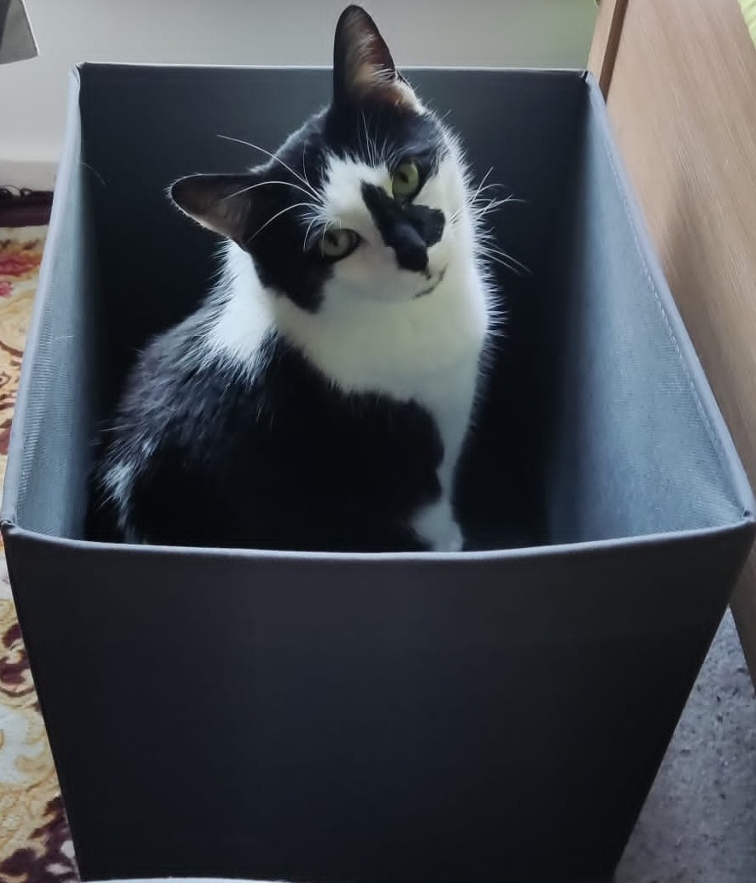
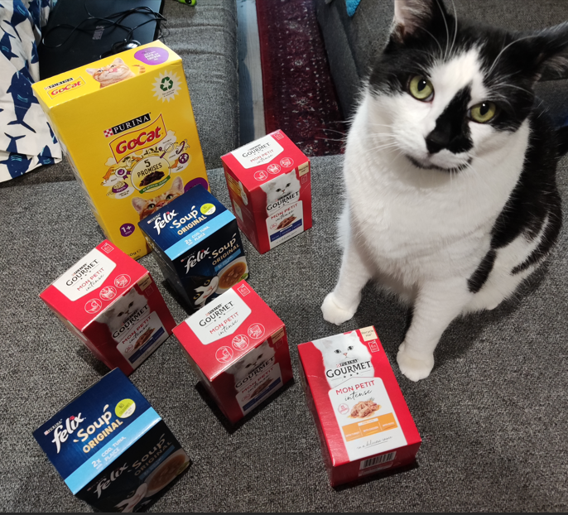
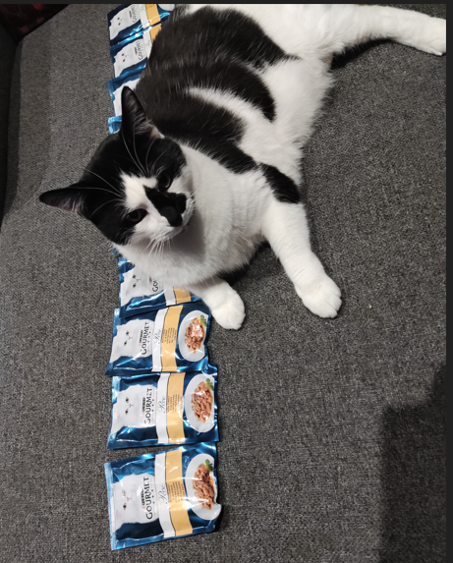
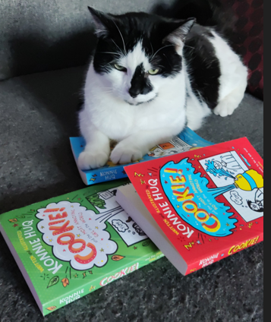
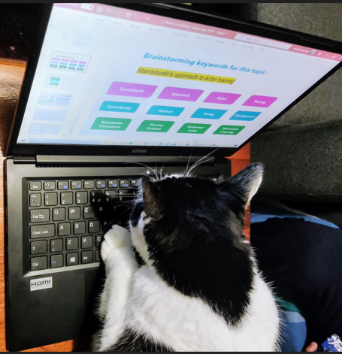
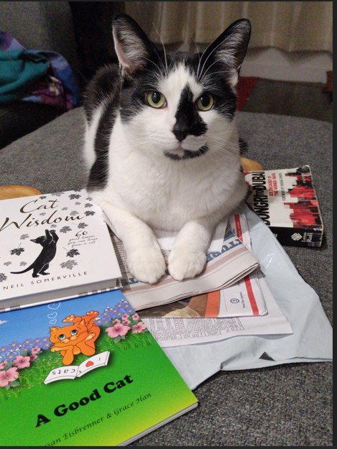
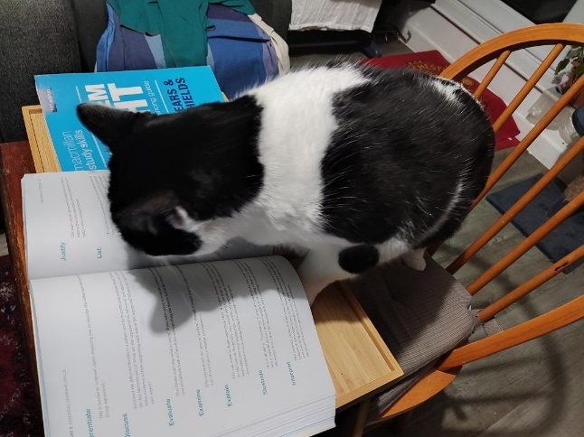
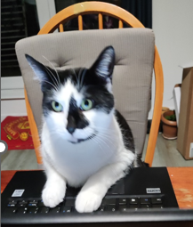
Every CAT tells a story !
The “How do I get out” Cat
The “Too much information” Cat
The “Can I use this resource” Cat
The “Information Literacy” Cat
The “Referencing ” Cat
The “I submitted my assignment” Cat

Slide 21
Thank you for giving me the opportunity to present here today. Please feel free to get in touch for more innovative ideas… Happy to help !

