Slide 1

M25 Diversity group

Slide 2
Workshop rules
Listen respectfully to each other
Ask questions where you are not sure about something
Give space for others to consider issues and ask follow up questions
Offer different viewpoints in a constructive and supportive manner
Any discussions / ideas raised in the workshop will be shared without identifying the person
If you need to leave at any stage, that is absolutely fine.
If you would prefer to just listen, that is absolutely fine as well.

Slide 3
Workshop
Welcome from the group and some background
Highlights from the 2024 M25 diversity survey
What does diversity mean to you?
How do we get from here to there?
What should the group prioritise in the next 12 months?

Slide 4

The M25 Diversity Group
Formed in 2019.
Membership open to any member of the consortium.
Meets every couple of months online.

Slide 5
Key responsibilities:
Share guidance and recommendations on best practice for fostering EDI within libraries in the M25 consortium.
1
Explore pathways to support the recruitment and progression of marginalised groups.
2
Amplify marginalised voices via events and sharing of case studies.
3
Regularly gather information from member institutions on EDI initiatives, working collectively to survey member institutions, analyse responses and disseminate.
4
Provide a platform/space to facilitate respectful and meaningful approaches to starting conversations about diversity.
5
Regularly review sector information on the most appropriate terminology.
6

Slide 6
Members
Cliff Van Dort
Erika Delbecque
Debbie Phillips
Anna Semmens
Katie Winter
Davina Omar
Caroline Marwein
Matt Barrow

Slide 7
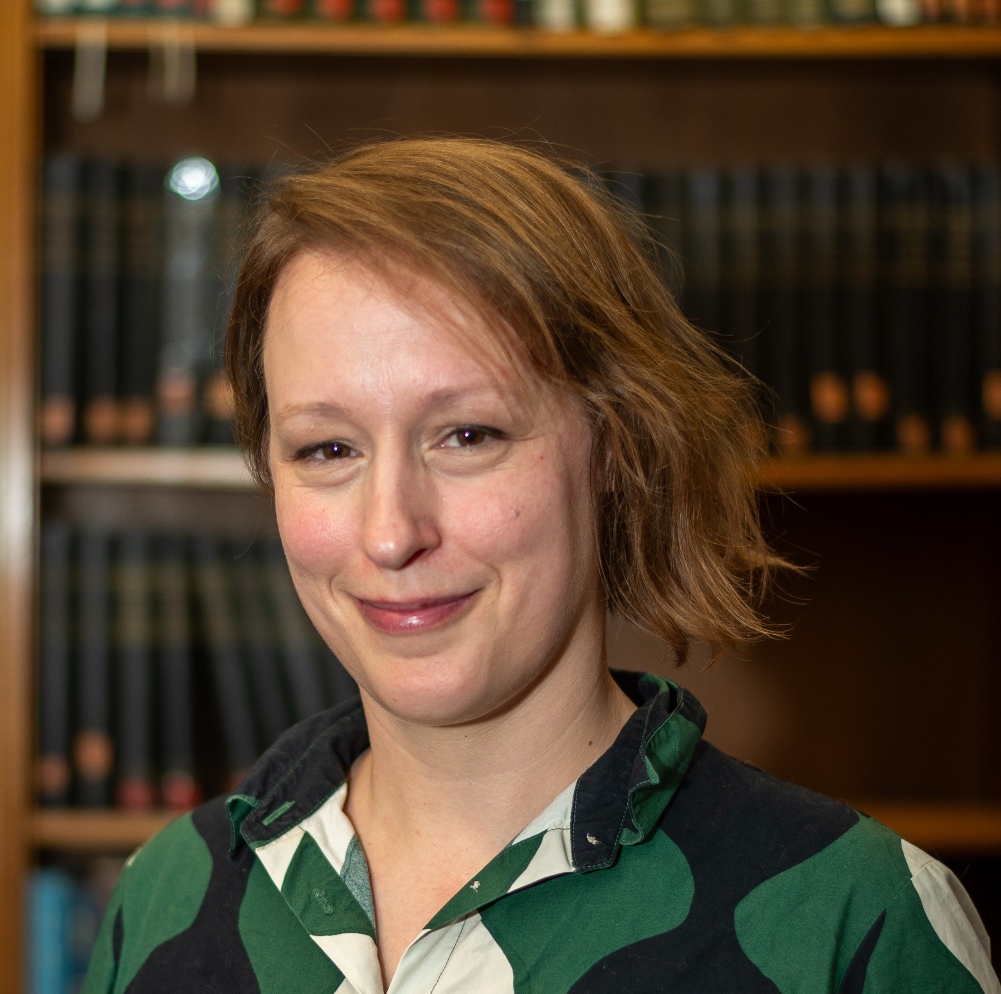
Erika Delbecque
Head of Rare Books and Academic Liaison at UCL
I joined the group because I am passionate about nurturing inclusive working environments and encouraging more diversity within the library sector
To me, diversity means that a range of backgrounds and lived experiences are welcomed and that everyone can be their authentic self at work

Slide 8
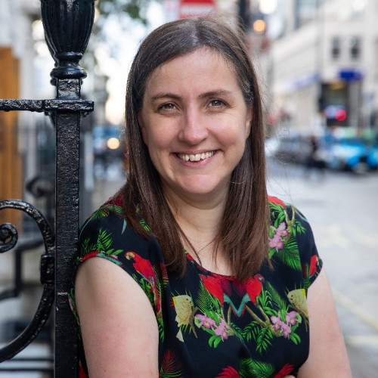
Anna Semmens
Director of Library Service Queen Mary University of London.
I joined the group as I’m interested and passionate and I wanted to be active in following the Black Lives Matter movement. As someone from a nation like New Zealand which was colonised and has a strong indigenous rights movement and strong Pacifica identity, I hoped I would bring a different perspective that would be useful.
Diversity to me means respecting, understanding and celebrating (that last one is very important) our similarities and differences, and finding ways of working together in ways whereby everyone is heard and seen.

Slide 9
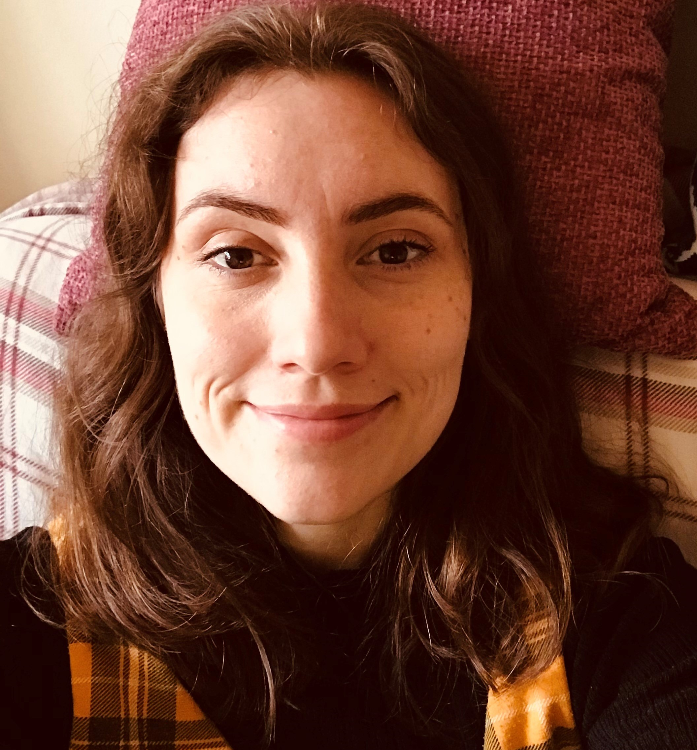
Katie Winter
Learning Development Librarian
University of Surrey
I joined the M25 Diversity Group in 2019 (when it first started) to learn about the EDI initiatives being undertaken by colleagues in other libraries and to share what I was working on.
I think diversity, alongside equity and inclusion (EDI), should form the foundation of our work as librarians to ensure everyone is welcomed, included and represented.

Slide 10
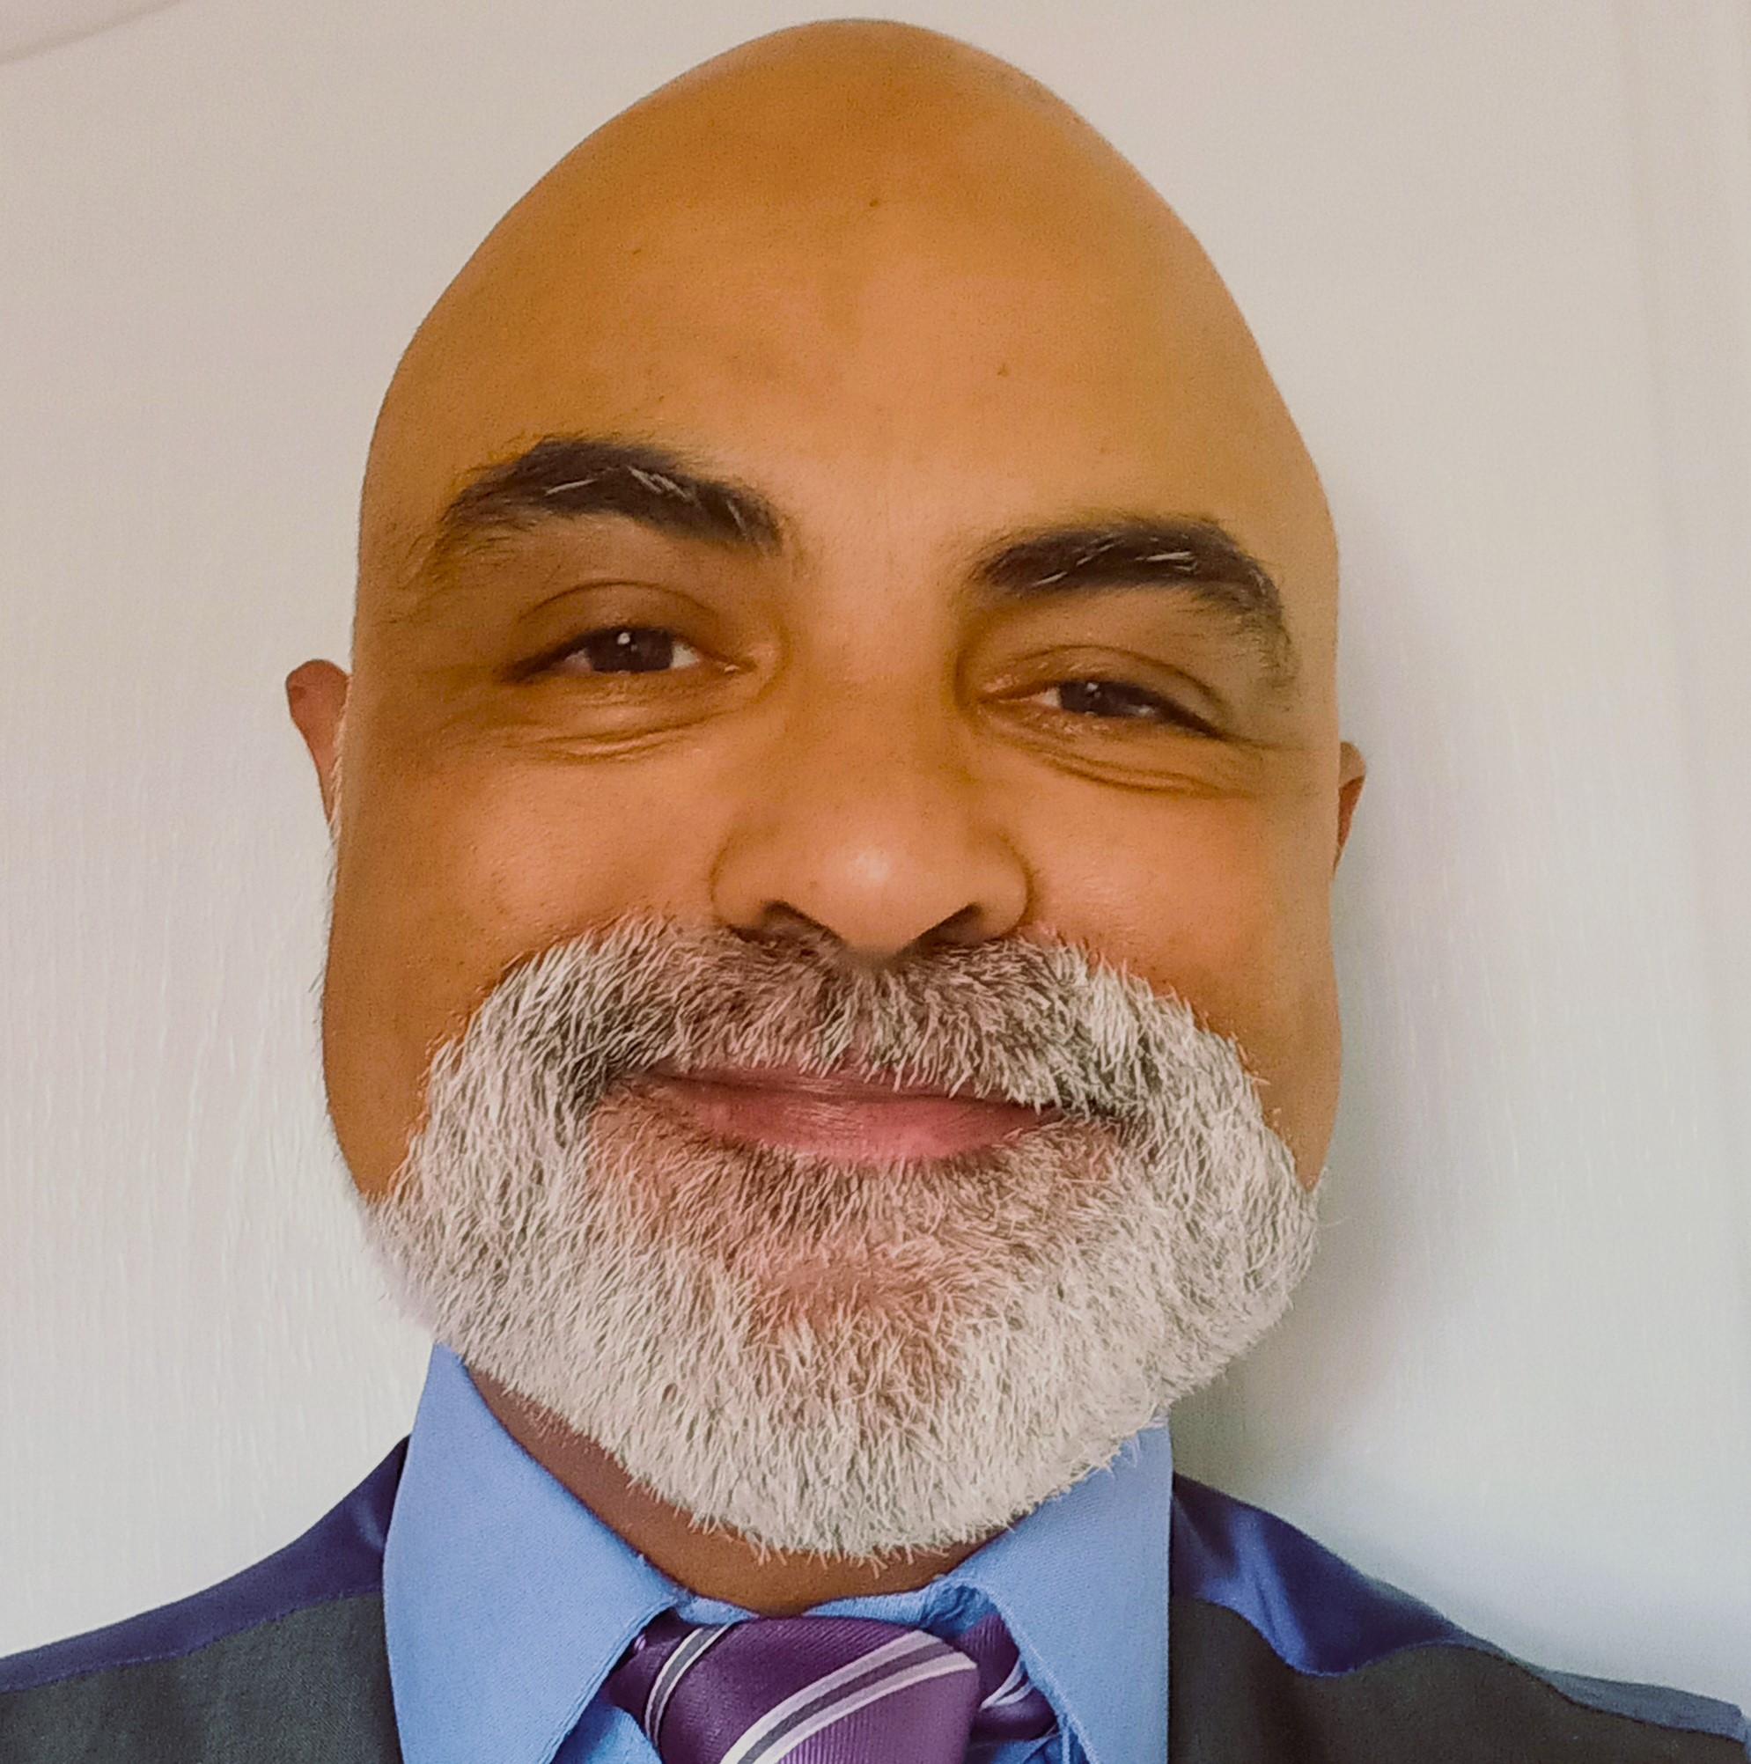
Cliff Van Dort
Head of Library at The National Archives
I joined the group in 2019 following a call for members particularly those from minority groups and to be more proactive in EDI, to learn more and encourage others
Diversity to me means working and socializing with people from all backgrounds, learning from them and sharing experiences to enable me to become a better person.

Slide 11
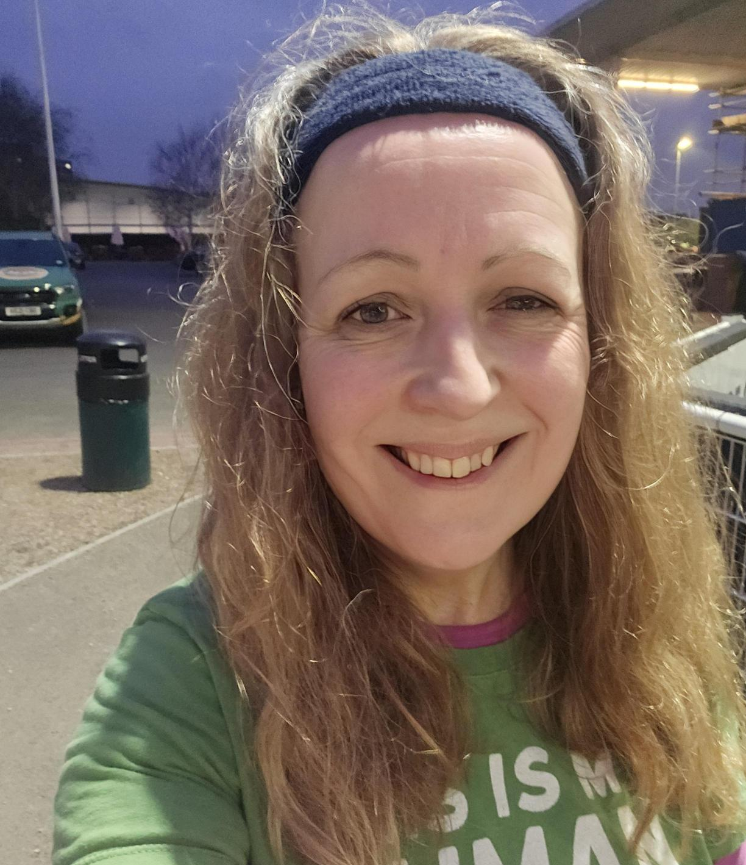
Davina Omar
Director of Library Services at the University of West London
I joined the group a few years ago because I wanted to learn from others, help share good ideas and help wherever I could.
Diversity to me is ensuring that we all feel valued, all voices are heard and we support each other and learn from each other.

Slide 12

2024 diversity survey
41 individuals coming from 17 institutions (31% of the membership).
21 questions framed around networks/support, recruitment and training.
Respondents could identify with multiple underrepresented groups in the profession. 10 respondents (24%) didn’t identify with any groups listed, 10 (24%) with a single group and 20 respondents (49%) identified with multiple options.
  working class background (31%)
  LGBTQ+ (18%)
  disability (15%)
  neurodivergent (15%)
  global majority (6%).

Slide 13
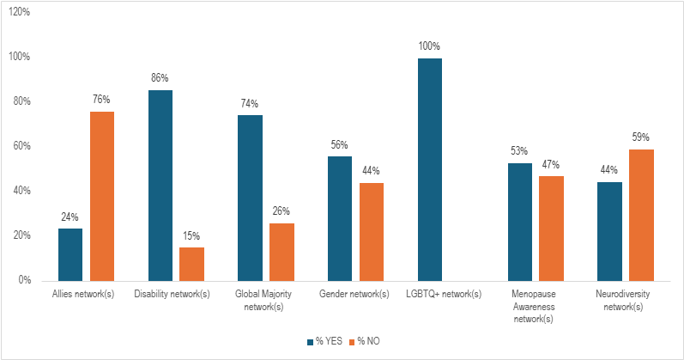
Which of the following EDI staff networks does your library or institution have?

Slide 14
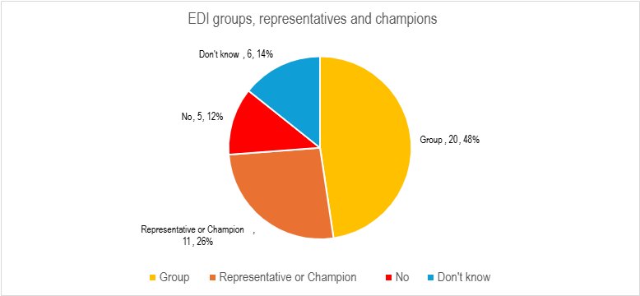
Within your library is there an EDI group, representative or champion?

Slide 15
Recruitment questions
Recruitment
Guidelines or rules regarding inclusive job descriptions | 83%
Guidelines or rules regarding diversity in interview panel members | 79%
Anonymous recruitment | 79%
Sending out some or all questions in advance of the interview | 54%
Hiring or interview quota for candidates with protected characteristics | 39%
Protected roles for Global Majority candidates | 15%

Slide 16
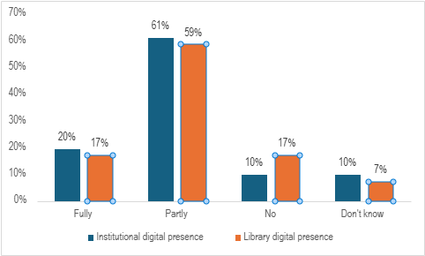
Do you feel the digital presence (including social media and website) caters to and engages with the diversity of the institution's population?

Slide 17
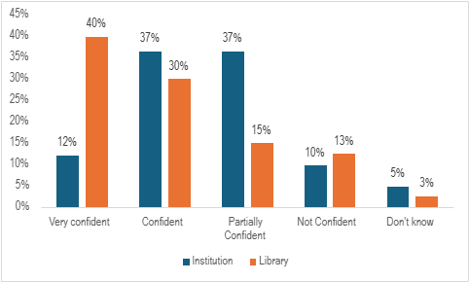
How confident are you that issues of equity, diversity and inclusion raised will be dealt with appropriately?

Slide 18
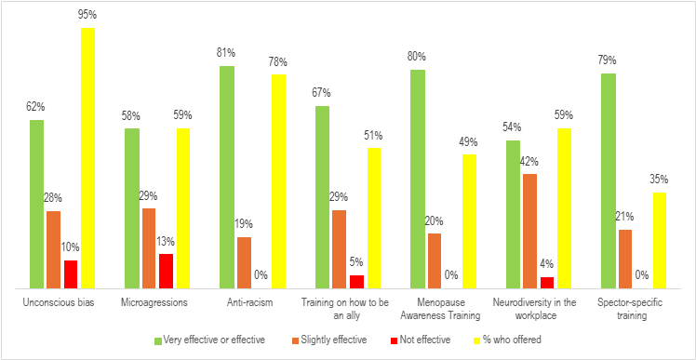
Training

Slide 19
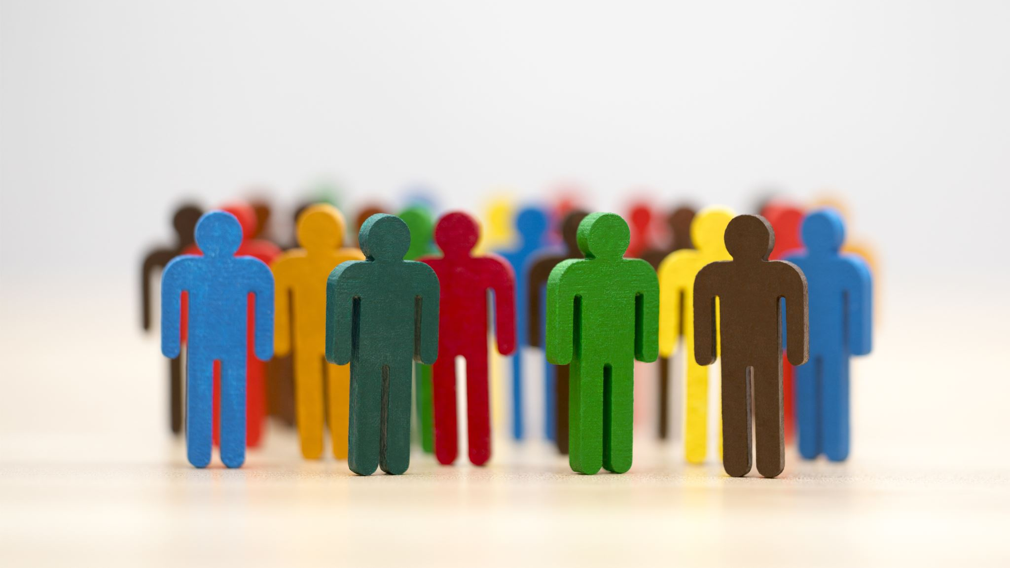
What does diversity mean to you?

Slide 20
Do we have a shared understanding of what we mean?
Equality
Equity
Diversity
Inclusion

Slide 21
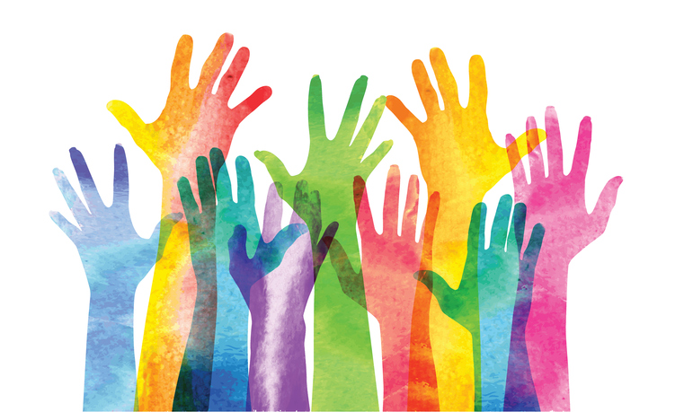

How do we get from here to there?
This Photo by Unknown Author is licensed under CC BY-NC

Slide 22
Recommendations from the report
M25 Diversity group to investigate the possibility of setting up (external to institutions) support networks for groups across the consortium to provide a safe space for discussion and knowledge sharing.
M25 Diversity group to create a list of networks seen across the consortium, and where possible contact details, to allow institutions to share best practice and resources.
M25 Diversity group to collate and share good practice and lessons learned on inclusive recruitment practices.
Further investigation is needed in relation to what sector specific training is offered and needed within libraries. M25 Diversity group to collate and provide a list of training that has taken place, success stories and a list of trainers.

Slide 23
Recommendation continued
Networks for Allies are low across the board – Institutions should aim to review this to increase the number of allies, developing support and resources to enable numbers to be increased. The M25 Diversity group will reframe the question in the next survey to investigate how allies are part of existing networks
Libraries should review their policies and current digital presence to ensure EDI aspects and communities are represented and consider why the institution's site is considered to cater for and engage with the diversity of the institution’s population more.
Libraries should review the relationship and effectiveness of actions and policies relating to intersectionality, where individuals who identify with multiple underrepresented groups to see how confidence in actions taken can be improved / brought in line with confidence levels of individuals identifying with a single group or no groups.

