Slide 1
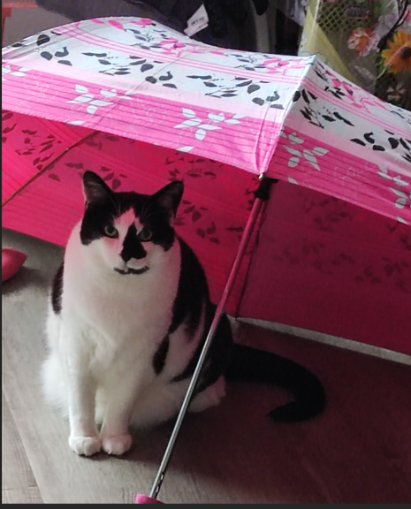
Student engagement in Librarianship My students and my Cat
Dr. Janice Fernandes
Academic Support Manager
University of West London
June 2025

Slide 2
How do students engage with the library … 1
Induction - Information overload ?
Library building - access, spaces and rules
Library resources - remote access, print/online, sufficient, relevant, current
Library facilities - Computers, furniture, quiet spaces, inclusivity

Slide 3
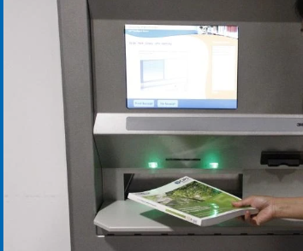
How do students engage with the library … 2
Library services - Opening times, floor maps, signage
Circulation Desk - Importance/ impact / value/ decision making
Information Literacy - knowledge transfer, academic integrity, supportive
1-2-1 sessions - direct engagement, anonymity

Slide 4
What is Information Literacy?
IDENTIFY
what information is needed
RECOGNISE
USE
the need for information
that information ethically
EVALUATE
FIND
that information critically
the required information
The librarian’s role – teacher, mentor, friend, pastor, cheer leader, carer, supporter, policeman, well-wisher.

Slide 5
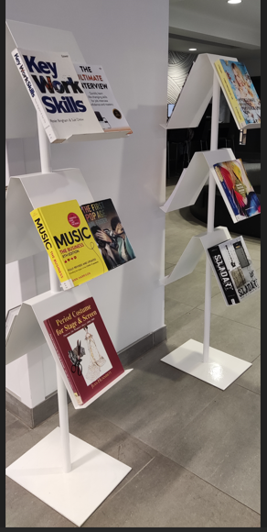
Information Literacy and student engagement
Active learning techniques, quiz and polls (inclusive)
Large classroom teaching – interactive case studies, worksheets, handouts (diverse learners)
Small group teaching – individual reflection and Q&A
Digital training – Exercises in the use of Libsearch, databases, referencing etc.
Watching instructional videos followed by Q&A
Online sessions – ask for feedback, queries in the chatbox, unmute and talk
1-2-1 sessions – observation, direct engagement

Slide 6
Tips and tricks to foster student engagement
Liaison with academics to understand the assignment
Enrolling onto the module to see the curriculum flow
Creating presentations where the second slide is the assignment question
Taking a few related books into the classroom
Creating a small inclusive bibliography
Co-create - suggestions for inclusive resources
Share experiences about managing your time, mental wellbeing and study buddy
Dive into it – like AI /using blogs

Slide 7
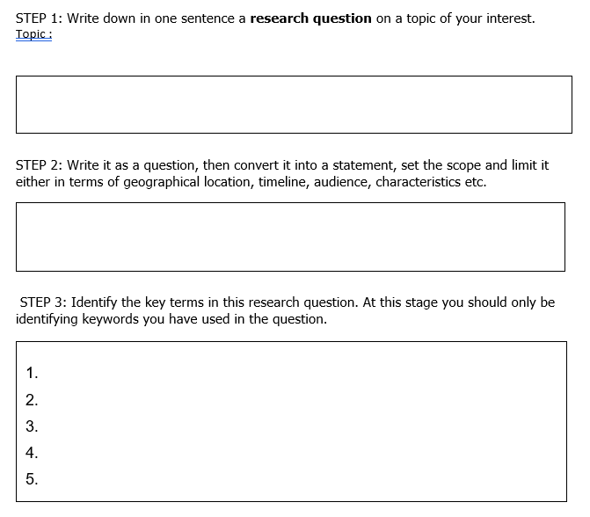
Some activities to engage learners
Image created by Copilot to a detailed prompt
DEBATE ON REFERENCING

Slide 8
Teach your students “skills for life”
Create an image of a watch showing 3:25 pm
Create an image of an Academic Support Manager
Create an image of a Manager
Microsoft collects data from you, through our interactions with you and through our products.

Slide 9
Cookery books and food swap among friends
Travel the world – just by reading a book

Slide 10
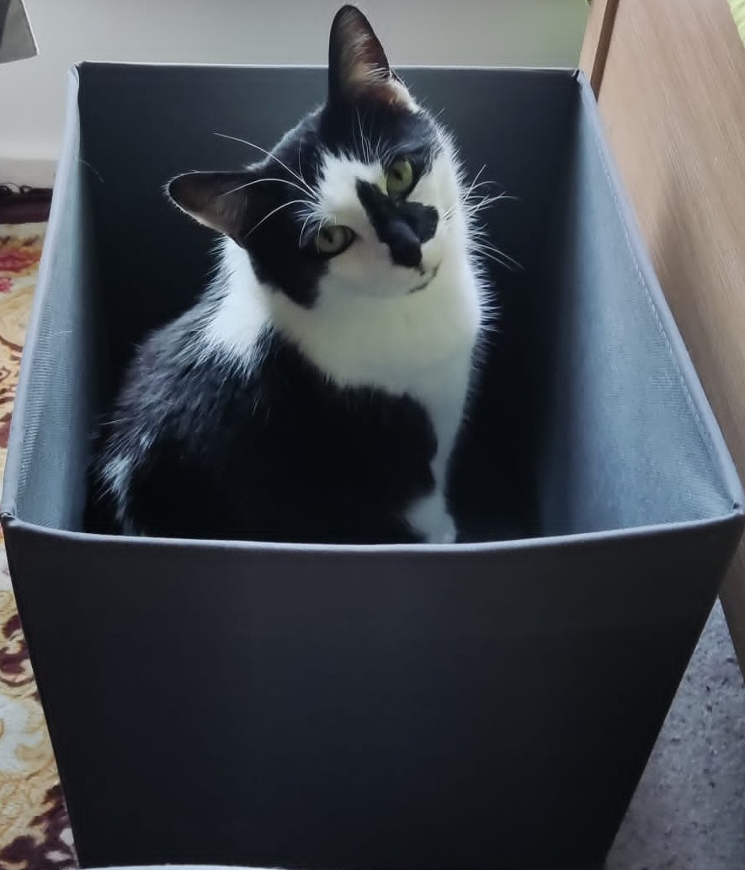
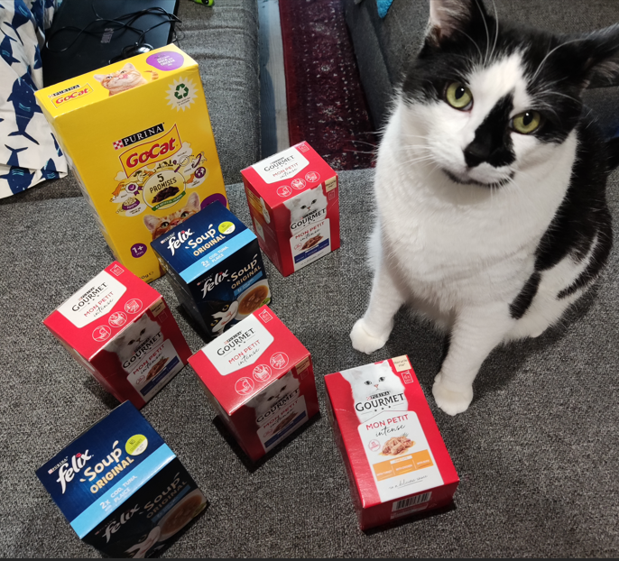
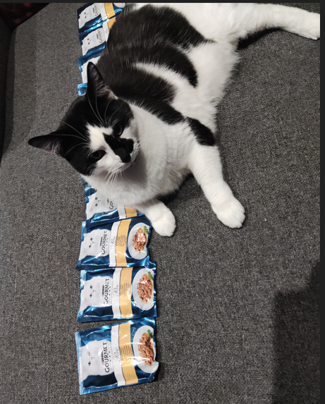
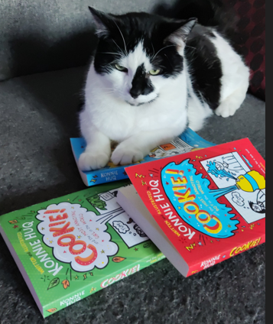
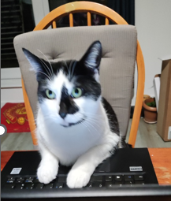
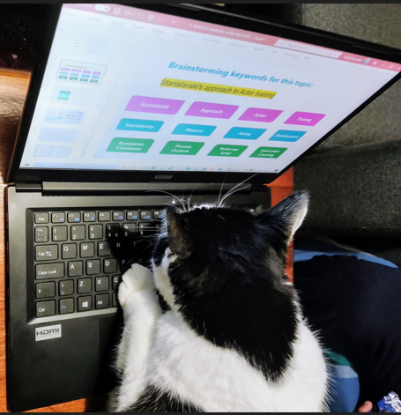
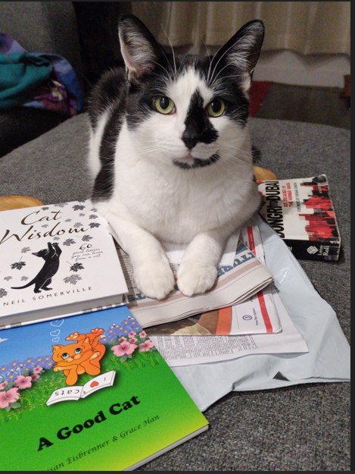
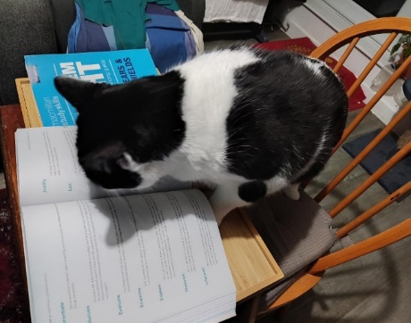
Every CAT tells a story !
The “How do I get out” Cat
The “Too much information” Cat
The “Can I use this resource” Cat
The “Information Literacy” Cat
The “Referencing ” Cat
The “I submitted my assignment” Cat

Slide 11
Thank you for giving me the opportunity to present here today. Please feel free to get in touch for more innovative ideas… Happy to help !

