Slide 1
The Role of Virtual Learning Environments in Assessment and Feedback in STEM
Diogo Casanova, University of West London Graham Alsop, Kingston University

Slide 2
Background
Nicol (2010) reports that 39% of the students in English universities mentioned that feedback was not sufficiently detailed, while 44% said feedback was not promptly delivered and did not explain things they misunderstood;
Winstone et al. (2017) identified barriers when students engage with feedback ranging from decoding terminologies to unwillingness to expend effort in reading the feedback received;
Zimbardi et al. (2017) report that students engaged significantly with feedback when it was provided in context. They report that the sooner students engage with feedback the more likely it is to have an impact.

Slide 3
Background
Policies and practices shaped by learning technologies by VLEs (Selwyn, 2013; Bausili, 2018)
VLEs have been designed with few engagement from stakeholders – however pressure from clients to respond to time and cost effectiveness, fairness and transparency (Bausili, 2018);
Standardisation of A&F (anonymous marking, rubrics, turnaround time, plagiarism checking);
Lack of students’ engagement with online feedback – need for agency and dialog, contextualization and signposting (Boud & Molloy, 2013; Carless & Boud, 2018).

Slide 4
Aims
Provide in-depth knowledge of how students and teachers want to access and engage with feedback, its format and method of delivery
Re-design scenarios of assessment and feedback aiming at creating new feedback methods, features and procedures
Have an impact on changing the way VLEs are designed in terms of their assessment and feedback features

Slide 5
Research design
Review of the literature and existing data on assessment and feedback practices
Benchmark existing tools
Redesign workshops (Sandpits)
Engaging with internal stakeholders
Engaging with external stakeholders

Slide 6
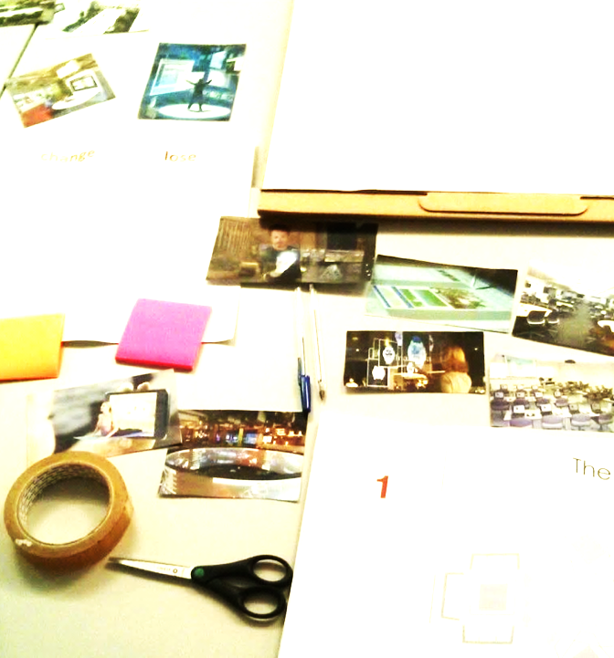
Method
Qualitative research framed on a participatory design approach (Schuler & Namioka, 1993);
Designing mockups representing 4 different A&F scenarios using the VLE;
First stage consisting eight ‘sandpits’ (Frohlich, et al., 2014) with students and teachers in two UK Universities aiming at redesigning 4 different scenarios.
Critique (using a keep, lose or change method)
Discuss
Present
Second stage consisting of two sandpits with students and teachers in two UK Universities aiming at redesigning one final prototype
Critique (using a keep, lose or change method)
Redesign (sketches and use of images)
Present redesigned scenario
‘Sandpits’ will be sound recorded and data will be thematic analysed using NVIVO 12.

Slide 7
Today’s Activity
Read the scenario
Make suggestion using post-its (Red, Amber, Green)
Plenary
We’ll use this outcome with product designers

Slide 8
The Sandpit
We will explain the scenario.
Then, discuss the scenarios on your tables (15 mins)
Use the post-it notes to make your comments as follows:
Red – lose
Green – keep
Orange – change
Select the group’s brightest idea to improve online assessment & feedback coming from the discussions

Slide 9
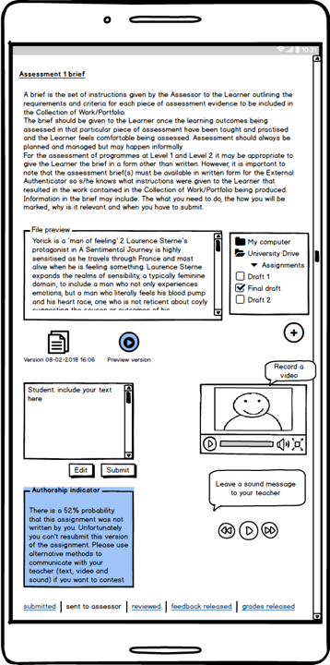
The Scenario
Visualization and Accessibility

Slide 10
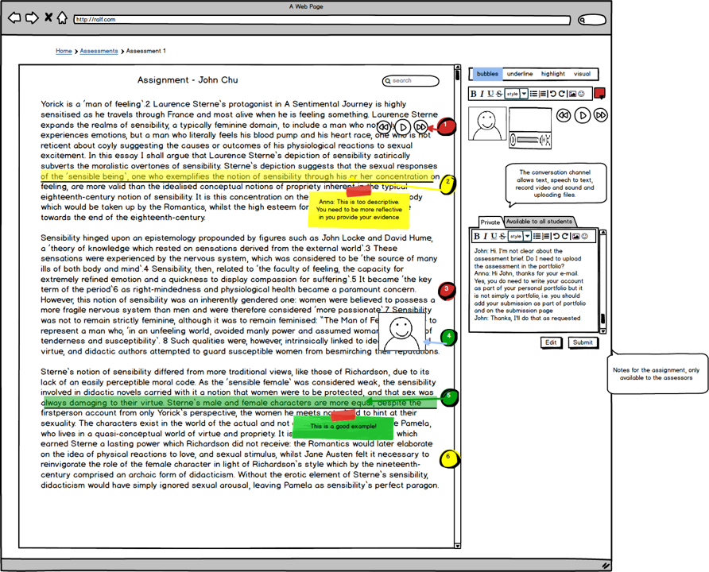

Slide 11
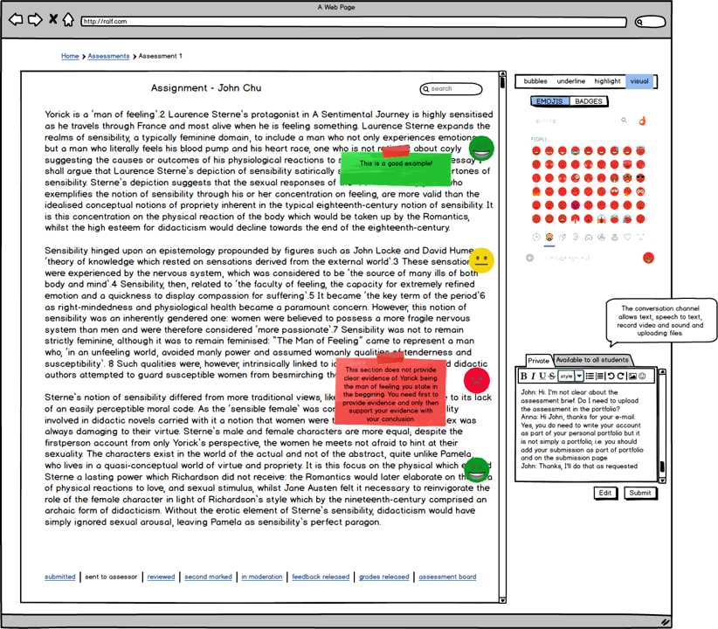

Slide 12
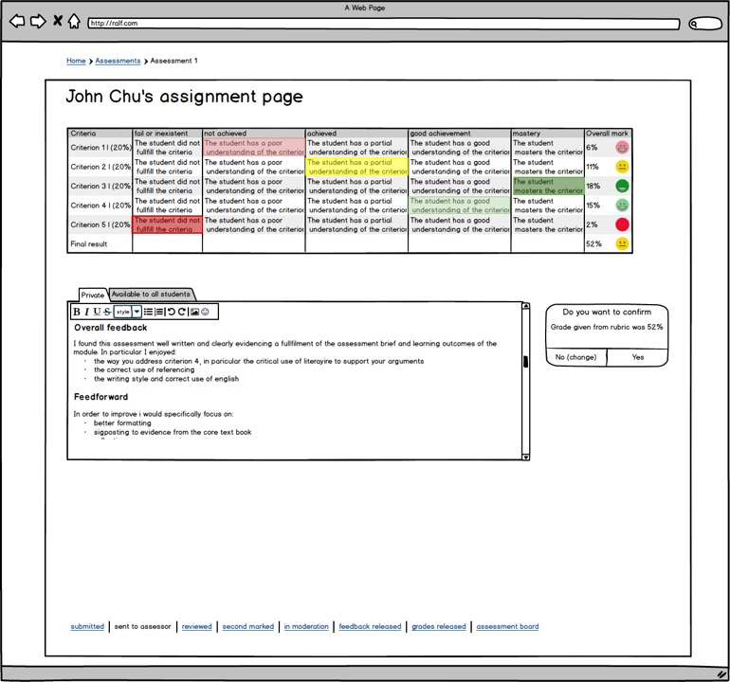

Slide 13
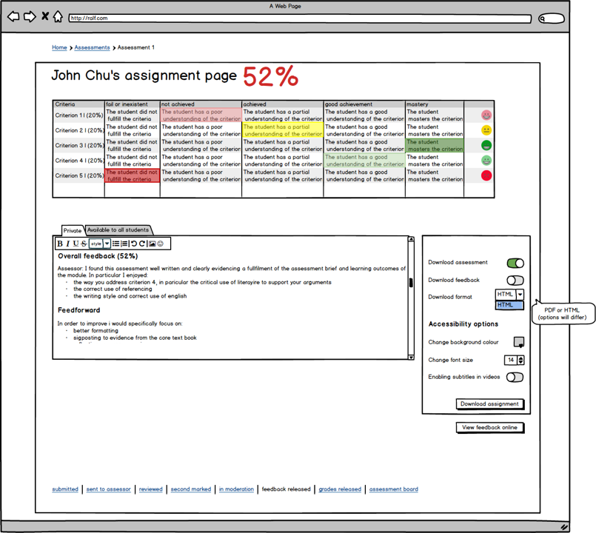

Slide 14
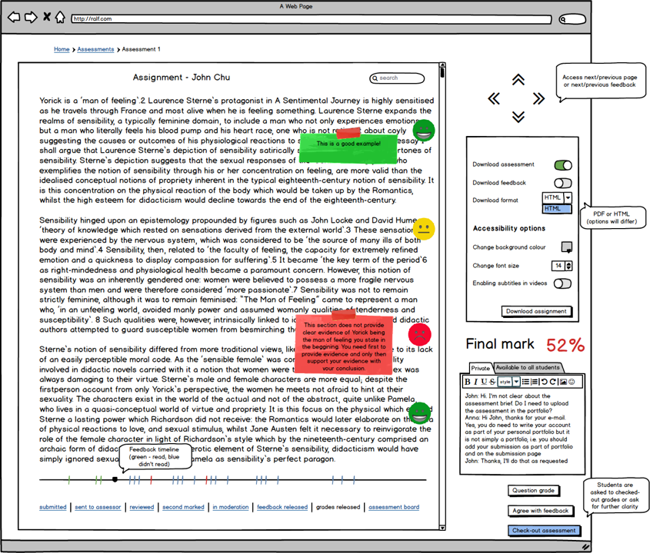

Slide 15
The Sandpit (from earlier)
We will explain the scenario.
Then, discuss the scenarios on your tables (15 mins)
Use the post-it notes to make your comments as follows:
Red – lose
Green – keep
Orange – change
You will see three copies of the scenarios around the room, one green, one red and one orange. Use the colour coding to place your post-its on the wall (10 mins)

Slide 16
Sandpits – Outcomes so far for this Scenario
Staff want more focus groups!
The submission process
Self-assessment opportunity requested
Allowing students to self-assess using criterion referenced learning outcomes
Grades to be released after students have read and engaged in feedback
Didn’t like students being able to print feedback – due to ‘gap’ in agency
Emojis too juvenile, suggestion to use star ratings (like Amazon) but only for positive comments

Slide 17
References
Bausili, A. (2018) ‘From piloting e‐submission to electronic management of assessment (EMA): Mapping grading journeys’, British Journal of Educational Technology. Wiley Online Library, 49(3), pp. 463–478.
Boud, D., & Molloy, E. (2013). Rethinking models of feedback for learning: the challenge of design. Assessment & Evaluation in Higher Education, 38(6), 698–712
Carless, D., & Boud, D. (2018). The development of student feedback literacy: enabling uptake of feedback. Assessment & Evaluation in Higher Education, 43(8), 1315–1325..
Frohlich, D. M., Lim, C. S. C. and Ahmed, A. (2014) ‘Keep, lose, change: Prompts for the re-design of product concepts in a focus group setting’, CoDesign. Taylor & Francis, 10(2), pp. 80–95. doi: 10.1080/15710882.2013.862280.
Nicol, D. (2010) ‘From monologue to dialogue: improving written feedback processes in mass higher education’, Assessment & Evaluation in Higher Education. Taylor & Francis, 35(5), pp. 501–517.
Parkin, H. J. et al. (2012) ‘A role for technology in enhancing students’ engagement with feedback’, Assessment & Evaluation in Higher Education. Routledge, 37(8), pp. 963–973.
Schuler, D. and Namioka, A. (1993) Participatory Design: Principles and Practices. Edited by D. Schuler and A. Namioka. Oxon, UK: CRC Press.
Selwyn, N. (2013) Distrusting Educational Technology: Critical Questions for Changing Times. Oxon: Routledge.
Winstone, N. E. et al. (2017) ‘“It’d be useful, but I wouldn’t use it”: barriers to university students’ feedback seeking and recipience’, Studies in Higher Education. Routledge, 42(11), pp. 2026–2041.
Zimbardi, K. et al. (2017) ‘Are they using my feedback? The extent of students’ feedback use has a large impact on subsequent academic performance’, Assessment & Evaluation in Higher Education. Routledge, 42(4), pp. 625–644.

