Slide 1
Zabin Visram
Ingrid Kanuga
An insight into the technologies used within the Hospitality and Tourism industry

Slide 2
Outline of Presentation
Potential Future - changing face of hotel – spurred on by technology wave.
New concept design – Matchmaker, Neighbour, Choreographer
Big Data
Virtual Reality (VR)
Robotics

Slide 3
Changing face of hotels
Traditionally hotel brands represented a certain style and value. Standardisation
In the future delivering the same brand to every customer wont be enough. Each guest is looking for new adventure, opportunities to build their businesses and new experiences.
Technology can be an enabling catalyst. They potential they provide can help reshape the concept of a hotel.

Slide 4
Future hotels
Future hotels will be (even more) about people
Hospitality will always be cantered - around customer experiences and connecting with people.
With new technologies – we can cater more to customer preferences, and address new competitive threats

Slide 5
Future Hotel Potential infrastructures
Technologies provide opportunities for new infrastructures.
Offering guests a memorable hotel experience uniquely tailored to their expectations for every stay.
Future Hotel
Matchmaker
Neighbour
Choreographer

Slide 6
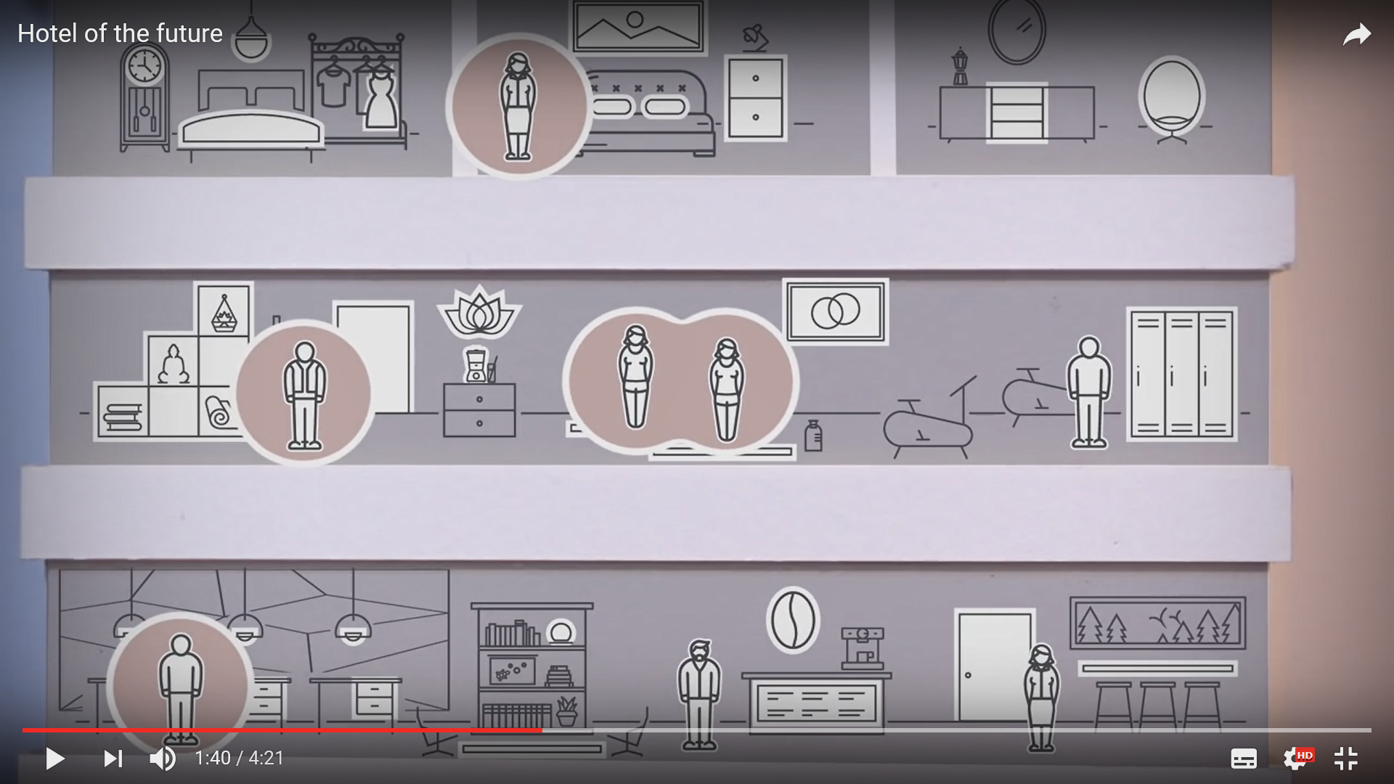
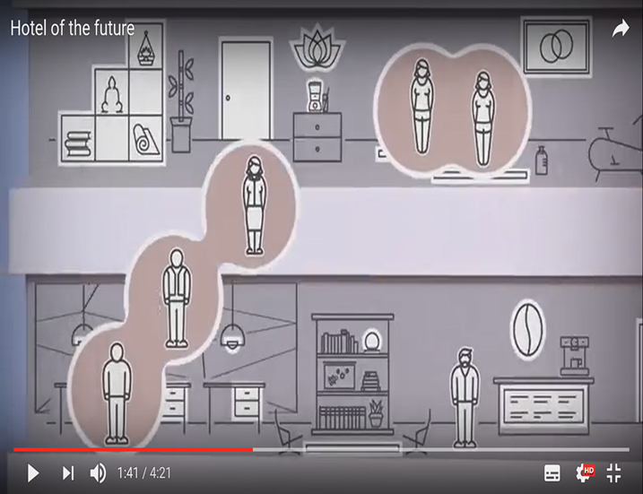
Matchmaker: An integrator of people
The matchmaker provides opportunities for guests to play a role in building personal connections with the hotel brand and between guests.
Using APP technology.
A matchmaker concept of a hotel - extends and deepens relationships with guests by creating a culture around the brand
Guests can use the APP to identify other people in the hotel who have an interest in their business or shared interest e.g. photography, reading club or pottery - once a network is established the app can be used to book a conference room for discussions.
These connections can last beyond the trip. They can follow each other on Blogs, set up by the hotel – arrange to have annual away days together and rebook in the hotel – all using APP and Blog technology
https://www2.deloitte.com/us/en/pages/consumer-business/articles/hotel-of-the-future.html.

Slide 7
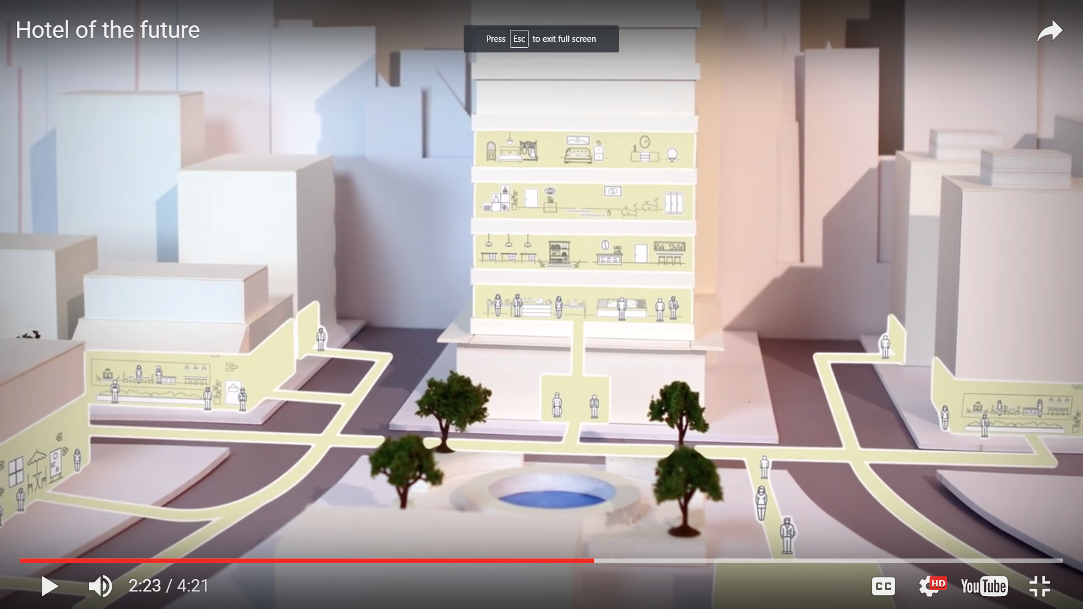
Neighbour: An integrator of cultures
The neighbour expands the hotel into the community and engages locals.
It’s a portal for local culture, so guests can feel immersed within the community – using APP technology guests can identify festivals within that area and have a community representative visit them and introduce them to local communities.
They could do community based projects to improve the area around the hotel – improving the neighbourhood, providing work or voluntary opportunities for the youth.
Other ventures could include using their conference rooms to host local artists paintings. Using APP technology, online newsletters to advertise events.
https://www2.deloitte.com/us/en/pages/consumer-business/articles/hotel-of-the-future.html.

Slide 8
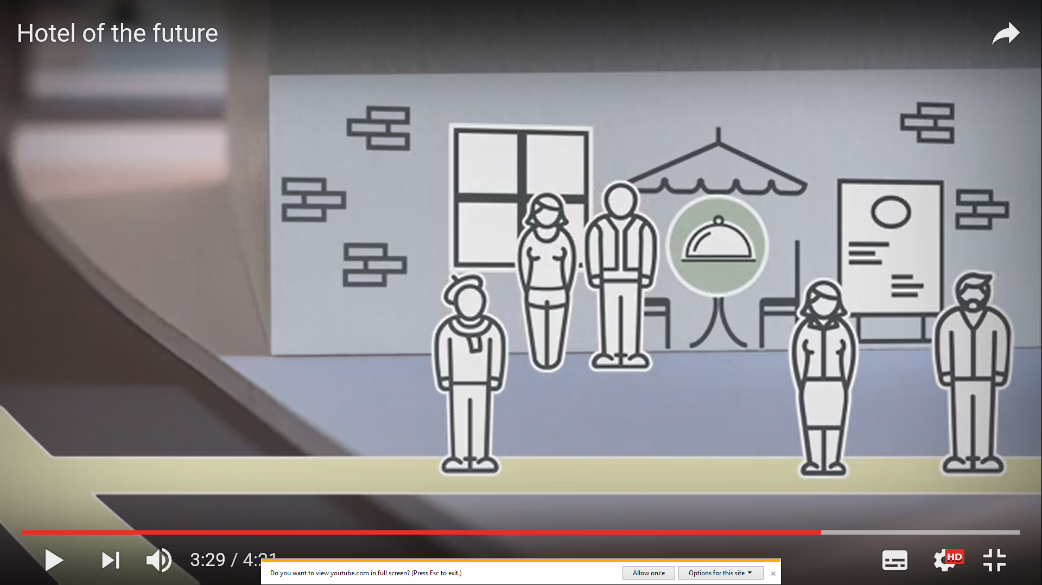
Choreographer: An integrator of processes
Big Data
It’s the virtual concierge and the logistics guru.
The choreographer integrates services.
E.g. they can have a taxi prearranged to pick up the customer at the airport, they can have the room accustomed to the guest needs – information can be obtained from their loyalty cards and using via drilling down technology to manage big data
https://www2.deloitte.com/us/en/pages/consumer-business/articles/hotel-of-the-future.html.

Slide 9
Big Data
Targeted Marketing campaigns.
Helps to understand today’s travellers, predict their behaviour through data.
Targeted Guest services – taxi, rooms settings, temperature, mini bar, customised tours etc.

Slide 10
Big Data
“The most exciting thing - data and analytics is having tools that can forecast the future.,”
says Eduardo Santander.
“In December 2016, Alpine regions in Europe didn’t see much snow, which has an impact on those travellers who might be considering booking a skiing holiday.
But after Christmas, it started snowing heavily, and bookings rocketed.
If we know there is snow coming to the Alps, we need to see how people react in real time, so that destinations can plan accordingly.

Slide 11
How can we visualise these new hotel concepts?

Slide 12
Virtual Reality
Videos
360 degree views
Real life experiences
Allows creation of Branded world – that builds emotional bonds with your customers

Slide 13
Interest in VR – is there a need?

Slide 14
Who has invested
Large section of travel customers are willing to visit travel stores with VR hardware
Thomas Cook Allows them to experience destination prompting booking. Several destinations can be experienced – Greece, Singapore, and New York.
Virtualisation of Tours.
First few months have seen 40% return on investment.

Slide 15
Quantas
Quantas developed VR apps – allowing visitors to experience Hamilton Island, Sydney and national parks
Ski holiday simulations – slope action

Slide 16
Integrated into booking process
Allows users to “Road test” their holiday, in a way still pictures cannot.
As technologies advance videos can be integrated into the booking systems, enabling customers to select the room that’s appropriate for their stay.

Slide 17
Hotels
2015 Marriott and Shangri-La Hotels announced VR services
VR simulator is being used to train front office, housekeeping, maintenance and breakfast staff to develop the program

Slide 18
Hotel entertainment
Possible Uses:
* Create your own branded showroom.
Let customers stroll and engage with your hotel facilities and products
* Build a sports newsroom with streaming video content on monitors or walls
* Create a fantasy space for customers to interact with animated brand icons

Slide 19
VR in hotels and restaurants
VR in hotels
VR in restaurants
https://www.youtube.com/watch?v=H_VxlcdP0Kk
https://www.youtube.com/watch?v=U3ZCHxynXRU&feature=youtu.be

Slide 20
Barriers to VR adoption
Cost
Designing content – 360 degree views are difficult to design the content as filming needs to cover Sky and ground views.

Slide 21
Robotics – how will they be used
Robot butlers – brings guests amenities toothbrushes, towels and room service.
Can be controlled via smart phone.
Japan – using robots to reduce staff by 90% . Receptionists, robot cooks, delivery service, concierge service.
New York – robots are used to help carry luggage and store luggage for hotels.
Pengheng Space Capsules Hotel located in Shenzhen China – hotel based on space-theme operated almost by robots.
Ghent Marriot hotel in Belgium gas robot ‘Mario’ acts a receptionist and is positioned in MICE (meetings, incentives, conventions, exhibitions) and speaks 19 languages

Slide 22
Robotics in Hotels
https://www.youtube.com/watch?v=b8IKfQLGIRQ&feature=youtu.be

Slide 23
Discussion
Discuss the challenges these new technologies bring to the industries and the graduate employment market.

Slide 24
References
https://www2.deloitte.com/us/en/pages/consumer-business/articles/hotel-of-the-future.html.
http://www.amadeus.com/documents/travel-intelligence/TI-DMO-smart-decisions-for-smart-destinations-using-big-data_WhitePaper.pdf

