Slide 1
Our lived experience is a decolonial project in itself which is why Rest is Resistance’
Decolonizing Academia: Balancing Personal Narratives and emotional labour within Systemic Change
Naomi L.A Smith

Slide 2
Aim of this session
Keywords: Self-care,
Grounded in, liberation psychology, a theory and framework which outlines how people understand, resist, and overcome oppression to achieve psychological well-being and intersectionality
Influenced by Wyatt and Ampadu (2020) work: offering attention to the factors that hinder our attitude to self-care amongst us
Decolonial work is necessary to change the social problems oppressed people face however, “To thrive in the face of oppression is through the practice of radical self-care.”

Slide 3
An introduction to Naomi
.
“As a Black Librarian in an overwhelming White Sector, I often feel I cannot escape Race even when emotionally I want to. I regularly find myself in a psycho-analytical Fanon-like state of existence where I am regularly acutely aware of my blackness, and at times fearful of the stereotypes and unconscious bias my white colleagues have towards me. Such anxiety, and isolation and lack of support have already been noted as a key reason why there is an under-representation of minority Library staff in London” – Naomi Smith, 2024

Slide 4
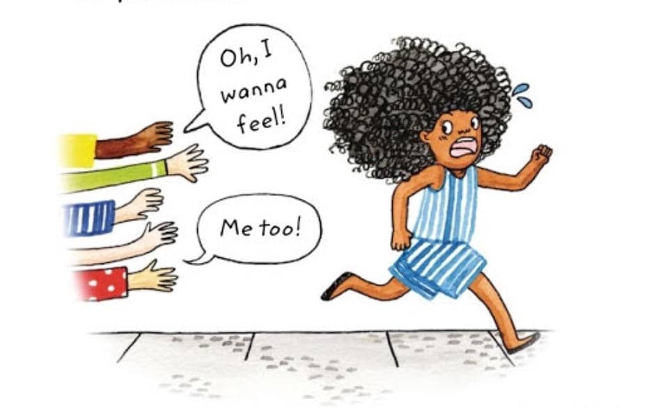
Being a system changer is emotional labour
Motivation for Decolonisation projects in academia often derive from personal Lived Experiences of racial trauma and microaggressions

Slide 5
The automatic assumption that we should be the lead on decolonial initiatives (which is also a microgression!)
“We cannot conclude our decolonial work at 5 pm, leave it behind at our desk, and go home without carrying these issues with us. Systemic Racism affects us and our family outside the library/academia and the emotional labour of being expected to participate in work which relates to personal and collective present and ancestral trauma”

Slide 6
Audre Lorde :Caring for myself is not self-indulgence. It is self-preservation, and that is an act of political warfare!”
Self care is a radical act however why is it associated with “treating oneself”
The market’s co-option of self-care practices transforms these into the antithesis of their original purpose.”
Buddhist meditation without the Buddhism” rather than interconnectness and universal compassion Under capitalism Mindfulness becomes inherently selfish and disconnected and the opposite of decoloniality

Slide 7
Intersectional barriers which create guilt
“Self-care is giving ourselves permission to express our emotions. We become open and honest about what we desire, crave, need and expect of ourselves and of those around us. We should not feel ashamed for struggling, for feeling hurt, sad, angry or lonely”
However, are we able to do this?
“For so long, racism and sexism (a.k.a. misogynoir) told Black women that we cannot sit down and rest, because we must work twice as hard to be respected and rewarded” Ololudara Adeeyo ….

Slide 8
Concluding reflections…
“self-care is, and has always been, a tool for social justice in efforts to resist the oppressive systems that threaten the health and wellness of Black people. This can be seen through examples of the Black Panther Party and their launch of initiatives promoting community health such as the free breakfast program and organizing community clinics for medical care (Heynen, 2009).
Being a systems changer is holistic…
Begin to reflect on what permission for self care would look like for you?

Slide 9
blackandgoldeducation

Slide 10
Resources / References
The capitalist co-option of self-care - Glasgow University Magazine
Wyatt, J. P., & Ampadu, G. G. (2022). Reclaiming Self-care: Self-care as a Social Justice Tool for Black Wellness. Community mental health journal, 58(2), 213–221. https://doi.org/10.1007/s10597-021-00884-9
Smith, N (2024) ‘Don’t Touch My Hair in the Library’ (pending publication)
Oludara Adeeyo: Self-Care Is A Form Of Resistance For Black Women (womenshealthmag.com)
10. Slowness is resistance - SEEDS OF SELF | Podcast on Spotify
23. Decolonising wellbeing: intersectionality, context and the collective w/ Bianca Winter-Mallari - SEEDS OF SELF | Podcast on Spotify
Instagram @blackandgoldeducation

