Slide 1
Dr Sally Bentley – University of Bedfordshire Dr Diogo Casanova – University of West London
Designing space to enhance teaching and learning

Slide 2
Background
A lecture at the University of Bologna in Italy in the mid-fourteenth century.
Lector - Latin for the one that reads
Theatre - Greece for the beholding area
Notes:
The design of learning spaces in higher education has, until recently, been influenced by traditional paradigms of teaching that originated in ancient Greece and Rome, whereby the lector would proclaim scripture readings to the monks who vigorously copied what they heard, without any form of questioning or interaction.
The word theatre comes from the Greek the beholding area where patrons sit to view a spectacle. The word lector comes from the Latin and means the one who reads. So, lecture theatre would be the place where a reading would take place to those that behold the spectacle.

Slide 3
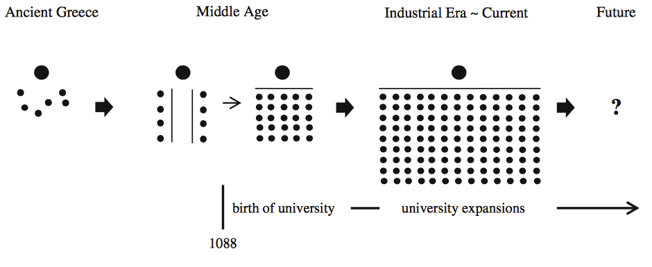
the evolution of learning spaces from ancient Greece to Current Classrooms
Park & Choi, 2014
Notes:
There has been different research that points out to the fact that HE learning spaces are not suitable for what we aim our students to achieve in HE and for how we want to teach them.
Learning spaces have been designing not because of pedagogical needs but because of economical, architectural, technological reasons.

Slide 4
Yang et al. (2013) discuss the impact of classroom attributes (ambient, spatial, and technological attributes) on student satisfaction and performance
Ambience (color, temperature, light, acoustics)
01
Furniture (tables, podium, chairs, whiteboards)
02
Layout and space (small or large, square, rounded, cabaret-style, row-by-row, horseshoe, debate, flexible?)
03
Technology (tangible technology, projecting screens,
04
Agency
05

Slide 5
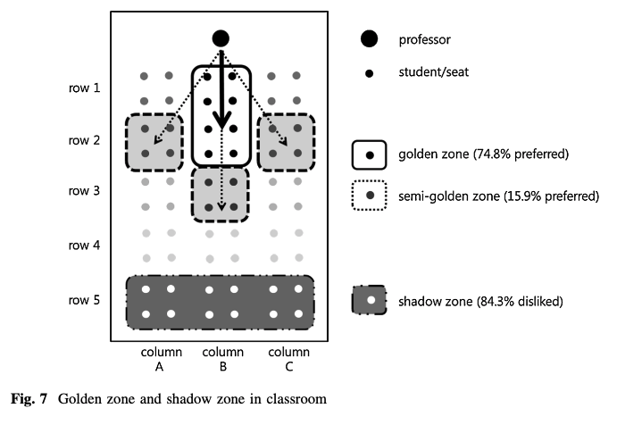
Growing interest about learning spaces and how they may affect learners and learning experiences
Jessop, Gubby & Smith (2012) compare the perceptions of students and academics and conclude that space may re-inscribe hierarchical, teacher-centred approaches;
Park & Choi (2014) discuss the importance of changing room layout in order to promote more active learning (golden and shadow zone);
Radcliffe (2009) presents a framework for designing and evaluating learning spaces which integrates Pedagogy, Space and Technology as there key vectors referring that each influences the other in a dynamic force.
Park & Choi (2014)
Notes:
Things are changing though and discussions about HE and learning spaces are being more frequent.
Nowadays, we want learners to become more creative and innovative and to experience an array of learning activities, the existing learning spaces are too traditional and inflexible (Jessop et al. 2012).
Brooks presents a case of the impact of two different formal learning spaces – a traditional classroom and a technologically enhanced active learning classroom – on instructor behavior, classroom activities, and levels of on-task student behaviour at the University of Minnesota. He demonstrate that not only are clear differences manifest in terms of what occurred within each space, but that the different classroom types are linked causally to the observed differences in instructor and student behaviour.
Park & Choi compare a traditional classroom and an active learning classroom. The result proved the existence of a ‘golden zone’ and a ‘shadow zone’ in the traditional classroom, which discriminate students’ learning experiences depending on seating positions. On the contrary, the ALC (the room they suggested) did not produce such positional discrimination.

Slide 6
Scale-up
First attempt to bring the benefits of collaborative and interactive learning to larger classrooms using technology in 1998 (Beichner, 2014; Beichner et al., 2000)
Student-Centered Activities for Large Enrollment Undergraduate Programs
Notes:
The first attempt to bring the benefits of collaborative and interactive learning to larger classrooms using technology was the SCALE-UP (Student-Centered Activities for Large Enrollment Undergraduate Programs) project at North Carolina State University (Beichner, 2014; Beichner et al., 2000). A space was redesigned based on the teacher’s position, how the students were seated (cabaret-style), and the integration of three computers on each table with nine students divided into groups of three. The originality of this project is that it combines the redesigned instructional space with the reformed pedagogy that the teacher employed. The students would work together in groups of three to respond to a specific problem.

Slide 7
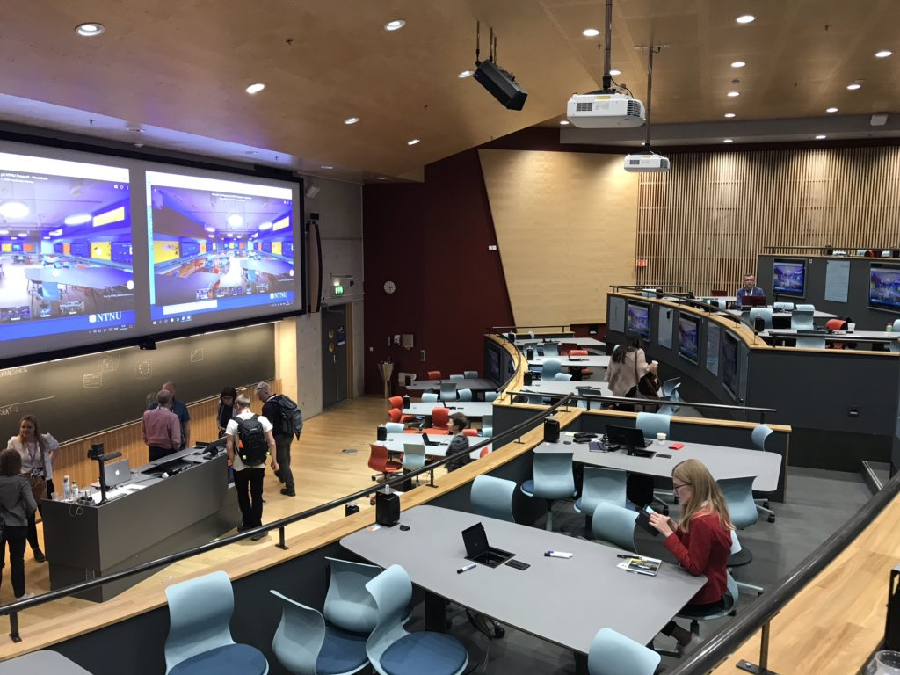
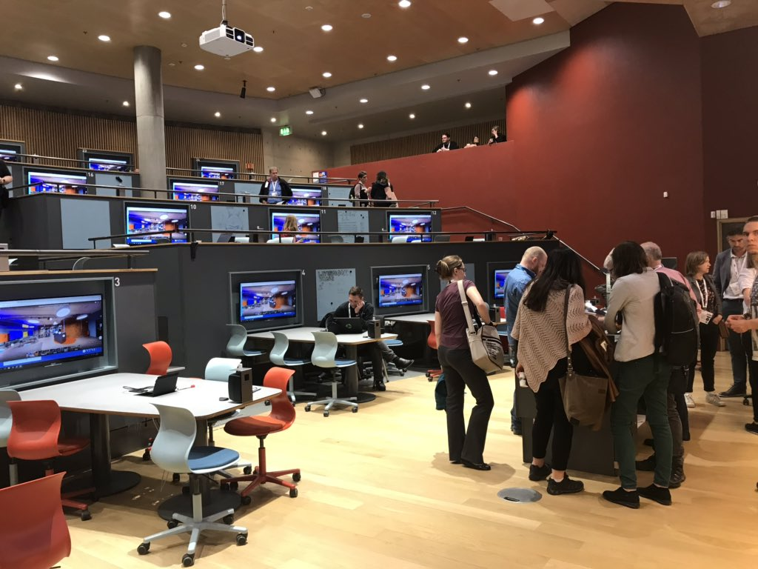
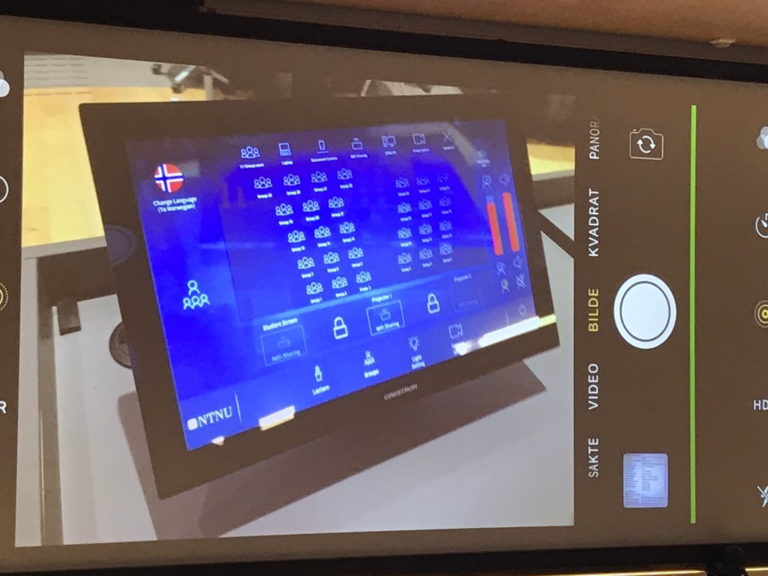
Previous
Next
Previous
Next
Previous
Next
Norwegian University of Science and Technology

Slide 8
Trends in learning spaces design
New York University
Differently shaped tables
More screens to project on or more feeds
Smaller and more flexible podium
Further Whiteboards or scribble walls
Increase number of sockets
Flexible furniture
University of Melbourne
Notes:
Square or rounded tables to allow more group discussions
More screens to project one or more feeds – allowing also students devices to project
Smaller and more flexible podium – in some instances in the middle of the room
Further Whiteboards or scribble walls to be used by students to write collaboratively
Increase number of sockets to ensure charging mobile devices
Flexible furniture

Slide 9
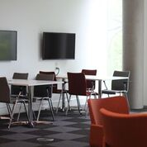
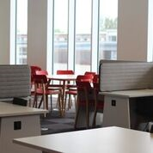
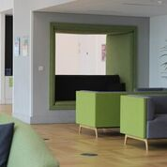
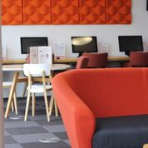
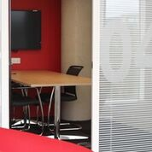
Social learning in the Gateway
Notes:
Social learning designed to work alongside ‘break out’ from classrooms
For staff, students and the public
For leisure, learning and events
Public-private spaces
Working outside the office
Teaching outside the classroom
Private rooms and booths
Varied AV solutions – Micrsoft, Apple, bench, screened table, IT suite,
Plus static and movable booths
Colour co-ordinated per floor, otherwise move as you wish

Slide 10
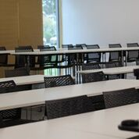
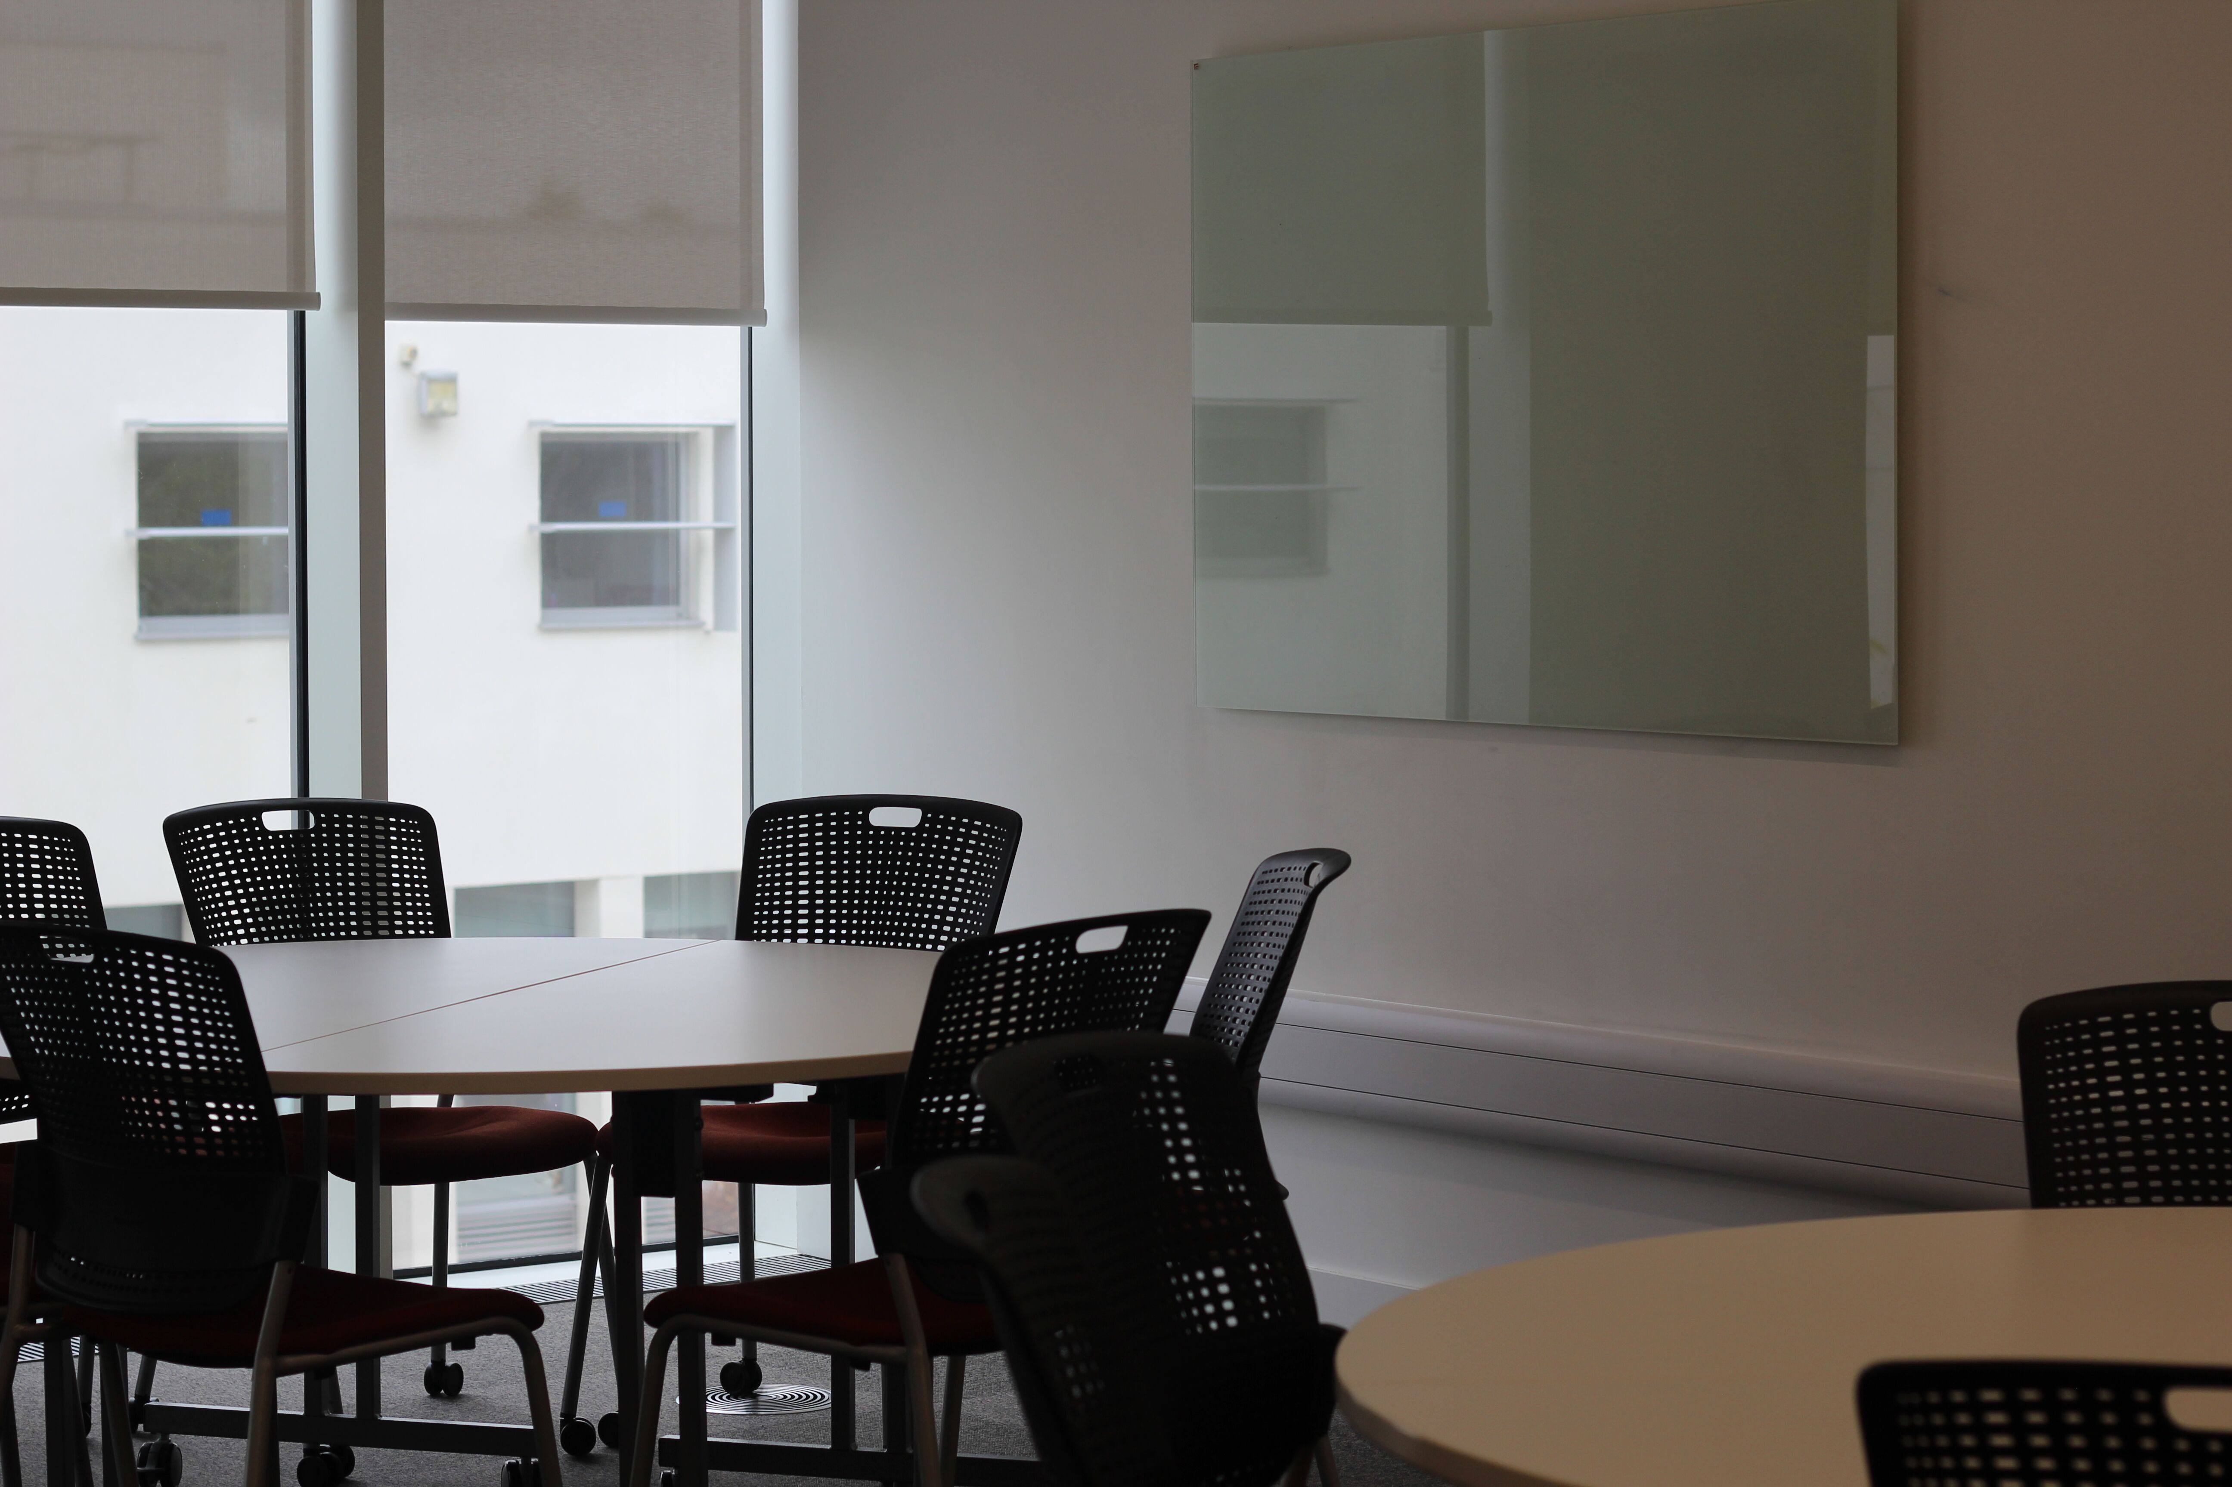
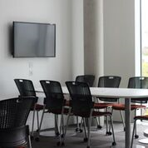
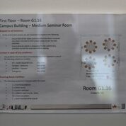
Classrooms in the Gateway
Different height tables in stead of tiered lecture theatre; stools for high tables at back; tables on wheels allowing ‘conference style’ layout; dividing doors
Large round tables; chairs on wheels; glass boards
D
+ Harvard ‘UN’ debating chamber with AV
+ Rectangular tables and chairs on wheels
+ Board rooms
+ Teaching IT suite
Trapezium tables designed for butting up against AV screens of facing front; chairs on wheels
Every room has a sign showing layout option and facts and figures
Notes:
Works in conjunction with social learning
‘Deconstructed Business Pod’ on top floor
No tiered lecture theatre – different height tables
Lecture theatre can become conference venue
‘Forced’ group work – round tables, chairs on wheels, every table has a glass board
Trapezium tables butt up to AV encourages on-line group work
Varied IT solutions: Micrsoft, Apple, benches, tables, desks, BYO, provided, sockets in walls & floor edge
Standardised AV console
IT suite for teaching
Board rooms for 14
Multiple smaller meeting rooms (x8) for 6 – all with AV
Inter-connecting doors – smaller and larger rooms on 2 floors – aids events (furniture clearance) and project learning
Dividing walls (2 rooms) – standard class sizes to large events/lectures
Every room has glass boards – enough for every group – also for blue tacking posters
Move table or chairs
Layout sign shows starting position and facts and figures
Mostly stackable and tippable furniture

Slide 11
How are people using the Gateway?
Positives
Social learning – ground floor
Non-tiered lecture theatre
Round tables & chairs on wheels
Lost opportunities
Trapezium tables – misunderstood
AV screens for group work in social learning & classrooms – not used
Deconstructed ‘business pod’

Slide 12
In groups of 5 and using the space and the different tools provided
Corridor
Inside window
Speaker
Identify what you would keep, lose or change in the space (10 min) - Use the post-its to write each input;
Using the exercise above try to redesign the space by sketching the group approach of a learning space. Use the provided pictures to help you in this design (10 min).
Blank wall
Projected image
Speaker
Podium
Outside window

Slide 13
references
Brooks, D. C. (2014). Space and consequences: The impact of different formal learning spaces on instructor and student behavior. Journal of Learning Spaces, 1(2), 1–13.
Jessop, T., Gubby, L., & Smith, A. (2012). Space frontiers for new pedagogies: a tale of constraints and possibilities. Studies in Higher Education, 37(2), 189–202. doi:10.1080/03075079.2010.503270
Park, E., & Choi, B. (2014). Transformation of classroom spaces: traditional versus active learning classroom in colleges. Higher Education, 68(5), 749–771. doi:10.1007/s10734-014-9742-0
Yang, Z., Becerik-Gerber, B., & Mino, L. (2013). A study on student perceptions of higher education classrooms: Impact of classroom attributes on student satisfaction and performance. Building and Environment, 70, 171–188. doi:10.1016/j.buildenv.2013.08.030

